Slide 1
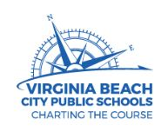

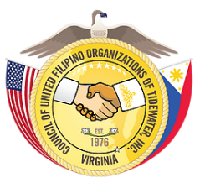


Born of Empires: Filipino Americans in the United States and Virginia, 1565 to the Present
In-House Content Academy for
Presentation for:
The Philippines on the Potomac Project (POPDC): Philippine-American History in the Metro DC Area
Tuesday, 7 August 2018, 2:40-3:40PM
Prepared by:
Titchie Carandang-Tiongson
Erwin R. Tiongson
The Philippines on the Potomac Project (POPDC)
Copyright The Philippines on the Potomac Project, 2018
All rights reserved.
SPONSORING ORGANIZATIONS
The MacArthur Memorial

Slide 2
The Philippines on the Potomac (POPDC) Project

Slide 3
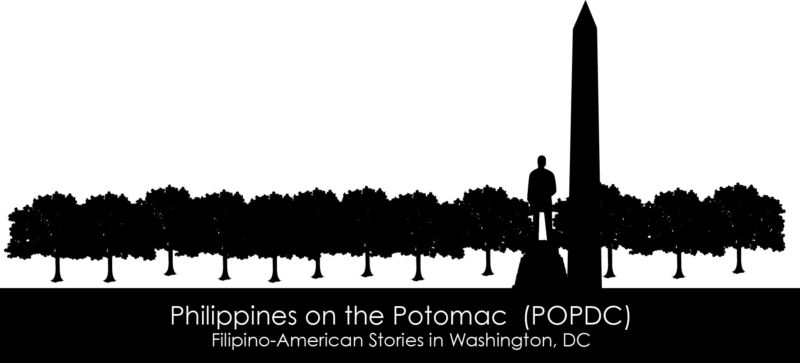
Our Story
Led by Titchie and Erwin Tiongson, The Philippines on the Potomac (POPDC) project is a family project to find traces of Philippine culture and history in DC.
POPDC started in September 2012 when we started listing all the places in the DC area that we thought had some significance to Philippine-American history and culture. We were pleasantly surprised to find that we knew enough places for a small walking tour and for what we hoped could someday be a Philippine-American street map of DC.
Since then we have sifted through a wealth of hard copy and digital archival materials, including memoirs, diaries, news archives, and vintage directories, among many other sources of information.
Names of important historical and cultural figures—Filipino and American colonial officials, member of the Philippine Independence Missions in the 1920s and 1930s, Commonwealth officials, National Artists—guided our search but the materials we found also quickly led us to many other sources we knew little about, including those related to the social history of the first community of migrants in the DC area.

Slide 4
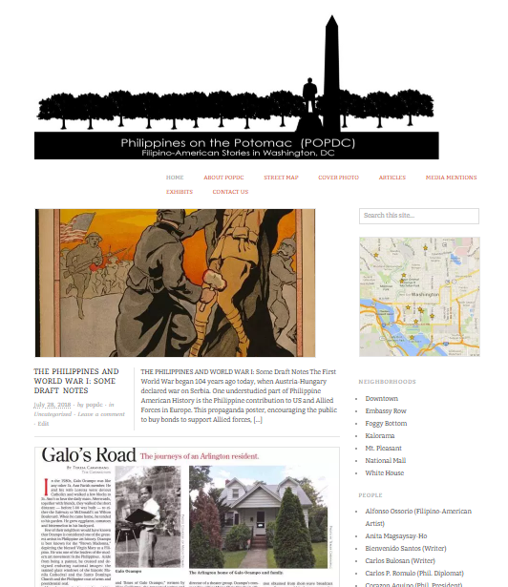
Website
The Philippines on the Potomac Project
popdc.wordpress.com
Features DC sites relevant to Philippine history and culture
museum
residence
school, etc.

Slide 5
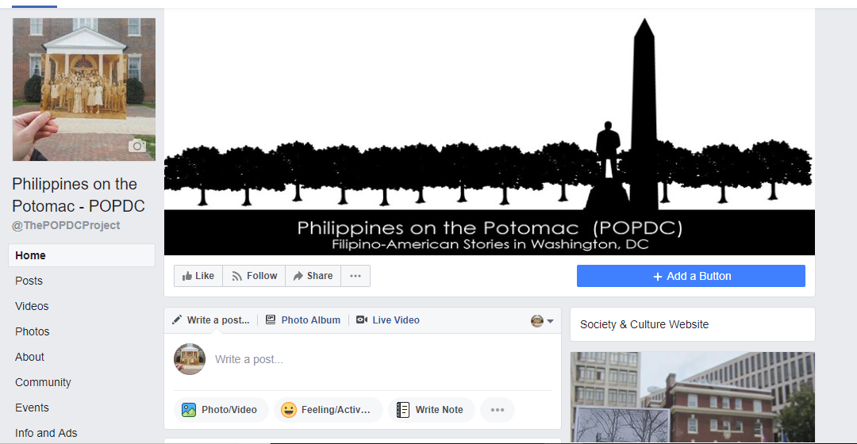
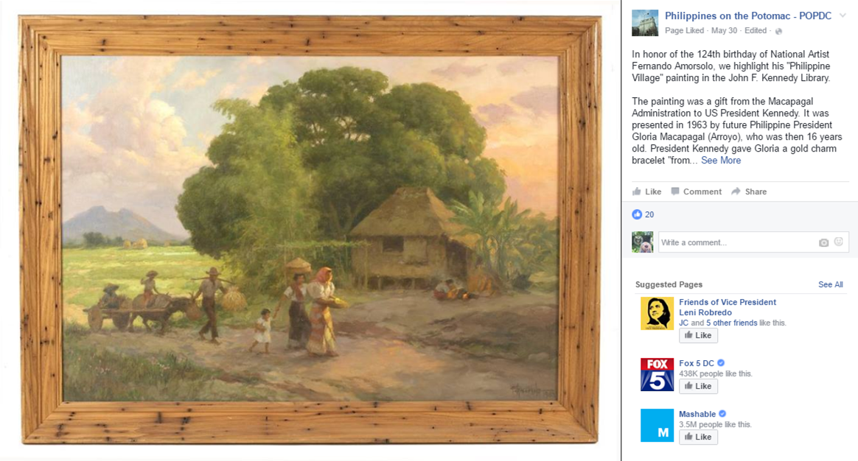
Facebook Page
@ThePOPDCProject

Slide 6
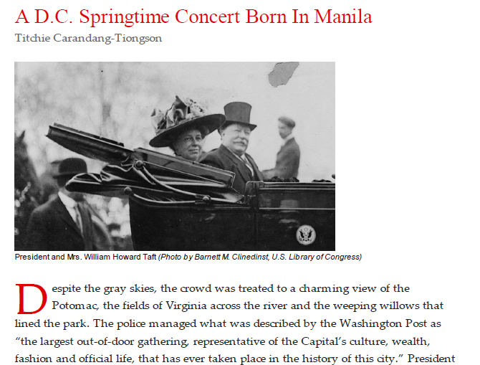
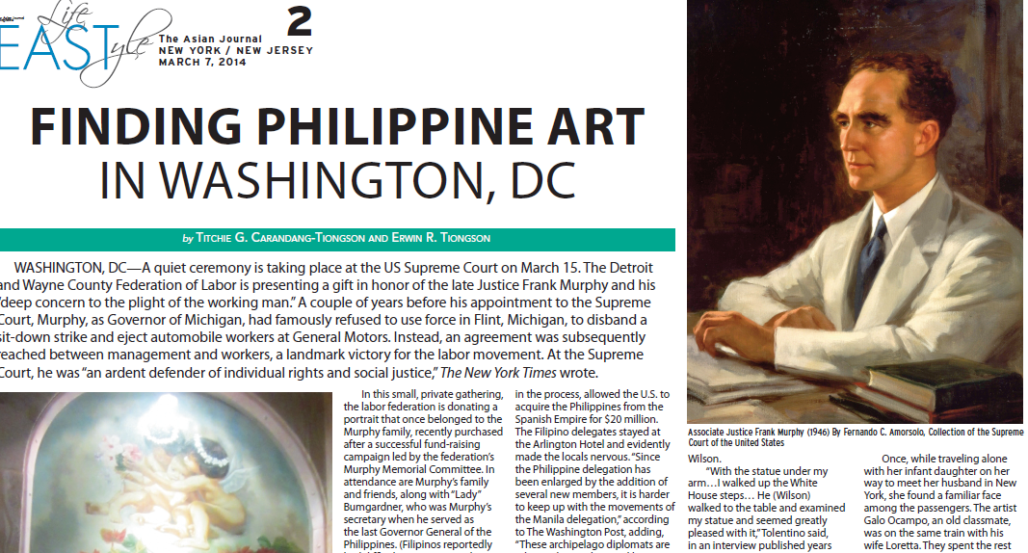
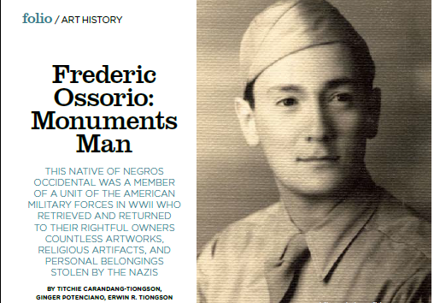
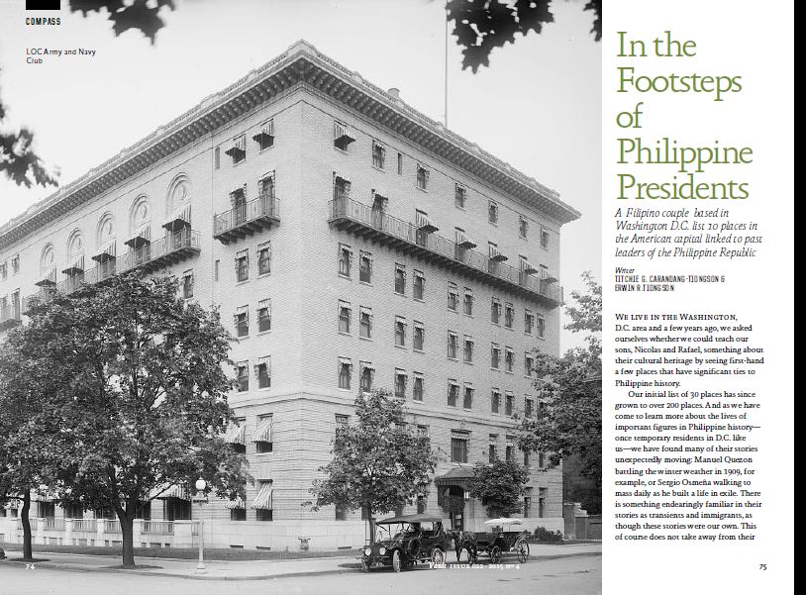
Published Articles in the Public Domain

Slide 7
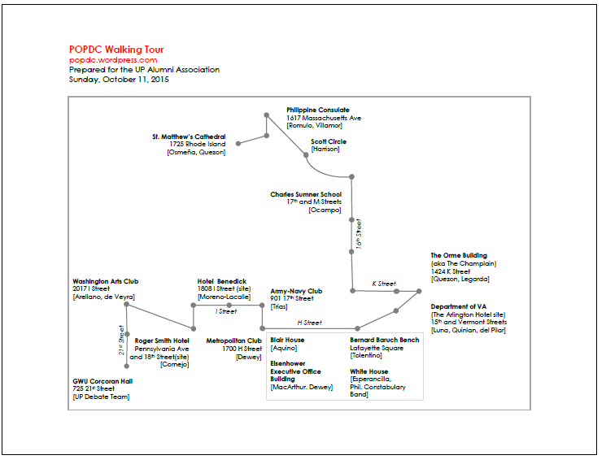
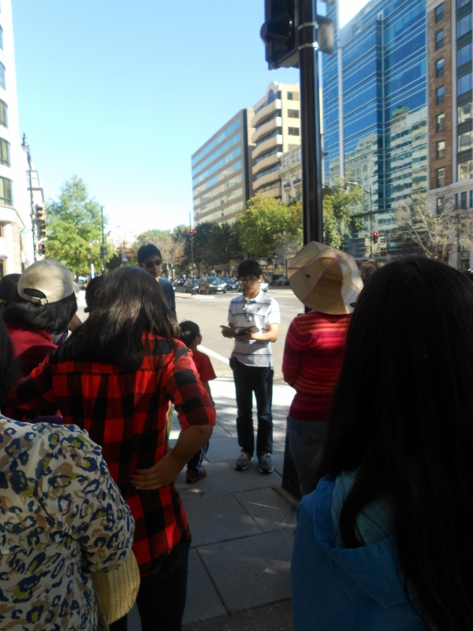
Walking Tours on Request

Slide 8
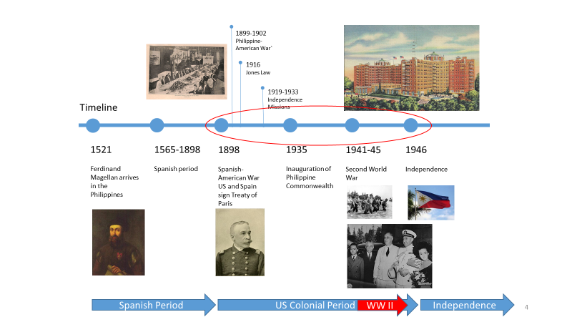
Important Dates
Here are the most important dates in Philippine history explaining the strong Filipino presence in the United States and in particular the metro DC area including Virginia.

Slide 9
The 1916 Jones Law
William Atkinson Jones and Manuel Quezon

Slide 10
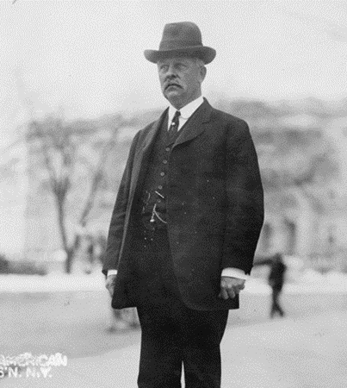
William Atkinson Jones
Member of the US House of Representatives 1891-1918
William Jones of Warsaw, Virginia and the state’s Representative to the US House of Representatives, sponsored a bill called the Philippine Autonomy Act, promising eventual independence for the Philippines and creating the freely elected bicameral legislature. This was signed into law on August 30, 1916 and became known as the Jones Law, after its sponsor.
          Credit: [Caption from Library of Congress] William Atkinson Jones, congressman from Virginia, full-length portrait, standing, facing slightly left, on U.S. Capitol grounds. , ca. 1910. Photograph. https://www.loc.gov/item/91729504/.

Slide 11
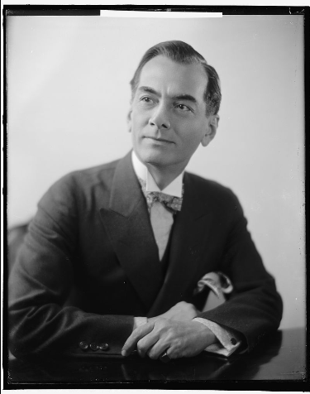
Manuel Quezon
Resident Commissioner, US Congress 1909-1916
Senator, Philippine Senate 1916-1935
President of the Philippine Commonwealth Government 1935-1944
Manuel Quezon supported the Philippine Autonomy Act sponsored by William Jones. As the non-voting Philippine representative to the US House of Congress, he pushed for Philippine independence and worked closely with William Jones to have the bill passed in 1916. Afterwards, Quezon left immediately for the Philippines where he became a Senator and later President of the Philippine Commonwealth Government.
During World War II, Quezon, his family and members of the Philippine Commonwealth Government moved to Washington, DC and established the Philippine government-in-exile. He died on August 1, 1944
Photo Credit: {Caption by the Library of Congress] Harris & Ewing, photographer. QUEZON, MANUEL L. , None. [Between 1905 and 1945] Photograph. https://www.loc.gov/item/2016862102/.
Credit: [Caption from Library of Congress] Harris & Ewing, photographer. QUEZON, MANUEL L. , None. [Between 1905 and 1945] Photograph. https://www.loc.gov/item/2016862102/.

Slide 12
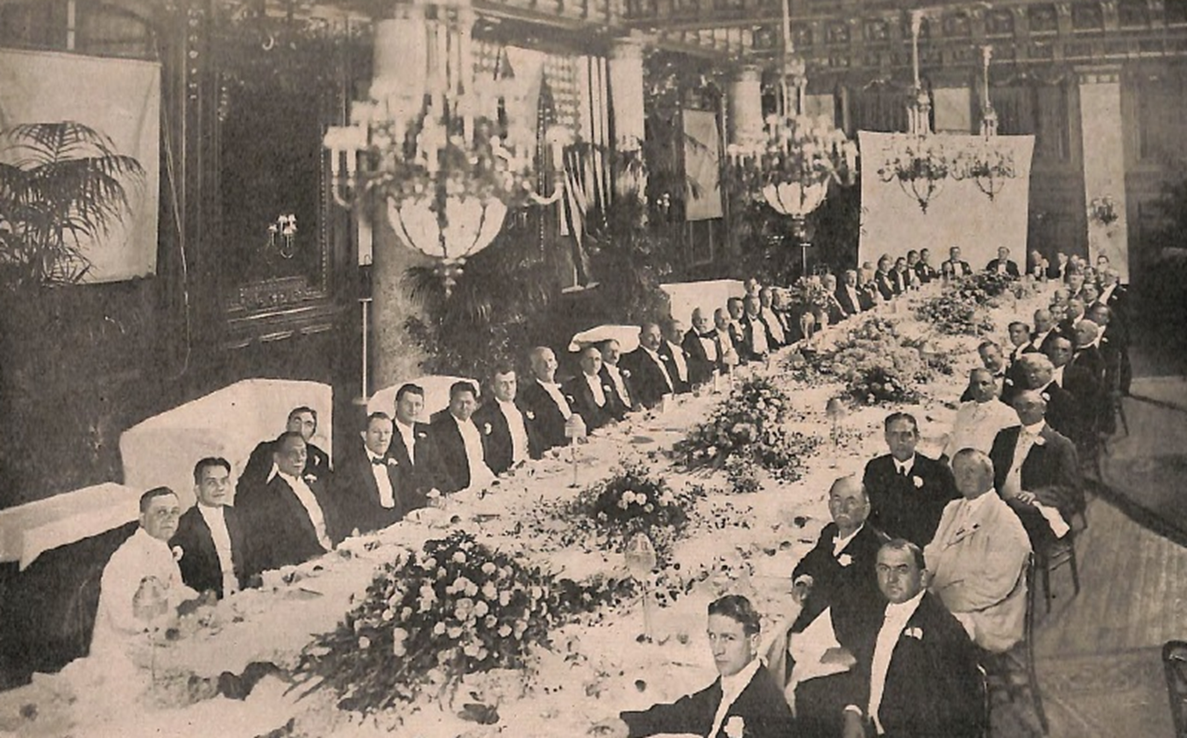
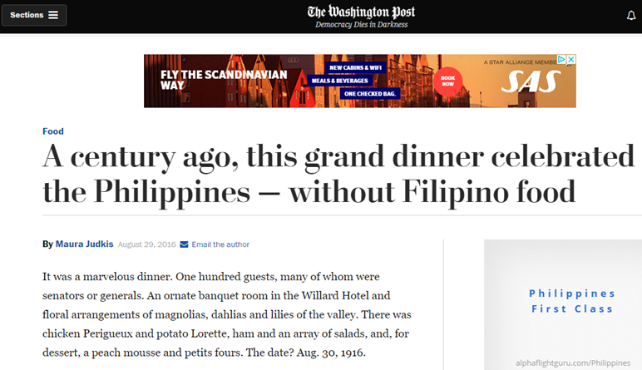
Celebratory Dinner
Willard Hotel
August 30, 1916
The evening of the day Congress passed the Jones Law, a large group of members of Congress and friends of the Philippine Independence movement gathered at (what was then) the New Willard Hotel, to give thanks to William Atkinson Jones –– and say goodbye to Manuel Quezon who was leaving the following day.
Photo Credit:
Gallagher, Peter, Quezon’s Farewell to Congress that becomes Congress’ Farwell to Quezon. Philippine Review (Revista Filipina). 1:10, October 1916.
Screenshot of Judkis, Maura. “A Century Ago, This Grand Dinner Celebrated the Philippines – Without Filipino Food.” The Washington Post https://www.washingtonpost.com/news/food/wp/2016/08/29/a-century-ago-this-grand-dinner-celebrated-the-philippines-without-filipino-food/?utm_term=.b51f3af63d9c (August 1, 2018).

Slide 13
References
Gallagher, Peter. “Quezon’s Farewell to Congress that becomes Congress’ Farwell to Quezon.” Philippine Review (Revista Filipina). October, 1916. https://archive.org/details/acp0898.0001.010.umich.edu (August 1, 2018)
“JONES, William Atkinson. ”History, Art & Archives, U.S. House of Representatives,” http://history.house.gov/People/Detail/16021 (August 01, 2018)
“QUEZON, Manuel L.,” History, Art & Archives, U.S. House of Representatives http://history.house.gov/People/Detail/20053 (August 01, 2018)
Judkis, Maura. “A Century Ago, This Grand Dinner Celebrated the Philippines – Without Filipino Food.” The Washington Post https://www.washingtonpost.com/news/food/wp/2016/08/29/a-century-ago-this-grand-dinner-celebrated-the-philippines-without-filipino-food/?utm_term=.b51f3af63d9c (August 1, 2018).

Slide 14
The Philippine Constabulary Band and West Potomac Park
William Howard Taft and Helen Herron Taft

Slide 15
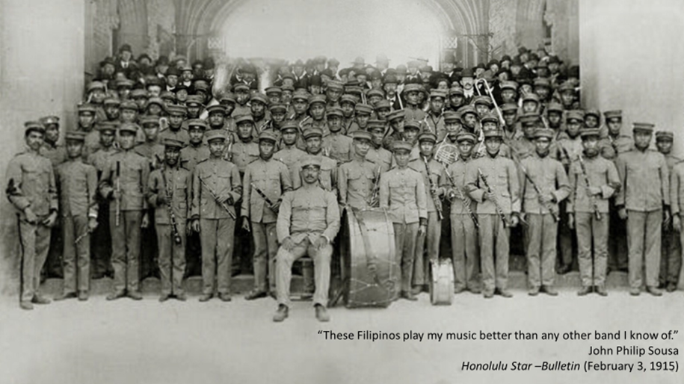
The Philippine Constabulary Band
They were about 84 musicians recruited from all over the Philippines through rigorous auditions. Eight clarinet from 300 who applied. Two French Horn players selected from 28.
They were very popular in the early 1900s. They toured the US. The reviews were reportedly “ecstatic”. The band was in a class all by itself, according to one paper, and cannot be compared with other bands.
Photo Credit: [Caption from Missouri History Museum] Jessie Tarbox Beals. Philippine Constabulary Band 1904 World’s Fair. Saint Louis, Missouri 1904 Photograph. http://collections.mohistory.org/resource/146090

Slide 16
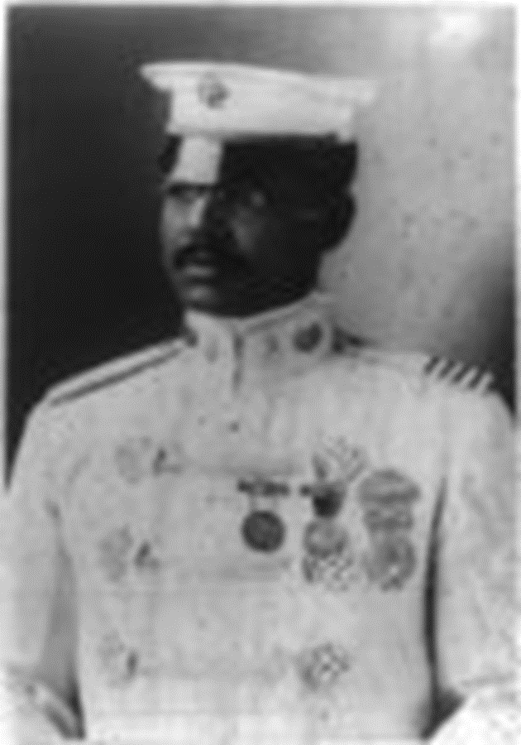
Colonel Walter Loving
Conductor, Philippine Constabulary Band
1902 – 1915, 1937-1940
The band was led by Walter Loving, an African American conductor who himself was previously a DC resident. He went to school on M street. He was the son of former slaves and born in Nelson County, Virginia. He was raised by relatives and they lived in a small slum area that is now the football field of Gonzaga College High School near the Union Station.
Photo Credit: [Caption from Library of Congress]Walter Loving. , . [No Date Recorded on Caption Card] Photograph. https://www.loc.gov/item/2003670941/.

Slide 17
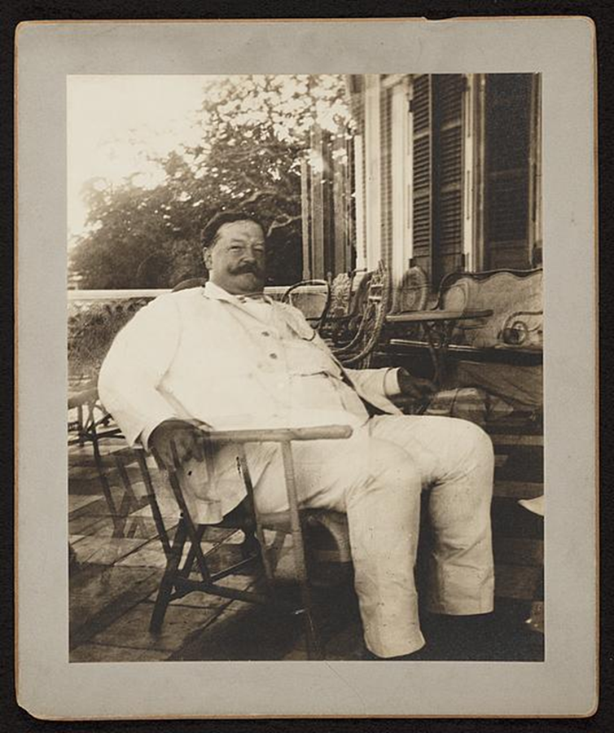
William Howard Taft
US President 1909-1913
When he was elected President of the United States, Taft asked the Philippine Constabulary Band to perform at his inauguration in 1909.
From the beginning, the Taft presidency seemed to feature facets of the Tafts’ Philippine experience. A few years earlier, Taft had served as the first Civil Governor-General of the newly acquired U.S. colonial territory. Sympathetic to the Philippines, Taft was generally popular among Filipinos. He enacted a U.S.-style civil service system and judicial system. He established a new system of English-language public schools and recruited hundreds of new American teachers (the Thomasites). He built transportation networks and health care facilities.
Photo Credit: [Caption from Library of Congress] William H. Taft, seated in a wicker chair, probably during his tenure as Governor-General of the Philippines. Philippines, None. [Between 1901 and 1903] Photograph. https://www.loc.gov/item/2013649079/.

Slide 18
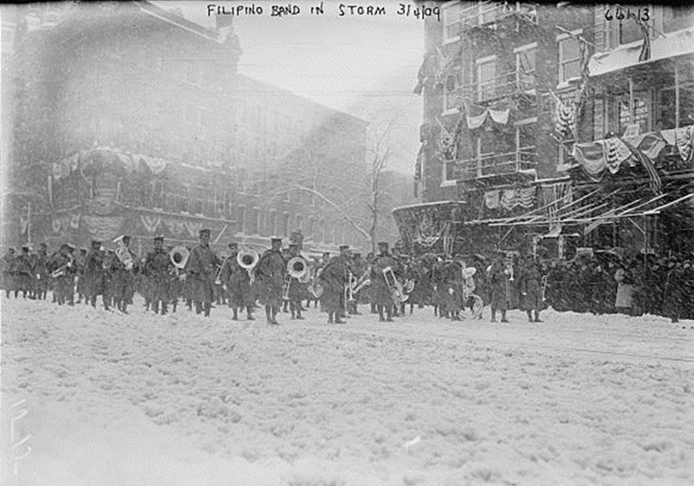

Taft Inauguration
March 4, 1909
The Philippine Constabulary Band performed at Taft’s blizzard-drenched inauguration.
Photo Credit [Caption from Library of Congress] Bain News Service, Publisher. Inauguralparade, Flipino Band, snowstorm, Washington, D.C. , . 3/4/09 date created or published later by Bain. Photograph. https://www.loc.gov/item/2014683168/
Sound Recording: 1910 recording of the Philippine Constabulary Band ("La Sampaguita"). This is from the Cylinder Preservation and Digitization Project of University of California Santa Barbara's Davidson Library. http://cylinders.library.ucsb.edu/mp3s/8000/8469/cusb-cyl8469d.mp3

Slide 19
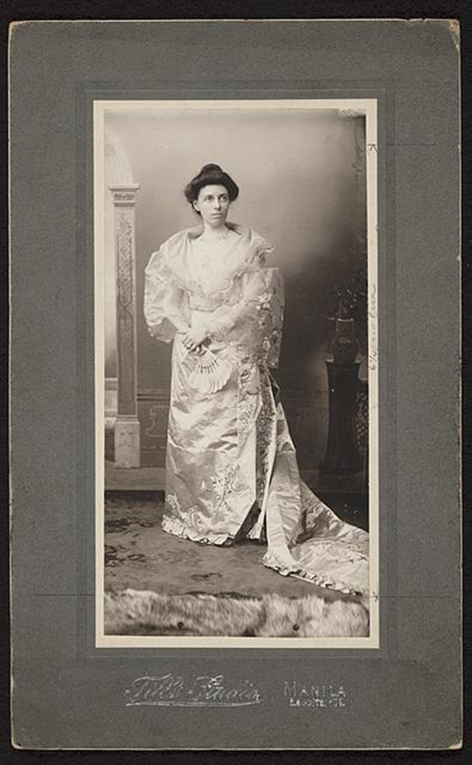
Helen Taft
US First Lady 1909-1913
The West Potomac Park was entirely the first lady Mrs. Helen Taft’s creation. In her memoir, Recollection of Full Years, she wrote, “That Manila could lend anything to Washington may be a surprise to some persons, but the Luneta is an institution whose usefulness to society in the Philippine capital is not to be overestimated.” The First Lady wanted to “convert Potomac Park into a glorified Luneta, where all Washington could meet, either on foot, or in vehicles, at five o’clock on certain evenings, listen to band concerts and enjoy such recreation as no other spot in Washington could afford.”
Photo Credit: [Caption from Library of Congress] Till'S Studio, photographer. Mrs. Taft in Filipina costume / Till's Studio, Manila, Escolta 105. Manila Philippines, None. [Between 1901 and 1903] Photograph. https://www.loc.gov/item/2013649077/.

Slide 20
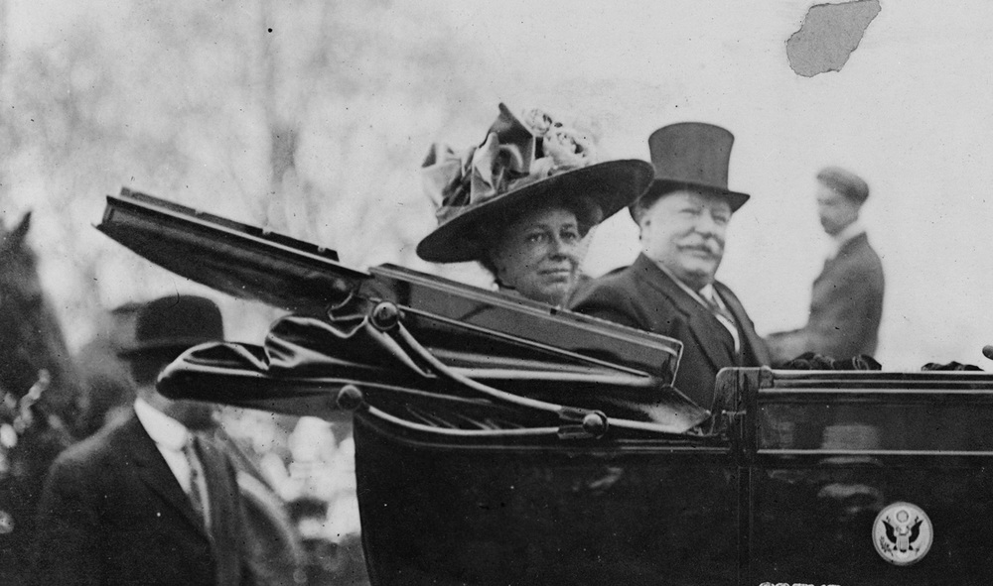
West Potomac Park Inauguration
April 17, 1909
All of Washington was there to attend the inauguration of the West Potomac Park and to hear a fine performance by the Philippine Constabulary Band.
On the day of the concert, the middle of the ellipse featured a white wooden octagonal band stand decorated with evergreens and flags. At 4 o’clock, people slowly trickled in, quickly occupying the prime spots closest to the bandstand. Ambassadors, ministers, cabinet members, senators and congressmen came with their wives, families and their guests
The president and the lady came without much fanfare, riding a White House automobile; but thousands of people soon moved toward them, applauding.
Photo Credit: [Caption from Library of Congress] Clinedinst, Barnett Mcfee, photographer. President and Mrs. Taft in White House automobile. Washington D.C, 1909. Photograph. https://www.loc.gov/item/2002719749/

Slide 21
References
Anthony, Carl Sfferrazza. The Unconventional First Lady of the Ragtime Era. New York: Harper Collins Publishers, 2006.
Carandang-Tiongson, Titchie. “A DC Springtime Concert Born in Manila.” Positively Filipino http://www.positivelyfilipino.com/magazine/2013/4/a-dc-springtime-concert-born-in-manila (July 30, 2018).
Hoover, Irwin Hood. Forty-Two Years in the White House. Boston: Houghton Mifflin Company, 1934.
Taft, Helen. Recollection of Full Years by Mrs. William Howard Taft. New York : Dodd, Mead & Co., 1914.
Yoder, Robert L. In Performance: Walter Howard Loving and the Philippine Constabulary Band. Manila: NHCP, 2013

Slide 22
Sofia de Veyra

Slide 23
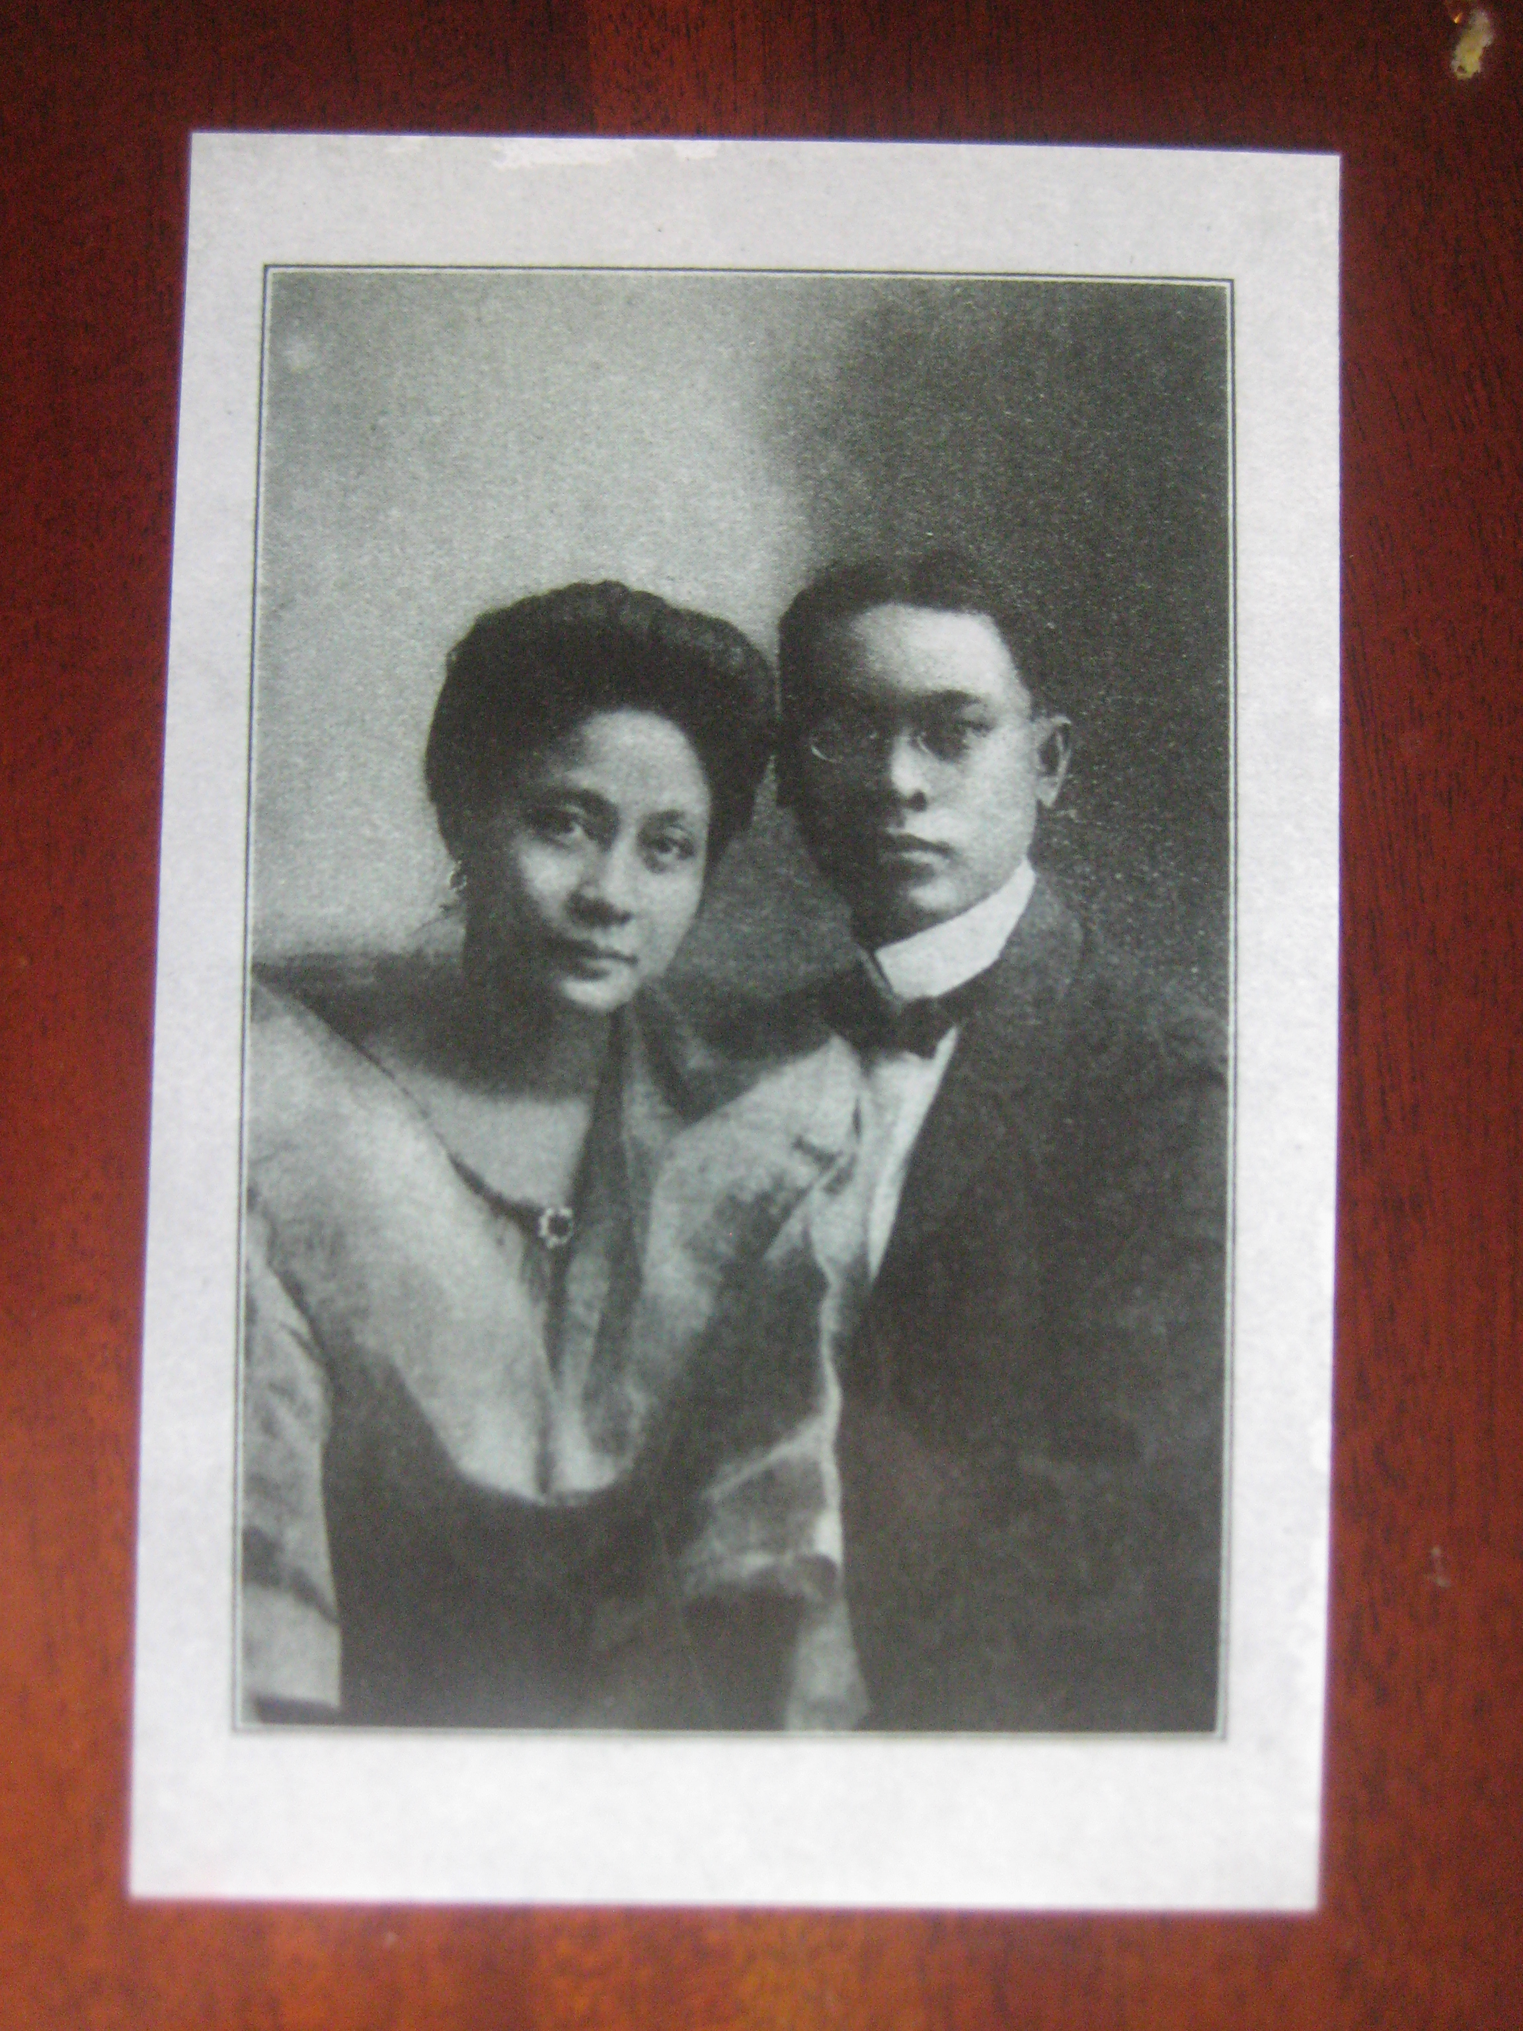
Sofia Reyes de Veyra
Washington Resident 1917-1923
Sofia de Veyra was the wife of Jaime C. de Veyra who served as the Philippine Resident Commissioner, a non-voting member of US Congress, and lived in DC for several years.
Before moving to the United States, she served as founding officer of clubs serving the needs of women and children (Asociacion Feminista) and its offshoot, Gota de Leche, an organization that provided milk for malnourished babies and trained their mothers in proper nutrition), and helped establish the first nursing school in the Philippines.
Photo Credit: Sofia de Veyra and Jaime De Veyra, Collection of Teresa Montilla

Slide 24
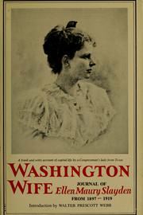
Sofia de Veyra, Congressional Wife
Sofia had many admirers in DC, including from among the wives of congressional representatives. One of them was Ellen Slayden, the wife of a Texas Congressman.
Slayden wrote in her diary that Sofia “was prettily dressed and her English was impeccable, and she talked with knowledge and vivacity on politics, especially, as well as books, Spanish and English, religion, the woman’s movement and domestic science. She told a quick and good story and showed a keen and humorous sense of the prejudice she met here because of her race. She was not resentful, but evidently means to safeguard her dignity.”

Slide 25
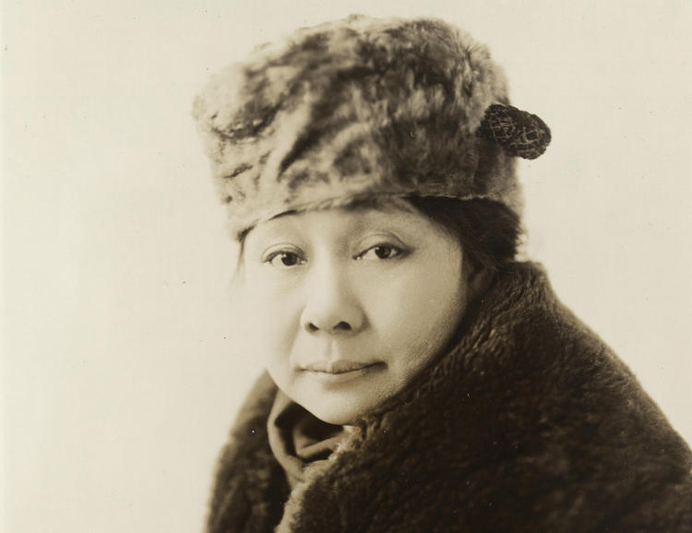
Sofia de Veyra, Feminist
A staunch advocate of women’s rights, her speeches and pronouncements often made headlines. In an article on an American Red Cross event, the Washington Post quoted Sofia: “The women over there [the Philippines] can do most everything a man can do.” At the Pan Am Conference of Women in Baltimore to which she was a delegate, the New York Times reported how she emphasized the Filipino wife’s role as equal partner: “No man transacts business in the Philippines without consulting his wife and every day he hands over his earnings to her and she gives him an allowance.”
Photo of Sofia de Veyra in Fur Hat
Credit: Library of Congress, Prints & Photographs Division, National Woman's Party Records, Group I, Container I:158, Folder: DeVeyra, Mrs. J. C.

Slide 26
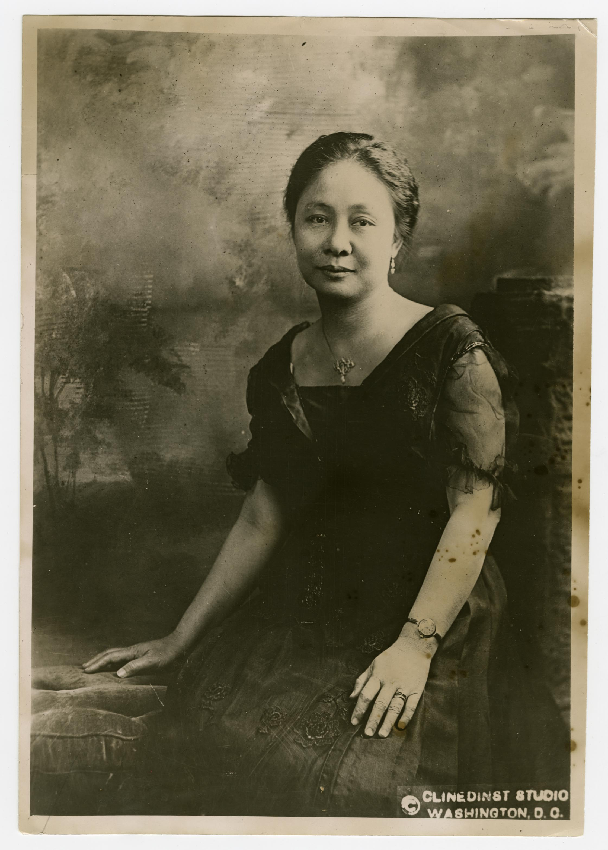
Sofia de Veyra, Multi-tasker
Here are a few other things we found out about Sofia de Veyra:
Her husband enlisted her help as his secretary.
She held responsibilities as the wife of the resident commissioner.
She had four young children to take care of.
She studied stenography (taking shorthand notes from oral instructions).
She volunteered at the Red Cross and was awarded a commendation by President Woodrow Wilson for her contributions to the war effort.
She travelled around the US and gave illustrated lectures about the Philippines.
Sofia along with a Mrs. Lao were the first women among the foreign commissions to lay a wreath on George Washington’s tomb.
Photo Credit: The Philippines on the Potomac Project Collection

Slide 27
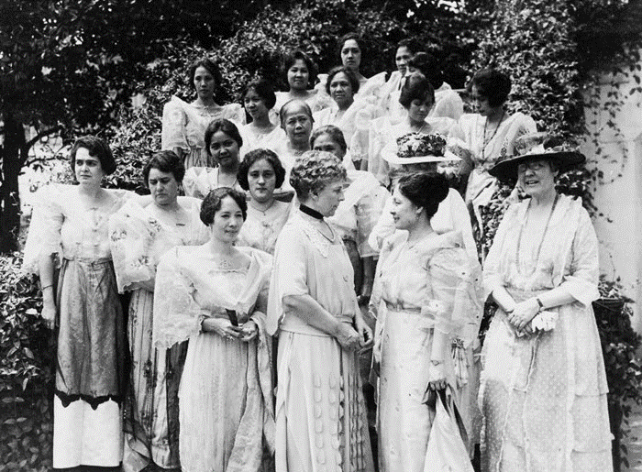
Sofia de Veyra at the White House
June 19, 1922
One of the highlights of Sofia’s stay in Washington occurred when she introduced U.S. First Lady Florence Harding to a group of women from the Philippines on the South Lawn of the White House. They were the “wives and daughters of the delegation which came to Washington to lay before President Harding the plea for Philippine independence.”
Photo Credit: [Caption from Library of Congress] Philippine women received by first lady, Washington, DC, 1922. Photograph. http://www.loc.gov/pictures/item/92519740/

Slide 28
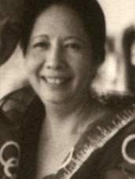
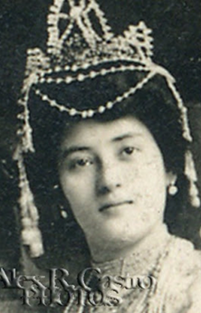
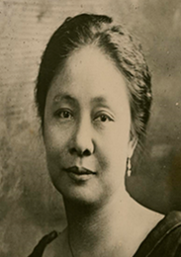

Aurora Quezon
Pura Villanueva Kalaw
Sofia de Veyra
Leaders of the Philippine Suffrage Movement
Aside from Sofia de Veyra, First Lady Aurora Quezon and Pura Villanueva Kalaw were instrumental in the passing of the 1937 Amended Election Law. This allowed Filipino women to vote and run for office. Aurora, Sofia and Pura proudly witnessed the signing of the 1937 Amended Election Law. This also paved the way for equally extraordinary women to emerge and play important roles in Philippine history and government, particularly those who were once visitors and temporary residents of Washington, DC.
Photo Credit: [Caption from Library of Congress] Philippine women received by first lady, Washington, DC, 1922. Photograph. http://www.loc.gov/pictures/item/92519740/
Aurora Quezon Manuel and Aurora Quezon: public domain wikicommons.jpg
Pura Villanueva Kalaw Courtesy of www.manilacarnivals.blogspot.com.jpg
Sofia de Veyra: The Philippines on the Potomac Project Collection

Slide 29
References
Carandang-Tiongson, Titchie. “The Thoroughly Modern Sofia de Veyra.” Positively Filipino http://www.positivelyfilipino.com/magazine/the-thoroughly-modern-sofia-de-veyra (July 30, 2018)
De Veyra, Rosario A. Faith, Work and Success: An Appraisal of the Life of Mrs. Sofia Reyes de Veyra. Phils: University of San Carlos,1959.
“Filipino Men Docile,” Washington Post. May 27, 1920.
Slayden, Ellen. Washington Wife: Journal of Ellen Maury Slayden from 1897 to 1919. New York: Harper & Row, 1963.
“Women Surprised by Mrs. Pankhurst.” The New York Times. April 22, 1922.

Slide 30
The Manila House
Gathering Place of the Filipino Community in Washington, DC

Slide 31
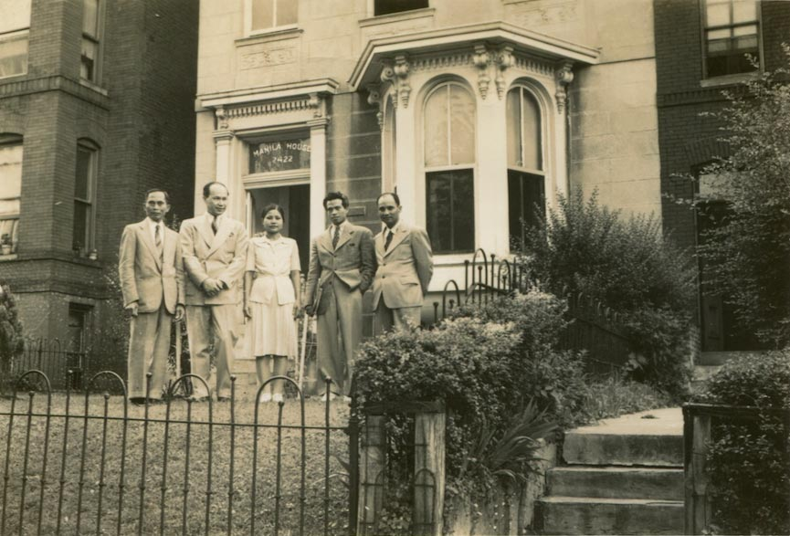
Home Away from Home
In 1937, the Visayan Club acquired a property on 2422 K street from the St. Stephen’s Club, which became known as the Manila House. Managed by Asuncion Gaudiel Esposo (fondly called “Manang” [big sister] by her customers) and her husband Gil, the Manila House soon became the cultural and social hub of Filipinos – “It was the gathering place for all notable Filipinos” – according to Bataan Magazine. Among the frequent customers of the Manila House were Filipino cab drivers, students, writers, musicians, soldiers and Philippine government employees.
Photo: Juliana (center) and Rudolfo Panganiban (far right) with friends in front of the Manila House, 1944. (Source: The Rita M. Cacas Filipino American Community Archives Collection, Special Collections, University of Maryland Libraries, College Park, Maryland)

Slide 32
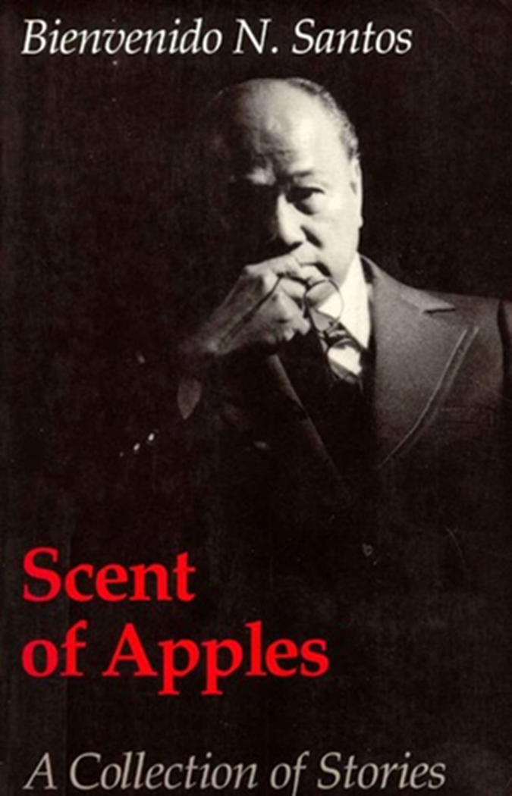
Bienvenido Santos and the Manila House
The acclaimed Filipino American author and professor Bienvenido N. Santos wrote about the Manila House. In Santos’s anthology, You Lovely People (Makati: Bookmark, Inc., 1991), a collection of stories written while living in Washington, one story is called “Manila House.” The story is reprinted in his anthology, Scent of Apples, (Seattle: University of Washington Press, 1980), winner of the 1981 American Book Award.
Santos worked as a public information officer of the Philippine government in the 1940s, along with other Philippine Commonwealth officials who were in exile in DC during the war. Peter Jamero in his memoirs, Growing Up Brown (Seattle: University of Washington Press, 2006), recalls attending an event at the Manila House hosted by the Boholano Club, where he was introduced to Santos. Santos in turn, wrote about his first meeting with Silverio Madelo, Jamero’s uncle in his memoir. Memory’s Fictions (Quezon City: New Day Publishers, 1993). It was at the Manila House where they enjoyed a meal of chicken and pork adobo.
Credit: The Philippines on the Potomac Collection
Text from Carandang-Tiongson, Titchie. “The Manila House in Washington, DC.” Positively Filipino http://www.positivelyfilipino.com/magazine/the-manila-house-in-washington-dc

Slide 33
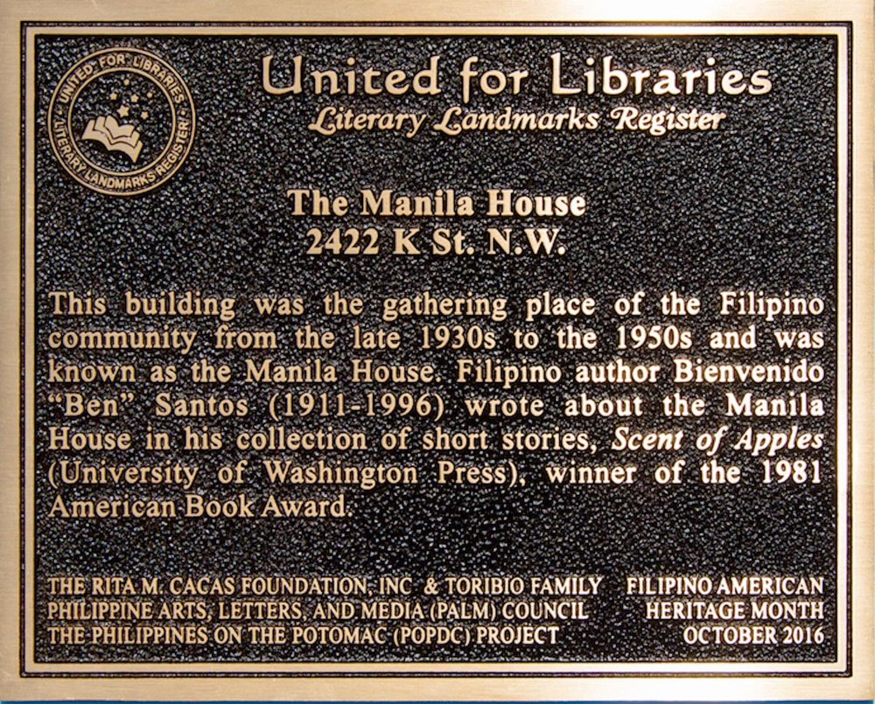
Manila House, a Literary Landmark
The Manila House Literary Landmark plaque was unveiled in October 2016 at the Embassy of the Philippines in honor of Philippine American History month. A dedication ceremony was held on Saturday, May 6, 2017 at the original site of the former Manila House.
There are only three other structures designated a Literary Landmark in the District. These are the Founders Library, Howard University (1997); The Jefferson Building, Library of Congress (1998); and the Frederic Douglas National Historic Site (2007). This is also the first time a Literary Landmark was designated in honor of a Filipino-American writer.
Credit: Manila House Literary Landmark. Location: 2422 K St., N.W., Washington, D.C. (Photo by Rita M. Cacas)

Slide 34
References
Carandang-Tiongson, Titchie. “The Manila House in Washington, DC.” Positively Filipino http://www.positivelyfilipino.com/magazine/the-manila-house-in-washington-dc (July 30, 2018)
Jamero, Peter. Growing Up Brown: Memoirs of a Filipino American. Seattle and London: University of Washington Press, 2006.
Santos, Bienvenido. “Manila House” in B. Santos, You Lovely People. Makati: Bookmark, Inc., 1991.
Santos, Bienvenido. Memories Fictions. Quezon City: New Day Publishers, 1993.

Slide 35
Galo Ocampo
Painter, Soldier, Civil Servant, Arlington Resident

Slide 36
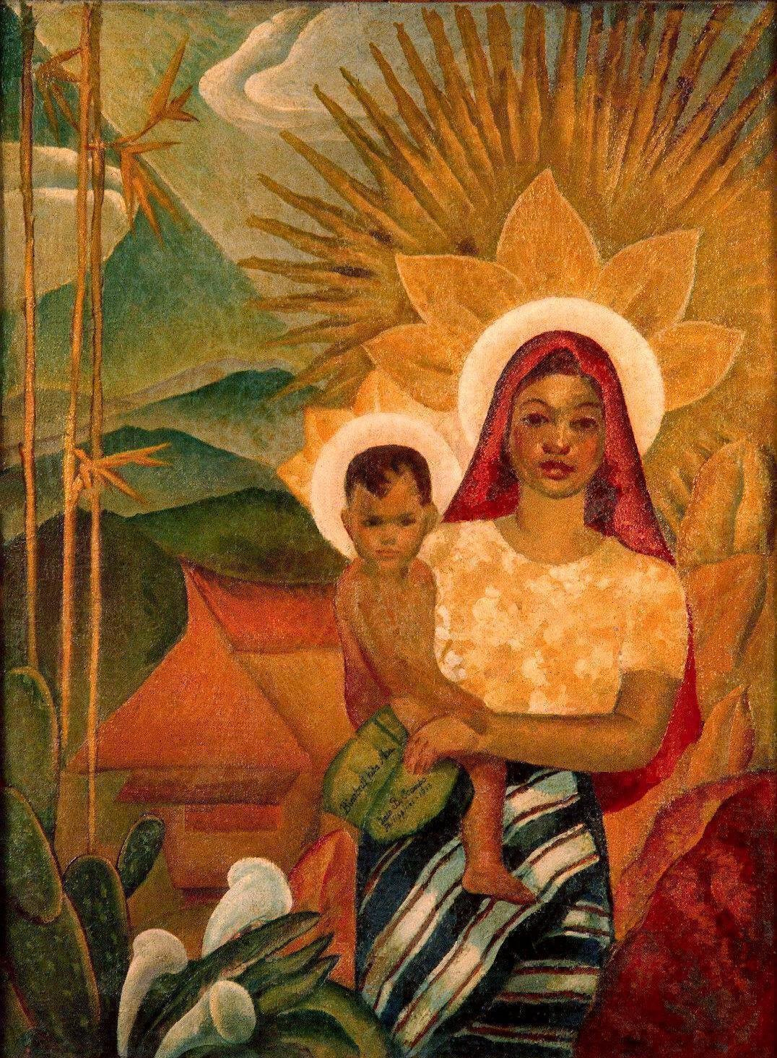
Galo Ocampo, Artist
Galo Ocampo is considered one of the greatest artists in Philippine art history. Ocampo is best known for the Brown Madonna, the first painting ever to depict the blessed Virgin Mary as a Filipino. He was one of the leaders of the modern art movement in the Philippines. Aside from being a painter, he created and designed enduring national images: the stained glass windows of the historic Manila Cathedral and the Santo Domingo Church and the Philippine coat of arms and presidential seal.
His achievements were recognized after his death. In 2013, his centennial was celebrated. Guillermo’s The Life and Times of Galo Ocampo was published that same year. In 2015, he was posthumously awarded The Order of Lakandula, one of the highest honors conferred by the Republic of the Philippines.
Photo Credit: The Brown Madonna by Galo Ocampo. Courtesy of Mitch and Dennis Ocampo

Slide 37
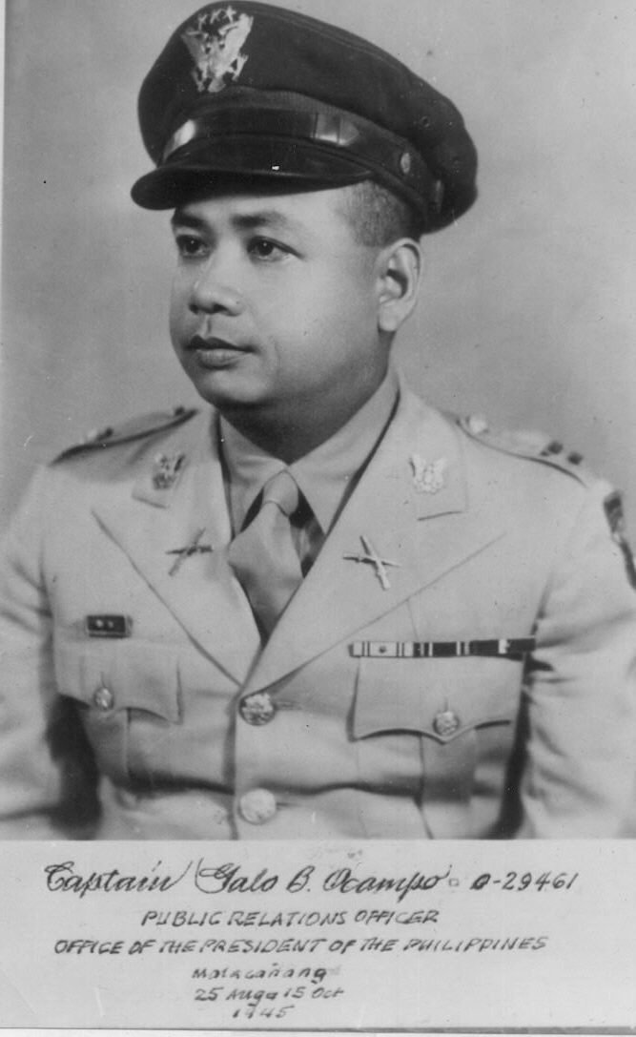
Galo Ocampo, Soldier and Spy
He did covert work for the United States Army Forces in the Far East (USAFFE) during World War II. A fascinating account of his spy work is documented in his biography, The Life and Times of Galo Ocampo, written by Alice Guillermo, the renowned writer and art critic. In 1943, Ocampo was inducted as a First Lieutenant of the Lapham Guerilla Unit under Captain Albert Hendrickson. He worked undercover in Manila as an art director of a theater group.
Galo Ocampo died on September 12, 1985. He was buried at the Arlington Memorial Cemetery with full military honors befitting his rank as a US Army Captain.
Photo Credit: Captain Galo Ocampo Courtesy of Mitch Ocampo

Slide 38
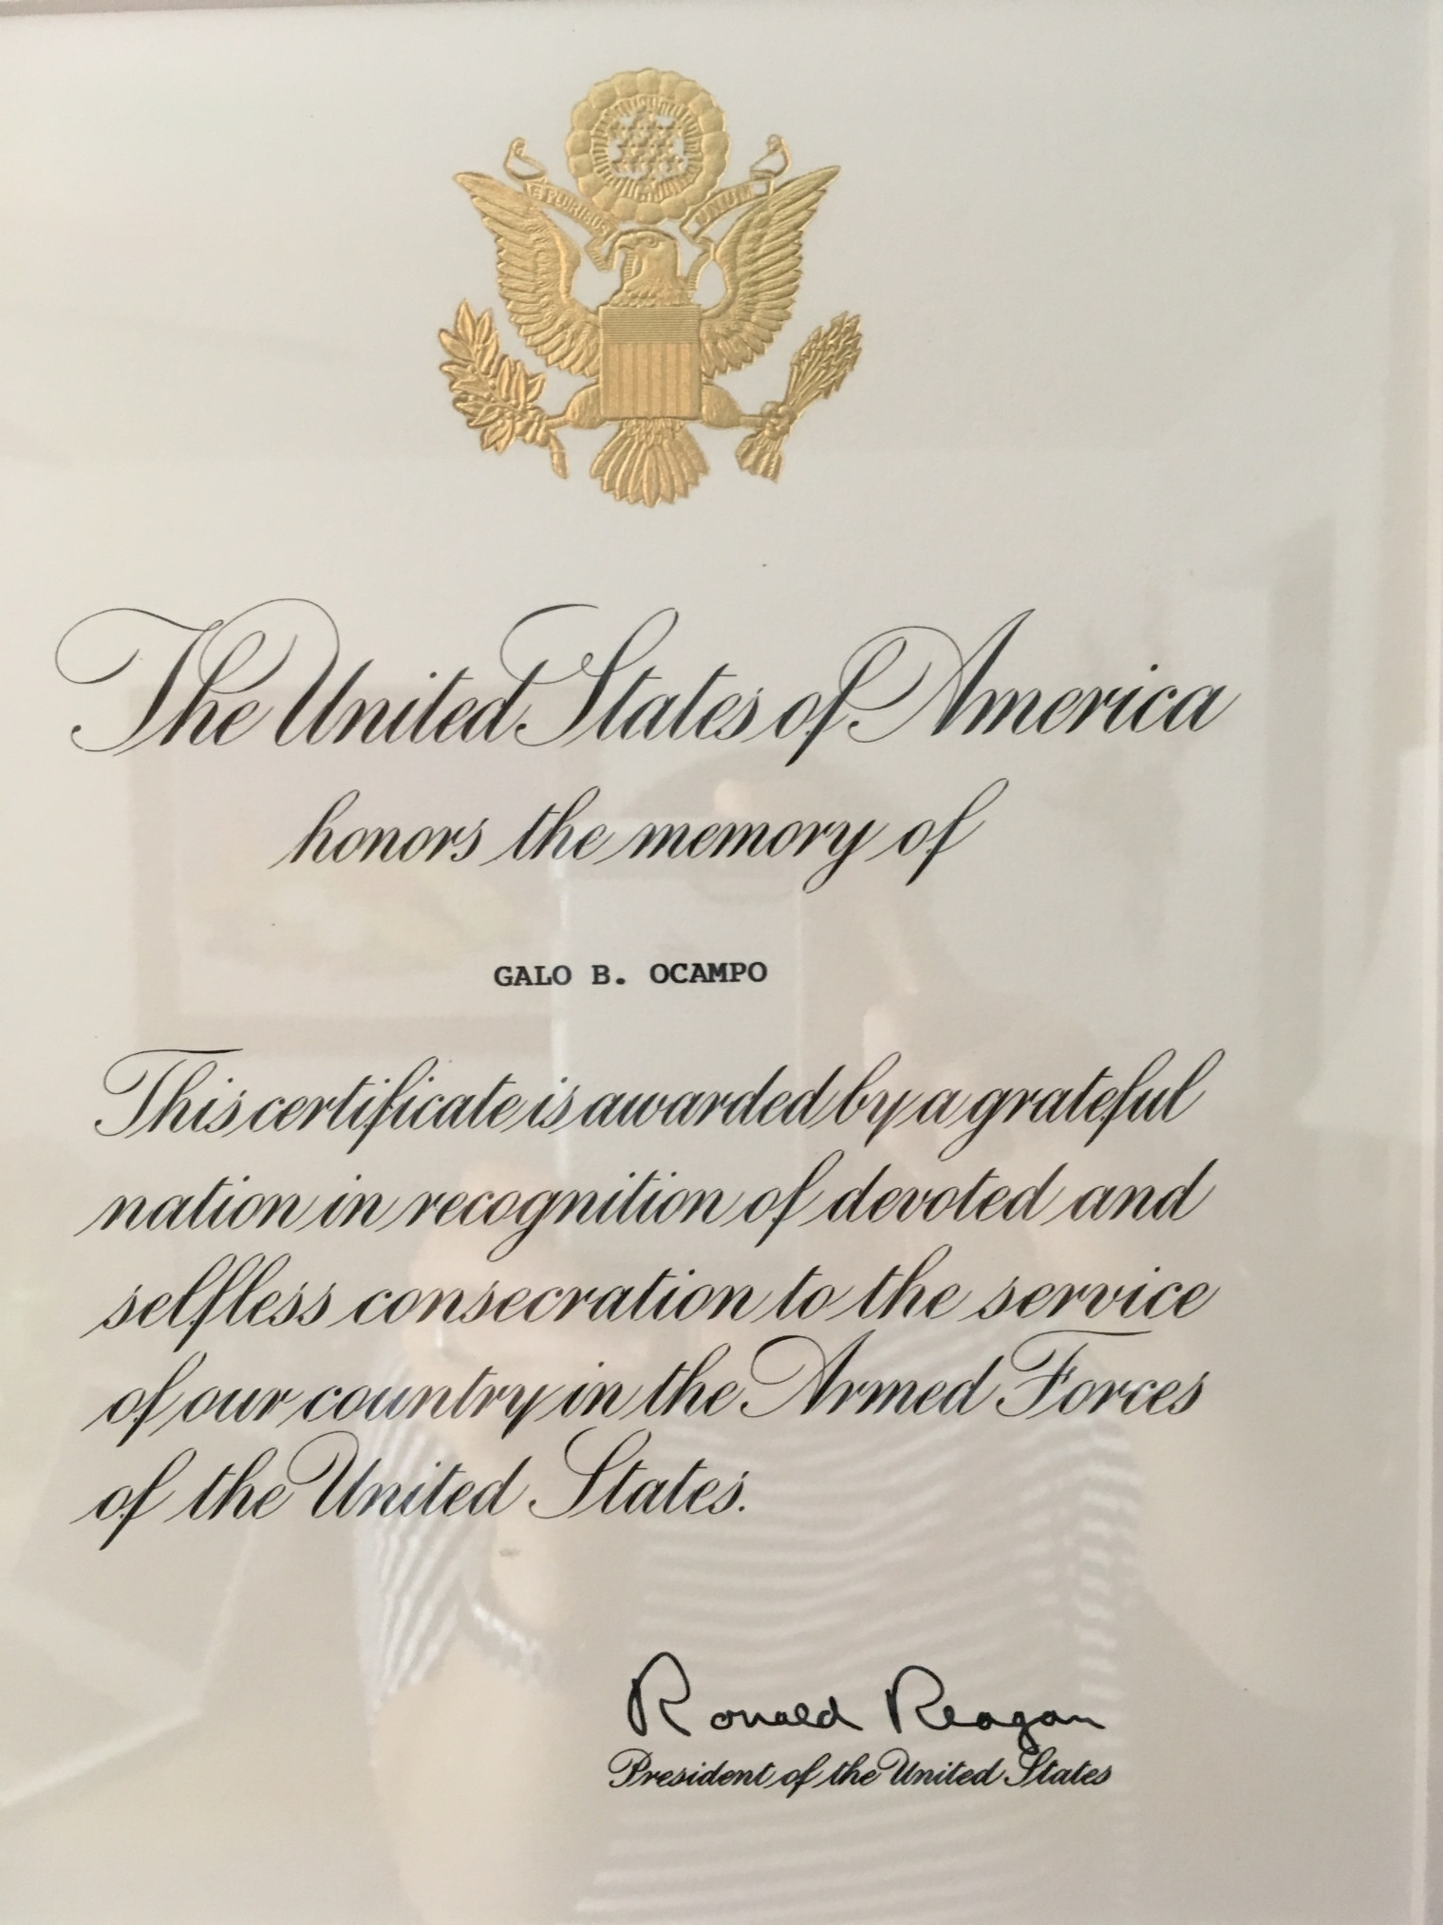
Galo Ocampo, Civil Servant
After the war, Ocampo lived in New York. He worked for General Carlos P. Romulo who was then the Philippine representative to the United Nations. (Gen. Romulo later served as President of the United Nations General Assembly from 1949 to 1950). Ocampo also stayed briefly in Washington, DC to study heraldry (the system by which coats of arms and other armorial bearings are devised, described, and regulated) at the U.S. War Department and numismatics (the study of coins and paper currency) at the U.S. Bureau of Engraving.
Photo Credit: Courtesy of Mitch Ocampo

Slide 39
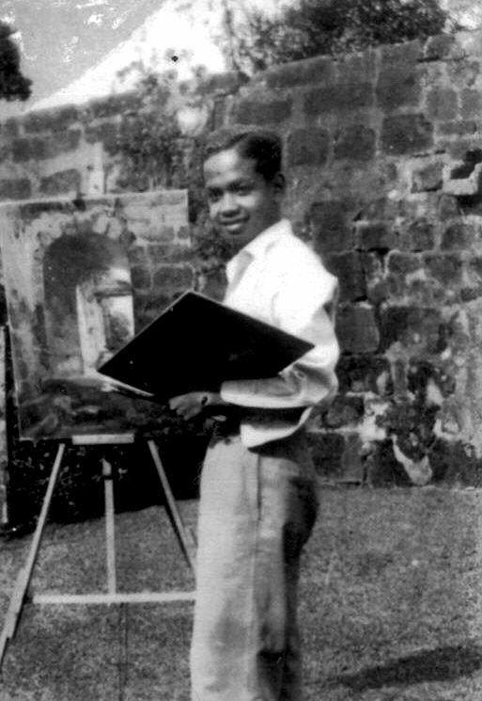
Galo Ocampo, Arlington Resident
In the 1980s, Galo Ocampo was like any other St. Ann Parish member. He and his wife Loretta were devout Catholics and walked a few blocks to St. Ann’s to hear the daily mass. Afterwards, together with friends, they walked the short distance — before I-66 was built — to either the Safeway or McDonald’s on Wilson Boulevard. When he came home, he tended to his garden. He grew eggplants, tomatoes and bittermelon in his backyard.
Painting was very much part of his daily routine, according to his son Mitch Ocampo. After tending to his garden, he then spent the rest of the day painting in almost every room. “He would start one in the upstairs bedroom, he would start one on the porch, then started one in the basement,” Mitch Ocampo recalled. Dennis Ocampo said his father “relished” getting Grumbacher oil paints from a local Arlington store because they were very expensive in the Philippines.
Photo Credit: Galo Ocampo Courtesy of Mitch Ocampo

Slide 40
References
Carandang-Tiongson, Titchie "Galo's Road: The Journeys of an Arlington Resident.” Connection Newspapers http://www.connectionnewspapers.com/news/2018/jul/14/galos-road-journeys-arlington-resident/(July 30, 2018)
Guillermo, Alice. “The Life and Time of Galo Ocampo.” Philippines: McEnrho Book Publishing, 2013.
Ocampo. Dennis. Interview by Titchie Carandang-Tiongson. June 15, 2018.
Ocampo, Mitch. Interview by Titchie Carandang-Tiongson. June 21, 2018.
Tiongson, Hector “A Brush with Greatness,” Positively Filipino http://www.positivelyfilipino.com/magazine/a-brush-with-greatness

Slide 41
Alma Stewart and Hadji Gulamu Rasul
A Love Story

Slide 42
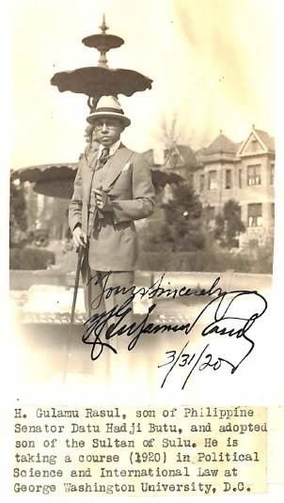
A Love Story
Alma Stewart, a member of a prominent family in Virginia married Hadji Gulamu Rasul of Jolo, the son of Senator Hadji Butu. They met while Gulamu was a GWU student in the early 1920s.
They were decades ahead of their time. Considering the social norms of that period, the anti-miscegenation laws in the US (laws prohibiting interracial marriages, including in Virginia until the 1967 civil rights case Loving v. Virginia finally struck down these laws as unconstitutional).
Almost a hundred years ago, in a world still unwelcoming of a marriage like theirs, what was life like for Alma and Gulamu? Thankfully, Alma’s letters about the unusual life she chose are among the papers of her brother, Dr. Harold Stewart “Dear Harold, Yes it’s ’23, I can hardly realize that I have been away from home 1 year,” she wrote to her brother from Manila in March 1923. “Time has passed quickly & I have been very happy,” she said.
(Special thanks to Hank Hendrickson and Dr. Jun Rasul who first told us about Alma Stewart Rasul. The papers of Harold Stewart are with the Weill Cornell Library in New York.)
Photo Credit: Scrapbook of Cylde H. Tavenner https://archive.org/details/ScrapbookClydeTavenner

Slide 43
One Last Image
We wanted to end with the image on the following slide.
This is the Hurley Mansion in Ashburn, VA. In Manuel Quezon’s writings he refers to it as Leesburg. Today, it is the Belmont Country Club. In summer of 1942, Quezon’s family lived here soon after escaping from the Japanese and just before moving to the Shoreham Hotel.
It shows a famous photo of the Commonwealth Government in exile taken at this same spot. There are many extraordinary individuals in this photo. There is Romulo – who was a Pulitzer Prize winner, who later served as President of the United Nations General Assembly and briefly as Chair of UN Security Council. There is Fanny Aldaba Lim who became the first female cabinet member of the Philippines. There is Arturo Rotor, a medical doctor after whom a type of jaundice is named, based on pathbreaking research he conducted at Johns Hopkins. He was also a prize winning author, a member of the first generation of Filipino Writers in English, along with Jose Garcia Villa, Carlos Bulosan and others. He also liked orchids, and knew a lot about orchids, and there is an orchid variety named after him. In 1942, he was Secretary to the Philippine Cabinet.
There are also a few individuals who stayed on in DC, past the war, raised families, and lived quiet, private lives. Where they lived, where they worked, where they sent their kids to school in the DC area – their lives reflecting the opportunities and constraints of the period – we know some of these, because their lives have been documented by Rita Cacas in her book, Filipinos in Washington.
We wanted to end with this image because in many ways it reflects what are our best hopes for POPDC. We are inviting people to take a second look at Washington DC, at the buildings and street corners around us. We are immersed in the rich, colorful legacies of Philippine-American history and culture. They are not always readily visible, but they are there, if you look hard enough.
Photo Credit (Photo on next slide): Quezon Cabinet: Courtesy of Ricardo Lim and the Lim Family

Slide 44
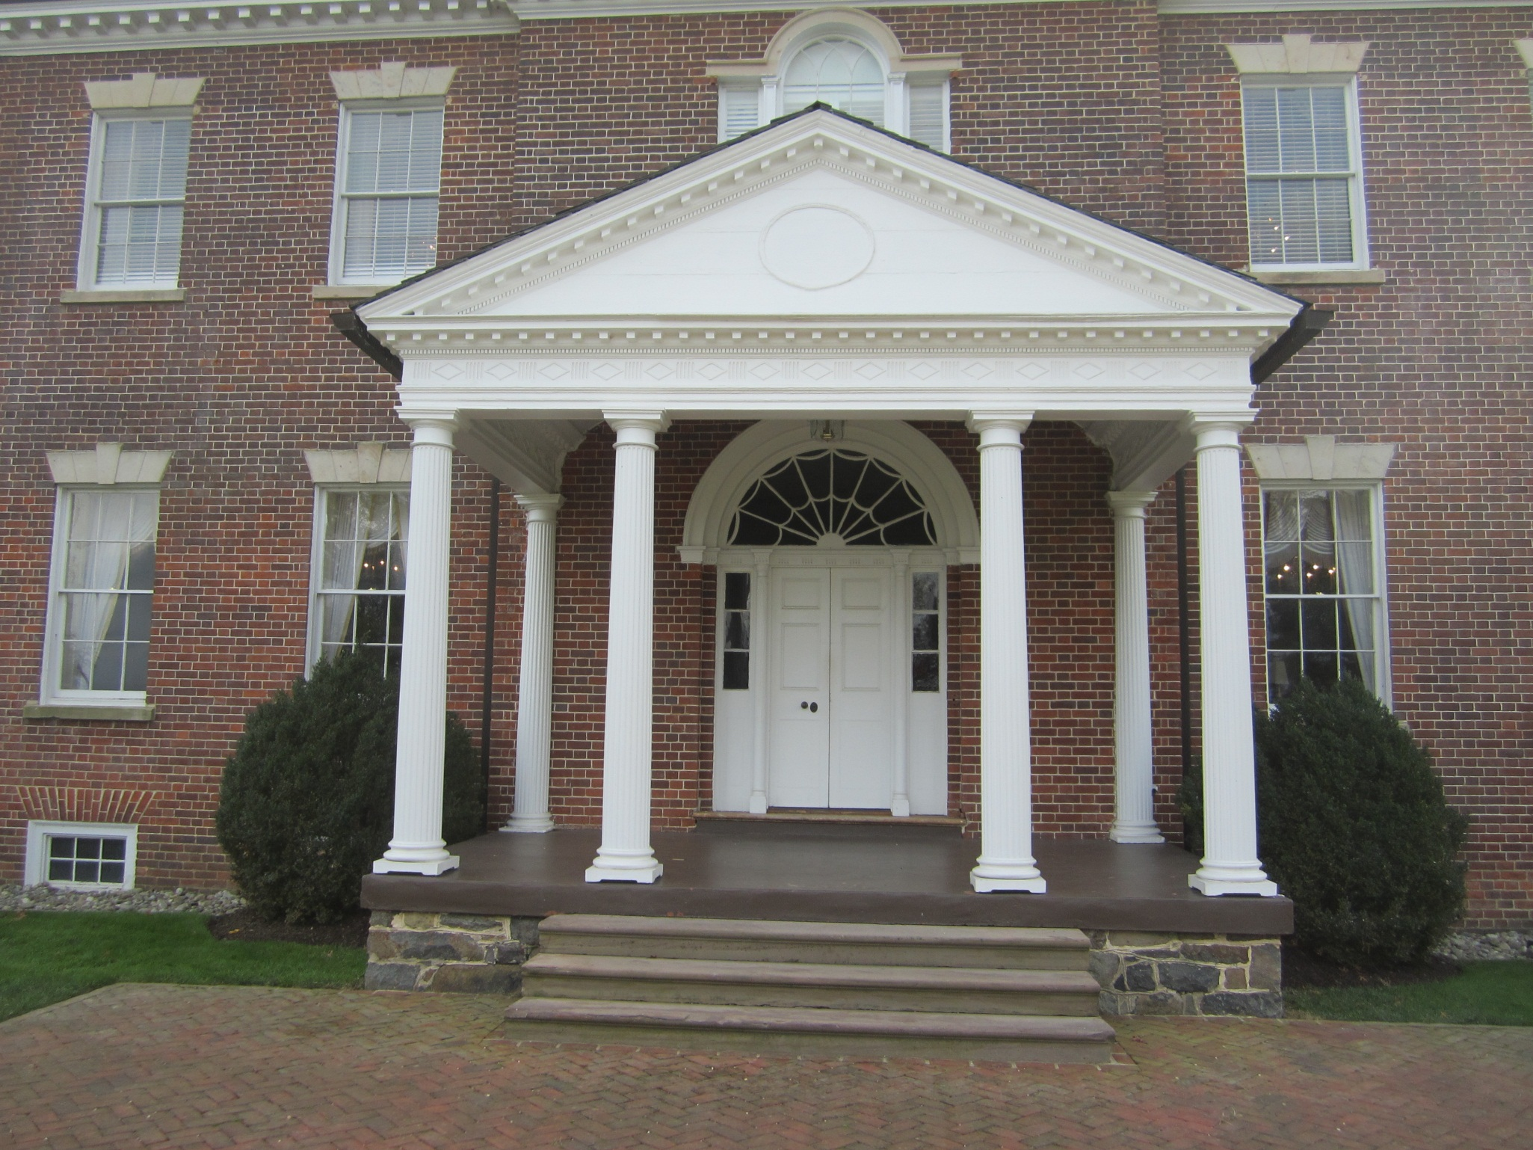
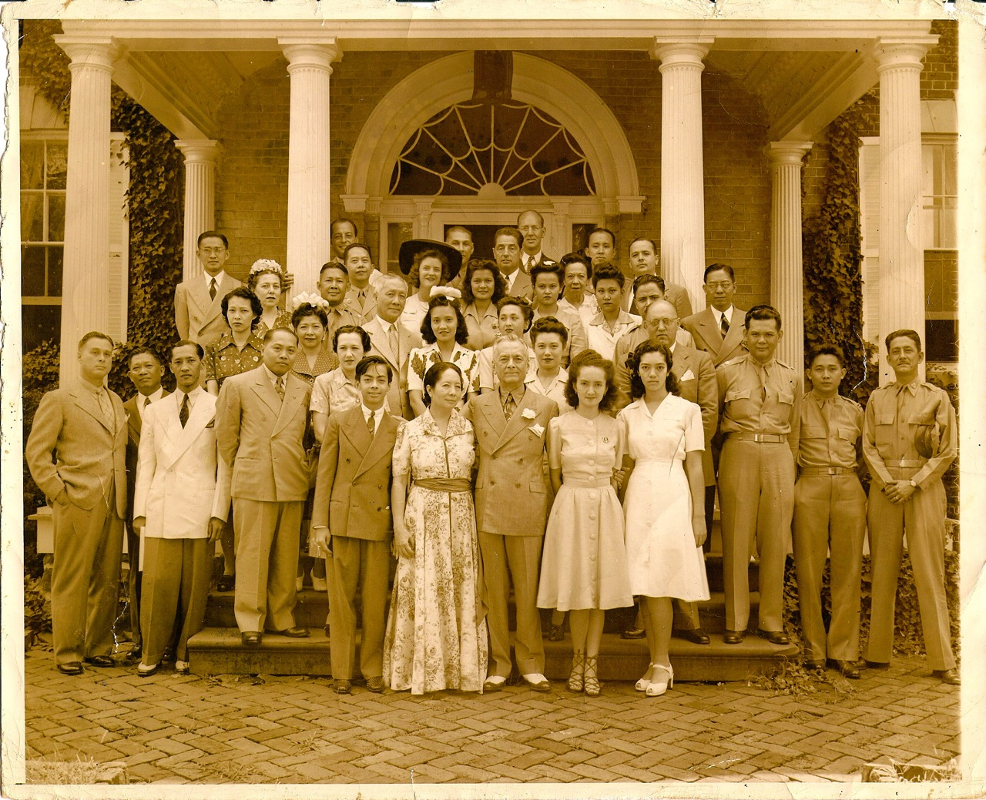
Notes:
We wanted to end with this image. This is the Hurley Mansion in Ashburn, VA. In Quezon’s writings he refers to it as Leesburg. Today it is the Belmont Country club. In summer of 1942, Quezon’s family lived here soon after escaping from the Japanese and just before moving to the Shoreham.
It shows a famous photo of the Commonwealth Government in exile taken at this same spot. There are many extraordinary individuals are in this photo. There is Romulo – who was a Pulitzer Prize winner, who later served as President of the United Nations General Assembly and briefly as Chair of UN Security Council. There is Fanny Aldaba Lim who became the first female cabinet member of the Philippines. There is Arturo Rotor, a medical doctor after whom a type of jaundice is named, based on pathbreaking research he conducted at Johns Hopkins. He was also a prize winning author, a member of the first generation of Filipino Writers in English, along with Jose Garcia Villa, Carlos Bulosan and others. He also liked orchids, and knew a lot about orchids, and there is an orchid variety named after him. In 1942, he was Secretary to the Philippine Cabinet.
There are also a few individual who stayed on in DC, past the war, raised families and lived quiet, private lives. Where they lived, where they worked, where they sent their kids to school in the DC area – their lives reflecting the opportunities and constraints of the period – we know some of these, because their lives have been documented by Rita Cacas in her book, Filipinos in Washington.
We wanted to end with this image because in many ways it reflects what are best hopes are for this website. I think through this website we are inviting people to take a second look at Washington DC, at the buildings and street corners around us. We are immersed in the rich, colorful legacies of Philippine-American history and culture. They are not always readily visible, but they are there, if you look hard enough.

Slide 45
The Philippines on the Potomac (POPDC) Publications
"Galo's Road: The Journeys of an Arlington Resident.” Connection Newspapers
“The Quezons at the White House”, Positively Filipino, (June 2018)
“The Manila House in Washington, DC”, Positively Filipino, (May 2017)
“A 3D Image of the Philippine Scouts“, March 4, 1905, Positively Filipino (March 2017)
“Frederic Ossorio: Monuments Man”, Metro Home Magazine, Vol. 13 No. 2, p.44
“The Untold Story of Nina Thomas”, Vault Magazine, Vol. 5 No.4, p. 177, also published in Positively Filipino http://www.positivelyfilipino.com/magazine/the-untold-story-of-nina-thomas
“In the Footsteps of Philippine Presidents”, Vault Magazine, Vol. 5 No.4, p. 177
“Finding Philippine Art in Washington DC”, Asian Journal (March 2014). We posted an update and a bibliography on the POPDC website. https://popdc.wordpress.com/2017/04/17/finding-philippine-art-in-washington-dcupdate-and-bibliography/
“The Thoroughly Modern Sofia de Veyra”, Positively Filipino (August 2013).
“A Glorified Luneta along the Potomac River”, Our Own Voice (June 2013).
“A D.C. Springtime Concert Born in Manila”, Positively Filipino (April 2013).

