Slide 1
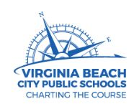

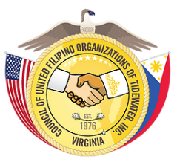


Born of Empires: Filipino Americans in the United States and Virginia, 1565 to the Present
In-House Content Academy for
Presentation for:
A Culture to Care: Filipino American Healthcare Professionals in Virginia
Tuesday, 7 August 2018, 11:00-12:00PM AM
Prepared by:
Ren Capucao
Nurse Historian
Filipino American National Historical Society-Hampton Roads (FANHS-HR) Chapter
Copyright Ren Capucao, 2018
All rights reserved.
SPONSORING ORGANIZATIONS
The MacArthur Memorial

Slide 2
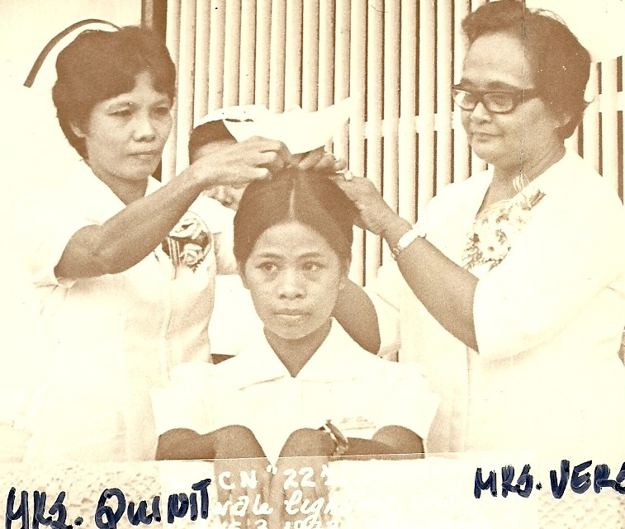
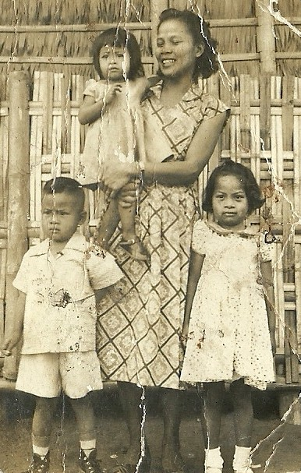
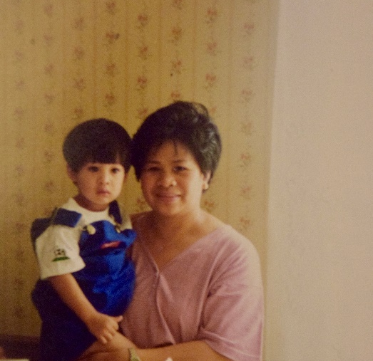
A Culture to Care: Filipino American Healthcare Professionals in Virginia
The Big Ideas
Big Idea 1: Following the Spanish American War, American models of medicine and nursing, and also naval recruitment, were introduced into the Philippines after it became a U.S. territory and deeply embedded into Filipino culture. The intersection of U.S. health and military policies affected the migration patterns of Filipino healthcare professionals.
Big Idea 2: The Philippines is the largest supplier of nurses to developing countries, and Filipino nurses comprise a significant portion of the American nurse labor force.
Jolly Capucao dreamed of becoming a nurse to escape poverty, care for others, and explore the world. She graduated from the University of Pangasinan in 1969 and migrated to the United States by following pursuit of her naval brother stationed in Norfolk. She prepares to retire next year from Chesapeake Regional Medical Center after forty years of service as nurse. Her son Ren Capucao has picked up the nurse’s mantle and pursues his graduate education in nursing at the University of Virginia.

Slide 3
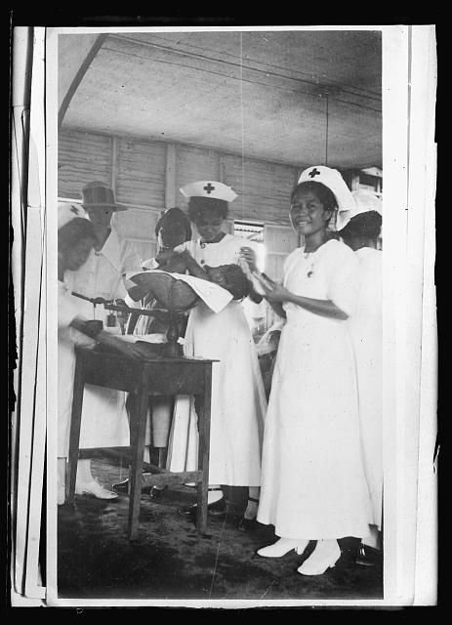
A Culture to Care: Filipino American Healthcare Professionals in Virginia
The creation of a globalized and highly mobile Filipino healthcare workforce, specifically nursing, has its roots in U.S. imperialism. After the Spanish American War, the U.S. government imported its models of nursing and medicine. These models reaffirmed the gender binary of nursing as a woman’s domain and medicine as man’s domain. However, nursing itself proved to be a vehicle for socioeconomic mobility for many Filipino women throughout the twentieth-century.
The intersection of U.S. naval and health policies would affect the migration and diaspora of Filipino healthcare professionals across the United States throughout the twentieth-century, as the country has undergone physician and nursing shortages.
Filipino nurses of a Philippine Chapter of the American Red Cross, 1922.
Notes:
https://www.loc.gov/item/2017679746/

Slide 4
A Culture to Care: Filipino American Healthcare Professionals in Virginia
The Spanish Colonial Era: 1521-1898
During the Spanish colonial era, formal healthcare services were primarily carried out by Spanish friars and priests. Outside medical institutions, indigenous healers continued to be consulted outside of Western medicine alongside Filipino women who provided care for sick family members and friends at home. However, some men from reputable families were encouraged to attend schools of medicine in Europe unafforded by women.
Jose Rizal, considered a Philippine national hero for opposing Spain’s colonial rule through his rhetoric, was trained as an ophthalmologist during the Spanish regime and furthered his education in Europe.

Slide 5
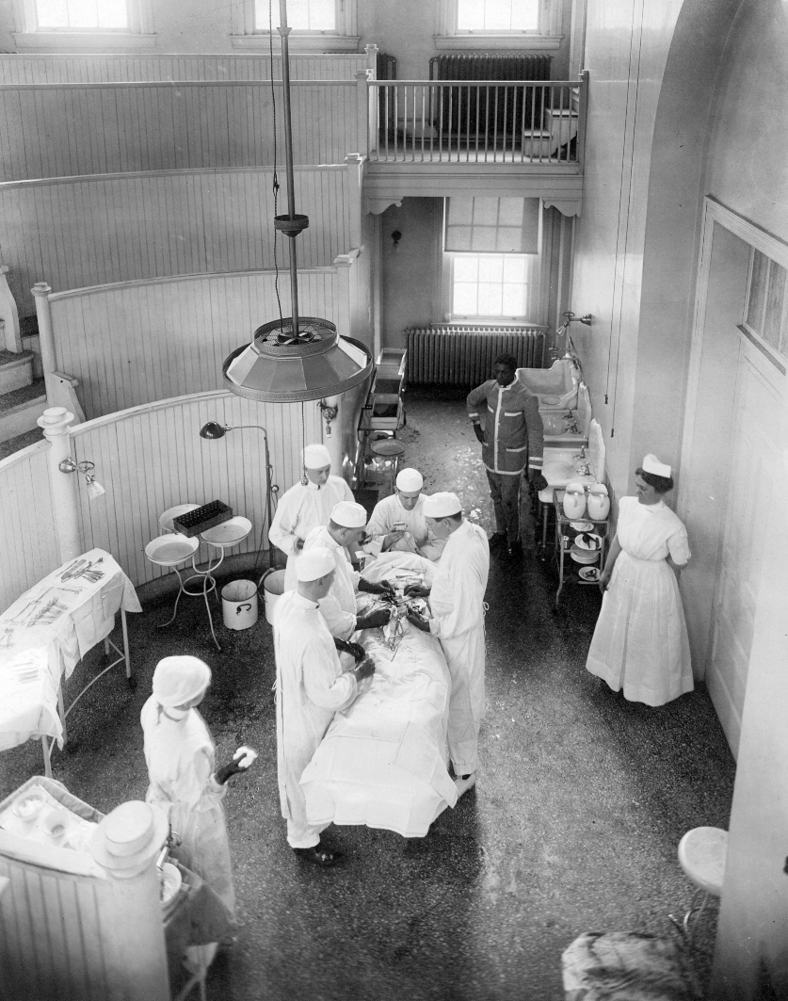
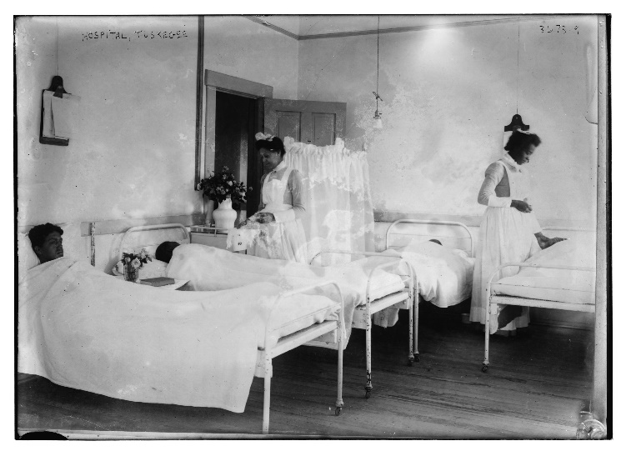
A Culture to Care: Filipino American Healthcare Professionals in Virginia
Philippines as a U.S. Territory: 1898-1946
During the late nineteenth and early twentieth century, science and technology advanced and led to the professionalization in the fields of medicine and science. Eventually, germ theory came into prominence and the medical profession began creating specialized fields. The building of hospitals and their usage heightened and the need for professional nurses in the U.S. increased. By the late 1920s, patients flocked to hospitals to receive care provided by trained nurses and to have ailments cured through physicians’ use of advanced medical technologies and aseptic surgery. However, many hospitals were either designated for whites or blacks, and black hospitals were often under resourced compared to their white counterparts.
University of Virginia hospital operating room, 1913.
Nurses tend to patients on the boys’ ward at Tuskegee Hospital, one of the first black-controlled hospitals in the United States.
Notes:
During the late nineteenth and early twentieth century, science and technology advanced. As a result, Germ Theory came into prominence. Also, the building of hospitals and their usage heightened and the need for professional nurses in the U.S. increased.

Slide 6
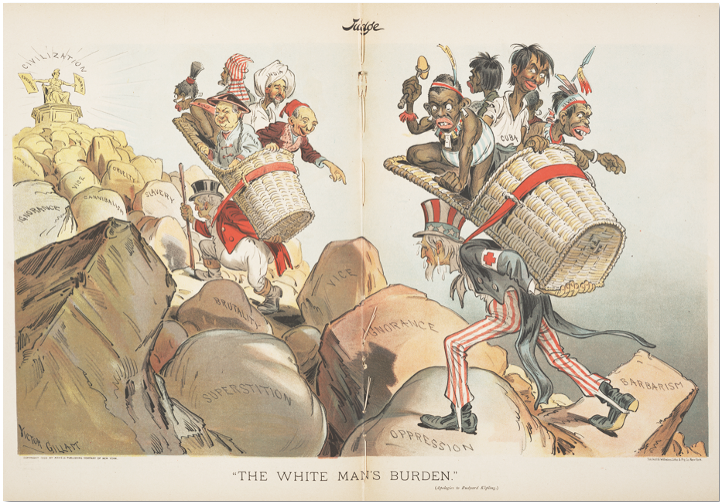
Question for consideration: What were the United States’ reasons for introducing its models of medicine and nursing into the Islands at the start of the twentieth century?
A Culture to Care: Filipino American Healthcare Professionals in Virginia
Philippines as a U.S. Territory: 1898-1946
As the Philippines became a United States territory in 1903, the American models of medicine and nursing were imported into the Islands. They became tools to address The White Man’s Burden and helped establish an unequal power relationship between the two countries. The importation of Western medicine into the Philippines created racialized hierarchies, reinforced cultural and physical differences, and instilled American culture and values into the Filipino people. At the same time, Filipino men and women were allowed to advance their knowledge in nursing and medicine by attending schools in the United States. The hope was for these students to return to their country and propagate American values. But for many Filipinos, this provided an opportunity to explore the world beyond the Islands.
The British John Bull and the American Uncle Sam bear Rudyard Kipling’s concept of The White Man's Burden: taking people of color of the world to civilization. Kipling’s poem of the same name addressed and encouraged American colonization of the Philippines.
Notes:
Although important to Filipino nurses’ history in the United States, a focus on imperialism alone denies the importance of place as a site for Filipino nurses to imagine new lives for themselves. Nursing provided the ability for Filipino women to be independent and explore the world. Beginning in the early twentieth-century, financial support from private institutions sponsoring Filipino nurses’ education in the United States was the primary route out of the country for them.

Slide 7

A Culture to Care: Filipino American Healthcare Professionals in Virginia
Philippines as a U.S. Territory: 1898-1946
The United States created an educational infrastructure that instilled the American Dream in the Filipino people. The classification of Filipinos as U.S. nationals allowed travel to the United States, and social mobility was possible by receiving an American collegiate education and a better job. Aside from the American colonial government and private institutions funding Filipino students to go to the United States during the early twentieth century, Filipino families, both rich and poor, sent their brightest children across the Pacific Ocean for a better life and to help the family.
Allan Bergano’s father traveled to the United States during the 1920’s with only his steerage paid and worked various jobs to put himself through college to become the first Filipino pharmacy school graduate at Oregon State University in 1936. However, at the time, lacking citizenship barred him from practicing as a pharmacist, so instead, he washed medicine bottles for a living.
Bergano inherited his father’s determination and understood the struggles of being a second-class citizen in America. He underwent a similar journey like his father and became the first Filipino dental graduate at the University of Washington in 1981. His desire to see the world led him to Virginia where he set up his dental practice in Virginia Beach. In 1988, he established the Hampton Roads chapter of the Filipino American National Historical Society to venerate the Filipino American identity and struggles against racism and discrimination.

Slide 8
A Culture to Care: Filipino American Healthcare Professionals in Virginia
Philippines as a U.S. Territory: 1898-1946
Question for consideration: How has the importation of the U.S. models of healthcare affected the Philippines?
According to Catherine Choy, “although both Filipino physicians and nurses migrated to the United States, nursing emerged as the international specialty of the Philippines. Her book, Empire of Care, is one of the few works that studies the transnational history of American healthcare through the Philippines. She provides a solid foundation for understanding the prominence of Filipino American nurses.
Historical research on people and nurses of color, specifically Filipino nurses, in the United States is limited. It’s estimated that 200,000 U.S. nurses are of Philippine origin—approximately 7% of the total nursing workforce. Because of these numbers, most studies focus on professional migration or quantitative studies, so there is relatively nominal historical literature.
By 1967, the Philippines became the United States’ largest exporter of nurses. As the Philippines continues to fill other country’s shortage of nurses and profit from oversea workers’ remittances, it also loses experienced nurses and faces its own shortage. However, just like American women who utilized professional nursing for socioeconomic mobility, so too did Filipino women. This can also be applied to how Filipino men utilized medicine. Because the Philippines is mostly an agrarian economy, opportunities for work in the United States provided boundless opportunities to explore the world, escape poverty, and care for the family.
Notes:
The professional education of Filipino nurses dates back to the late nineteenth and early twentieth centuries after the United States defeated Spain in the Spanish American War. This was a formative time for U.S. overseas expansion. The military played an important role during the war as an outlet for white nurses, who had worked during the war, to gain permanent professional recognition back home. Then newly professionalized American nurses came to the Philippines and forged a modern nursing identity among Filipino nurses based on the American model, creating what Catherine Ceniza Choy calls an “empire of care.” A half century later, the first mass migration of Filipino nurses occurred during the 1950’s, and as of 2017, out of 2,906,840 active registered nurses employed in the United States, it is estimated that 200,000 are of Philippine origin – approximately 7% of the total nursing workforce. Most studies and data on Filipino nurses either sort them under the Asian umbrella category, emphasize professional migration through economic logic, or portray them as statistical numbers. As Choy argues, however, this renders Filipino nurses as “impersonal, faceless objects of study, an objectification that prevents an understanding and appreciation of these migrants as multidimensional historical agents, and consequently hinders an identification with them as professionals, women, and immigrants.” Despite Filipino-Americans forming a sizable portion of the state’s nursing workforce, the Virginia Department of Health Professions’ publication, “Virginia’s Registered Nurse Workforce: 2017,” does not distinguish Filipino nurses from other Asian nurses.
Catherine Ceniza Choy, Empire of Care: Nursing and Migration in Filipino American History, (Durham: Duke University Press, 2003).
“Occupational Employment and Wages, May 2017: 29-1141 Registered Nurses,” Occupational Employment Statistics, Bureau of Labor Statistics, updated March 30, 2018, https://www.bls.gov/Oes/current/oes291141.htm. See also Danny Tex Van M.
Ardenio, “Why Filipino Nurses Work Abroad,” Panay News, January 16, 2018, https://www.pressreader.com/philippines/panay-news/20180116/281586651004151
Ceniza Choy, Empire of Care, 3.
Ceniza Choy, Empire of Care, 98.
Healthcare Workforce Data Center, ed., “Virginia’s Registered Nurse Workforce: 2017,” (October 2017): 6, http://www.dhp.virginia.gov/hwdc/docs/Nursing/0001RN2017.pdf.

Slide 9
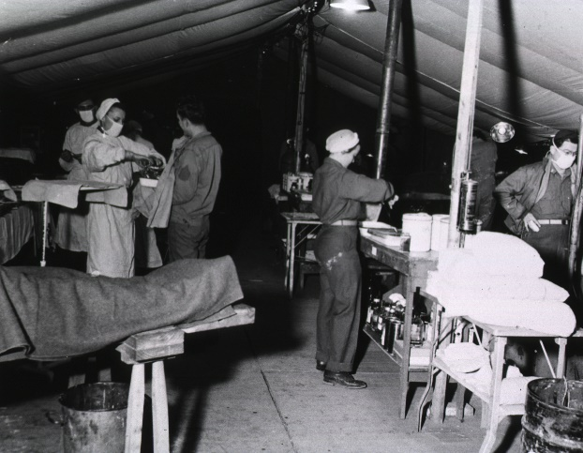
A Culture to Care: Filipino American Healthcare Professionals in Virginia
U.S. Healthcare Arena from WWII to the Great Society: 1941-1965
Question for consideration: What events in the U.S. healthcare stimulated the migration of Filipino healthcare professionals?
During the Second World War, the United States faced a critical nursing shortage with the need for nurses at the frontlines and at the home front. The need became so great that racial boundaries were broken in nursing. In 1943, the Bolton Act established the Cadet Nurse Corps to meet the demands of war by funding state-accredited programs that could shorten the length of nursing education from thirty-six to thirty months. The corps was inclusive of all races and genders, producing over 124,000 white nurses and 3,000 African American nurses. By 1950, the American Nurses Association had officially desegregated.
As science and technology progressed throughout the early twentieth century, Americans were living longer and the complexity of care increased. Thus, American health policy centered around hospitals. In 1946, the Hill-Burton Act supplied federal money greater than $75,000,000 over a five year period to expand the construction of hospitals around the country. This exponentially increased the need for healthcare professionals around the country as hospitals rapidly proliferated during the mid-century.
Notes:
During the Second World War, the United States faced a critical nursing shortage with the need for nurses at the frontlines and at the home front. expansion of hospitals, increased acuity of patients, and higher insurance coverage of American citizens. Concurrently, the Philippines had an overabundance of nurses and suffered from high rates of nurse unemployment. This was related to the inability of the relatively agrarian Filipino economy to employ highly skilled professional nurses. The intersectionality of these events together with American nursing recruitment policies created the perfect environment for the eventual migration of Filipino nurses at the turn of the century.
Maria C. Jereos, “Supply and Demand of Nurses,” Philippine Journal of Nursing, 47, no. 1 (1978): 3-5; Choy, Empire of Care.
September 21, 1946
THE HOSPITAL SURVEY AND CONSTRUCTION ACT
JAMA. 1946;132(3):148-149. doi:10.1001/jama.1946.02870380030010

Slide 10
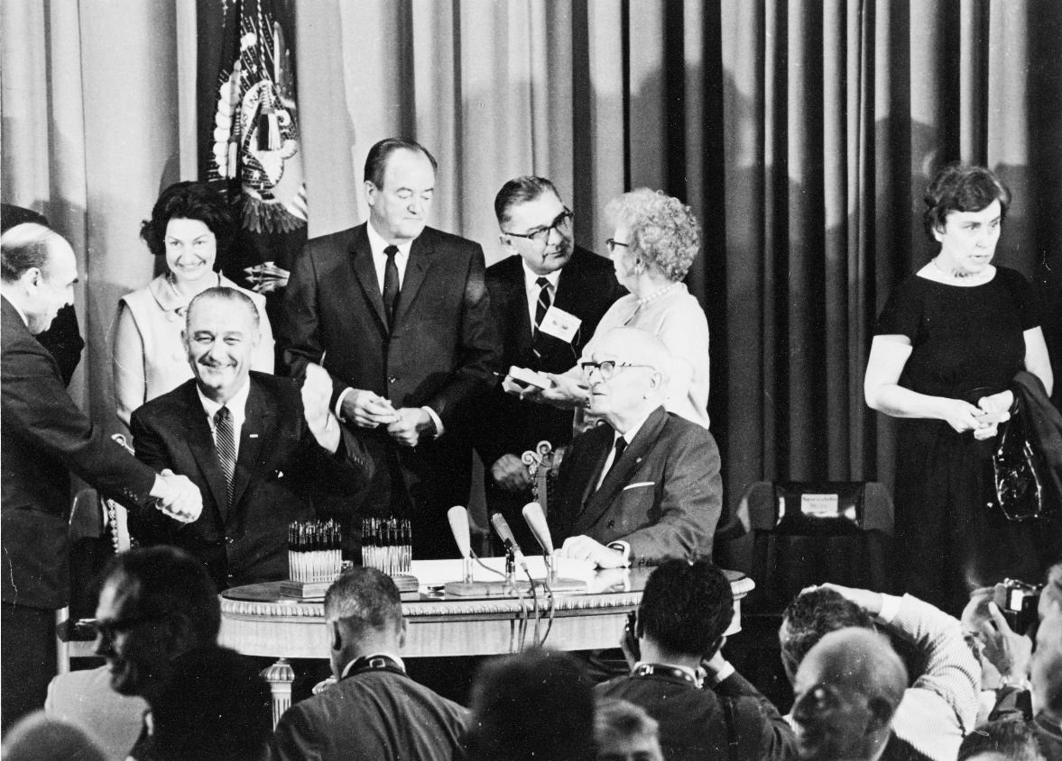
A Culture to Care: Filipino American Healthcare Professionals in Virginia
U.S. Healthcare Arena from WWII to the Great Society: 1941-1965
In 1965, significant healthcare and migration legislation were passed. Under President Lyndon B. Johnson’s “Great Society” reforms, the passage of Medicare and Medicaid increased insurance coverage and access to healthcare. It also required hospitals receiving federal funding to be in compliance with the Civil Rights Act of 1964 Title VI provision. This enforced the desegregation of hospitals and enabled physicians of color admitting privileges in formerly white-controlled hospitals.
More patients receiving care required more healthcare professionals. The Hart-Cellar Act, or Naturalization and Immigration Act of 1965, abolished the national origins quota system that favored European immigrants and implemented a preference system that allowed immigrants who possessed education, skills, and filial relationships to come to the United States. Because of the introduction of professional medicine and nursing into the Philippines at the start of the century, many Filipinos who traveled to America after 1965 were healthcare professionals.
Lyndon B. Johnson during the signing of the Medicare bill, July 30, 1965.

Slide 11
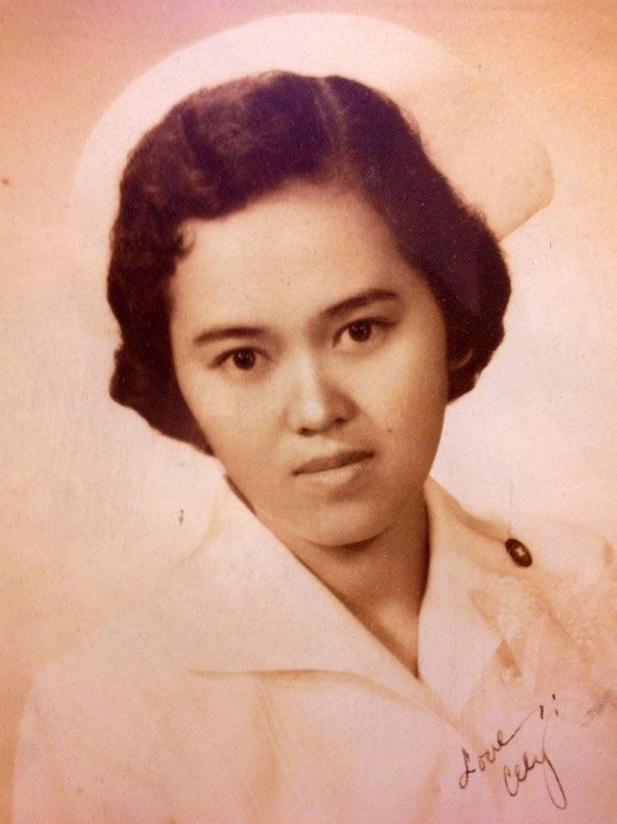
A Culture to Care: Filipino American Healthcare Professionals in Virginia
Migration of Filipino Healthcare Professionals to the Commonwealth
Question for consideration: How were Filipino healthcare professionals impacted by American social boundaries and how did they move around them?
In 1948, the United States created the Cold War-era Exchange Visitor Program (EVP) which was originally sponsored by the American Nurses Association. U.S. hospitals sponsored visiting nurses and provided them with temporary visas and expectations to further their education. The Program required participants to return to their home country after two years. Many visiting nurses were often exploited, primarily worked in urban hospitals with poor staffing, and usually scheduled for shifts deemed undesirable by American nurses. Despite the need for more nurses, the employment of a temporary Filipino nurse workforce was ideal because it enabled hospitals to maintain segregation by not hiring permanent black nurses prior to 1965. Initial sponsorships came primarily from European countries, and then later, the Philippines. Under this program, the first mass migration of Filipino nurses began in 1951, and by the late 1960’s, Filipinos constituted the majority of exchangees. By 1973, more than 12,000 Filipino nurses had entered the United States through the EVP.
Araceli Marcial had arrived in 1960 through the EVP at Newark, New Jersey, before settling in Hampton Roads with her naval husband in 1970. She would then become the founding president of the Philippine Nurses Association of Virginia. After more than sixty years of nursing experience shared between the Philippines and the United States, Marcial, continues to further nursing’s professionalization by working as the Abbott Education Center’s program director and teaching students, especially expatriates, to become nurse’s aides and the art of nursing.
Notes:
The first mass migration of Filipino nurses began in 1951 with the Exchange Visitor Program (EVP), and by the late 1960’s, Filipinos constituted the majority of exchanges. By 1973, more than 12,000 Filipino nurses had entered the United States through the EVP.
Cited in Roger Daniels, Guarding the Golden Door: American Immigration Policy and Immigrants since 1882 (New York: Hill and Wang, 2004), 165.

Slide 12
A Culture to Care: Filipino American Healthcare Professionals in Virginia
Migration of Filipino Healthcare Professionals to the Commonwealth
In 1970, the United States amended H-1 occupational visas’ temporary status to one of permanent employment to accommodate the needs of hospitals. This provided former visiting nurses and Filipino nurses opportunities for permanent employment and American citizenship. Philippine President Ferdinand Marcos’ supported the migration of Filipino nurses and the commodification of nursing to increase the country’s gross domestic product. This is depicted in his 1973 address to the Philippine Nurses Association:
“We intend to take care of [Filipino nurses] but as we encourage this migration, I repeat, we will now encourage the training of all nurses because as I repeat, this is a market that we should take advantage of. Instead of stopping the nurses from going abroad why don’t we produce more nurses? If they want one thousand nurses we produce a thousand more.”

Slide 13
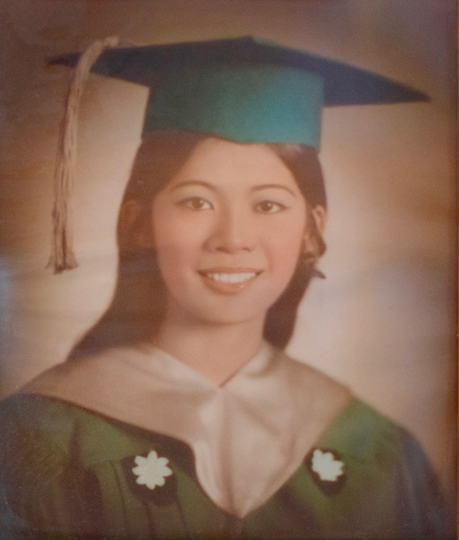
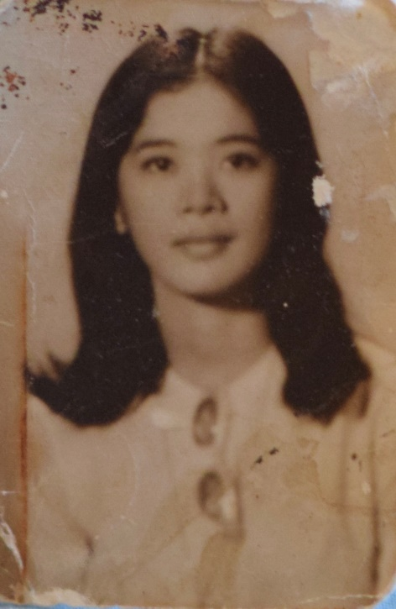
A Culture to Care: Filipino American Healthcare Professionals in Virginia
Migration of Filipino Healthcare Professionals to the Commonwealth
Estelita Davis had left for the United States with an H-1 visa the day prior President Marcos declared martial law. She accepted her first employment offer from Anniston Memorial Hospital in Alabama and worked there for fourteen months. At the time it was also commonplace for nurses to give up their seats to doctors. However, on one occasion, a nurse reminded her to relieve her seat, but she refused, stating, “In the Philippines, we are on equal footing with the doctors because we take care of patients together.” During lunch in the cafeteria, she was expected to sit with the white nurses versus the black ancillary staff. Before leaving her position, her black nurse’s aide apologized for being discriminatory from the fact that a foreigner came to America with a good job. On her way to a new position in New Jersey, she visited her cousin in Charlottesville and worked as an interim nurse at the University of Virginia hospital before deciding to settle in Virginia. For a while, she worked at the South Boston Hospital as the night nursing supervisor. She recollects only two nurses were qualified to become the hospital’s director of nursing, but a Filipino anesthesiologist warned her, “even if you are the most qualified…because how this place is run, you wouldn’t get the position.”
The post-1965 mass migration of Filipino Americans increased their visibility, especially in the U.S. healthcare system. Although hospitals desegregated and enabled equal privileges to healthcare providers, Filipinos often struggled with their place in the U.S.’ black-and-white dichotomy and adapting to the hospital hierarchy. Some were unaware they were facing racism due to coming from a mostly homogenous country. The struggles they endured forged resiliency. Through hard work and determination, many proved themselves to be excellent clinicians. However, in the United States, despite sedulous work ethics, racial barriers often prevented them from obtaining high ranking positions.

Slide 14
A Culture to Care: Filipino American Healthcare Professionals in Virginia
Migration of Filipino Healthcare Professionals to the Commonwealth
Filipino physicians migrated to the United States in parallel to nurses. Many traveled for medical residencies at healthcare institutions across the country.
Juan Montero began a general surgery residency at DePaul Hospital in Norfolk, Virginia on June 27, 1966 and later started a fellowship in thoracic surgery at the University of Virginia. Through his work as a physician, he has affected healthcare from the local to global levels. In 1978, he became the founding president of the Philippine Medical Association of Southeastern Virginia and later later became the 1983 president of the Association of Philippine Physicians in America. In 1992, he founded Chesapeake Care, a free and comprehensive clinic that provides an alternative to expensive emergency room and primary care visits for medical and dental care. Through 2017, the clinic had served 2,118 patients in South Hampton Roads. Montero Medical Missions began in 2011 as Montero’s most recent venture to solve healthcare disparities and stems from his humanitarian works as a member of Physicians of Peace. His organization provides local volunteering and global medical missions for interested expatriate healthcare professionals to give back to their respective countries and create sustainable healthcare projects.

Slide 15
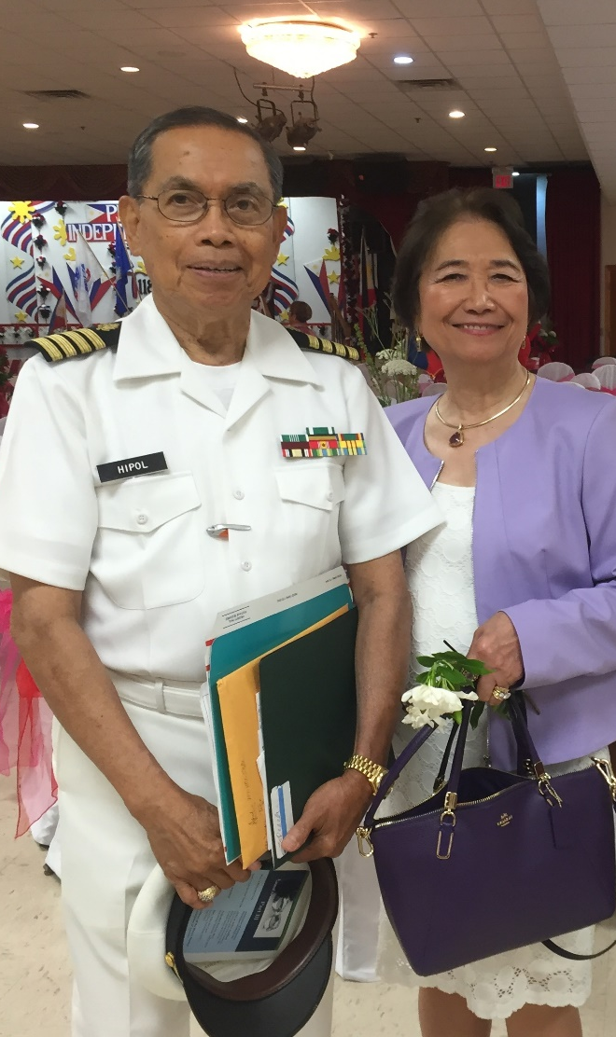
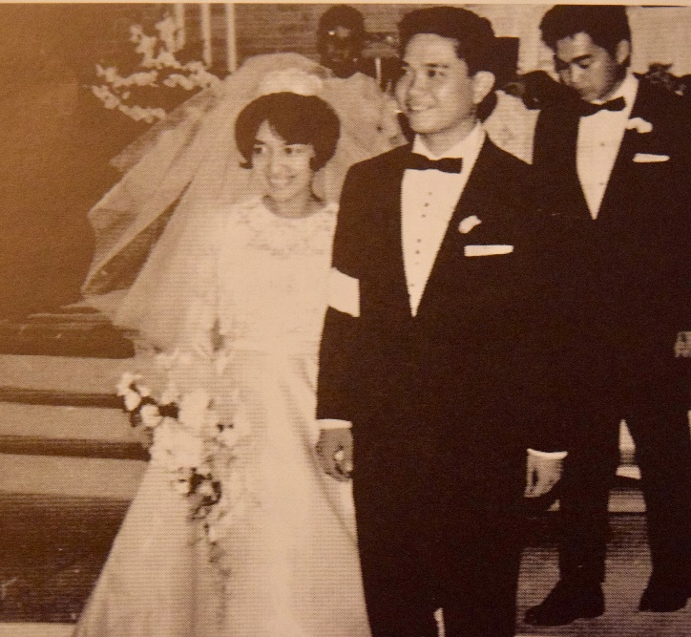
A Culture to Care: Filipino American Healthcare Professionals in Virginia
Migration of Filipino Healthcare Professionals to the Commonwealth
Hampton Roads exhibits a unique case study and intersection between health and military policies that affected the migration of Filipino healthcare professionals. Specifically, both nursing and naval service embedded themselves into Philippine culture. As the American healthcare model was introduced into the Philippines, so too did the U.S. Navy begin recruiting Filipino men in ancillary roles. Naval Station Norfolk can be primarily attributed to the large Filipino American and healthcare professional community in the surrounding area. Many Filipino pioneers of Hampton Roads consisted of relationships between nurses and naval servicemen. After the initial arrival of professionals and servicemen, the importance of family and community fueled the chain migration of Filipinos to the Tidewater region.
Manuel Hipol came to the United States as a medical resident before being drafted into the U.S. Army and becoming an American citizen. He later switched service to the Navy due its prominence in the Philippines. He was then stationed in Naval Station Norfolk and worked as a radiologist at Portsmouth Naval Regional Medical Center. In 1976, he helped foster a strong Filipino American community in Hampton Roads as a founding member of the Council of United Filipino Organizations of Tidewater, serving as its first chairman. In 2000, the construction of the Philippine Cultural Center of Virginia, the largest Philippine center in the United States at the time, was completed. Currently, it is the only Philippine center that is purely owned by the Filipino American community.
Rebecca and Frodelio Tolentino, a nurse and a sailor respectively, married in Philadelphia in 1965 before settling in Hampton Roads.

Slide 16
Appendix A: Registered Nurses and Population by Race/Ethnicity

Slide 17
UNITED STATES RN WORKFORCE, 2016
Notes:
https://datausa.io/profile/soc/291141/

Slide 18
VIRGINIA RN WORKFORCE, 2016
Notes:
https://www.dhp.virginia.gov/hwdc/docs/Nursing/0001RN2016.pdf

Slide 19
CALIFORNIA RN WORKFORCE, 2016
*The California Board of Registered Nursing has the only survey that differentiates Filipino Nurses from other Asian Nurses.
Notes:
https://www.rn.ca.gov/pdfs/forms/survey2016.pdf

Slide 20
Appendix B: Demographic and Employment Characteristics of New Entrants to the U.S. RN Workforce: U.S. Census 1990 and 2000

Slide 21
U.S.-TRAINED NURSES
Demographic Characteristic | 1990 Census | 2000 Census
New Entrants, Weighted Number | 427,875 | 344,803
Mean Age | 27.5 | 27.5
Men, % | 5.8 | 9.9
Race, %
White | 89.6 | 83.6
Black | 7.0 | 8.2
Asian | 2.0 | 4.3
Other | 1.4 | 3.9
Education, %
Associate’s | 40.4 | 35.7
Bachelor’s | 48.2 | 54.3
Master’s or Above | 11.4 | 10.0
Employment Characteristic | 1990 Census | 2000 Census
Mean U.S. Work Experience, Years | 6.2 | 6.1
Mean Total Work Experience, Years | 6.2 | 6.1
Mean Income, $ | 32,776 | 32,931
Hours Worked per Year | 1764 | 1782
Setting, %
Hospital | 79.8 | 72.2
Nursing Home | 4.1 | 6.6
Other | 16.0 | 21.3
Notes:
https://www.ncbi.nlm.nih.gov/pmc/articles/PMC1854875/

Slide 22
FOREIGN-TRAINED NURSES
Demographic Characteristic | 1990 Census | 2000 Census
New Entrants, Weighted Number | 41,374 | 62,066
Mean Age | 35.0 | 37.0
Men, % | 8.6 | 14.2
Race, %
White | 23.3 | 30.1
Black | 13.5 | 16.1
Asian | 60.5 | 48.7
Other | 2.7 | 5.1
Education, %
Associate’s | 30.8 | 32.2
Bachelor’s | 55.8 | 57.1
Master’s or Above | 13.3 | 10.7
Employment Characteristic | 1990 Census | 2000 Census
Mean U.S. Work Experience, Years | 4.4 | 5.4
Mean Total Work Experience, Years | 13.4 | 15.5
Mean Income, $ | 40,273 | 43,703
Hours Worked per Year | 1862 | 1898
Setting, %
Hospital | 83.4 | 63.8
Nursing Home | 6.3 | 17.5
Other | 10.3 | 18.7
Notes:
https://www.ncbi.nlm.nih.gov/pmc/articles/PMC1854875/

Slide 23
Appendix C: Filipino American Communities and U.S. Naval Bases

Slide 24
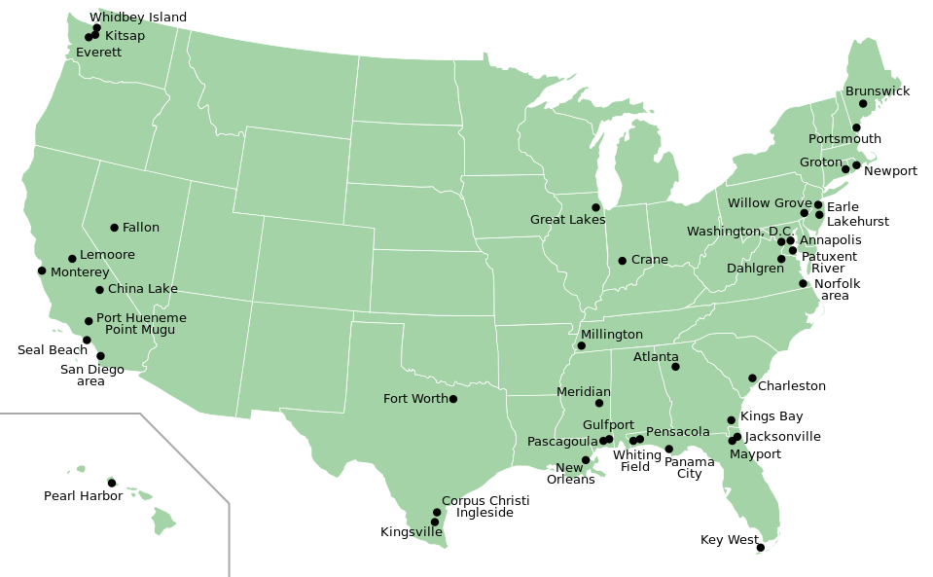
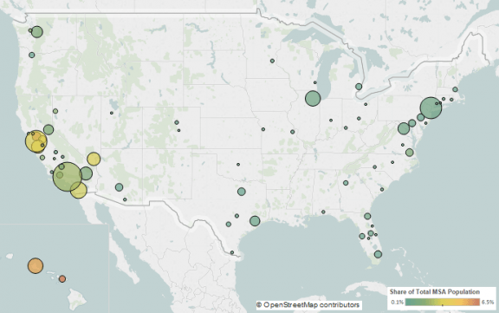
TOP METROPOLITAN DESTINATIONS FOR
FILIPINO IMMIGRANTS IN THE U.S.,
2009-2013
U.S. NAVAL BASES

Slide 25
Sources
“Address of His Excellency, President Ferdinand E. Marcos.” Philippine Journal of Nursing 43 (January-March 1974): 13-26.
Anderson, Warwick. Colonial Pathologies: American Tropical Medicine, Race, and Hygiene in the Philippines. Durham, NC: Duke University Press, 2006.
Baldoz, Rick. The Third Asiatic Invasion: Migration and Empire in Filipino America, 1898-1946. New York: NYU Press, 2011.
Bergano, Allan. Interview by Reynaldo Capucao, Jr., July 26, 2018.
Brush, Barbara. “Sending for Nurses: Foreign Nurse Immigration to American Hospitals, 1945-1980.” PhD diss., University of Pennsylvania, 1994. 104. https://repository.upenn.edu/dissertations/AAI9521006.
Capucao, Jolly. Interview by Reynaldo Capucao Jr., October 22, 2017.
Choy, Catherine Ceniza. Empire of Care: Nursing and Migration in Filipino American History. Durham, NC: Duke University, Press, 2003.
Davis, Estelita. Interview by Reynaldo Capucao, Jr., July 20, 2018.
Data USA. “Registered Nurses.” Accessed July 26, 2018. https://datausa.io/profile/soc/291141/.
The Filipino American National Historical Society Hampton Roads Chapter, ed., In Our Aunties’ Words: The Filipino Spirit of Hampton Roads. San Francisco: T’boli Publishing and Distributor, 2004.
The Filipino American National Historical Society Hampton Roads Chapter, ed., In Our Uncles’ Words: We Fought for Freedom. San Francisco: T’boli Publishing and Distributor, 2006.
Friedman, Emily. “U.S. Hospitals and the Civil Rights Act of 1964.” Hospitals and Health Networks (June, 3, 2014): https://www.hhnmag.com/articles/4179-u-s-hospitals-and-the-civil-rights-act-of-1964.
Healthcare Workforce Data Center, ed., “Virginia’s Registered Nurse Workforce: 2017,” (October 2017): http://www.dhp.virginia.gov/hwdc/docs/Nursing/0001RN2017.pdf.

Slide 26
Sources
Jereos, Maria C. “Supply and Demand of Nurses.” Philippine Journal of Nursing, 47, no. 1 (1978): 3-5.
Keeling, Arlene, Kirchgessner, John C., & Hehman, Michelle C. History of Professional Nursing in the United States: Towards a Culture of Health. New York, NY: Springer Publishing, 2018.
Liu, John M., Ong, Paul M., & Rosenstein, Carolyn. “Dual Chain Migration: Post-1965 Filipino Migration to the United States.” The International Migration Review, 25, no. 3 (Autumn 1991): 487-513. http://www.jstor.org/stable/2546757.
Lynaugh, Joan E. & Brush, Barbara. American Nursing: From Hospitals to Health Systems. Cambridge, MA: Blackwell Publishers, 1996.
“Occupational Employment and Wages May 2017: 29-1141 Registered Nurses.” Bureau of Labor Statistics. Updated March 30, 2018, https://www.bls.gov/Oes/current/oes291141.htm.
Marcial, Araceli. Interview by Reynaldo Capucao, Jr.,” October 21, 2017.
Montero, Juan. Interview by Reynaldo Capucao, Jr., July 20, 2018.
Montero, Juan M. Halfway Through: An Autobiography. Indianapolis: The Philippine Heritage Endowment Publications, 1982.
Polsky, Daniel, Ross, Sara J., Brush, Barbara L., & Sochalski, Julie. “Trends in Characteristics and Country of Origin Among Foreign-Trained Nurses in the United States, 1900 and 2000.” American Journal of Public Health, 97, no. 5 (2007): 895-899. doi: 10.2105/AJPH.2005.072330.
Sotejo, Juliet V. “Status of Nursing in the Philippines. Philippine Journal of Nursing, 47, no. 1 (1978): 3-5.
Villanueva, Lydia A. “Our History: The Council of United Filipino Organizations of Tidewater, Virginia, Inc.” http://www.pcc757.com/pcc757/docs/OurHistory_by_LAVillanueva.pdf.
University of California, San Francisco, ed., “California Board of Registered Nursing: 2016 Survey of Registered Nurses.” (September 2017): https://www.rn.ca.gov/pdfs/forms/survey2016.pdf.

