Slide 1




Presentation for
Welcome to the Philippine Cultural Center of Virginia
Tuesday, 7 August 2018, 8:45-9:59 AM
In-House Content Academy
Born of Empires: Filipino Americans in the United States and Virginia, 1565 to the Present
Prepared by:
Cynthia C. Romero, MD, FAAFP
Chairman, CUFOT, Inc.
PCCVA – An Educational Resource
Sponsored by
The MacArthur Memorial

Slide 2
Philippine Cultural Center of Virginia- An Educational Resource
Objectives
Review history of the Council of United Filipino Organizations of Tidewater, CUFOT
Describe the historic construction and enduring existence of PCCVA
Discuss PCCVA as the hub of Filipino- American learning and education about the values, traditions and culture of the Philippines

Slide 3
Filipino Immigration to U.S.A.
After World War II Filipinos came
  as war brides to servicemen
  as recruits in armed forces
  as health care worker trainees
1965 Immigration Act removed national origin quotas
Labor migration for development
  Government, Military
  Economic, Educational
  Healthcare
-Migration Policy Institute

Slide 4
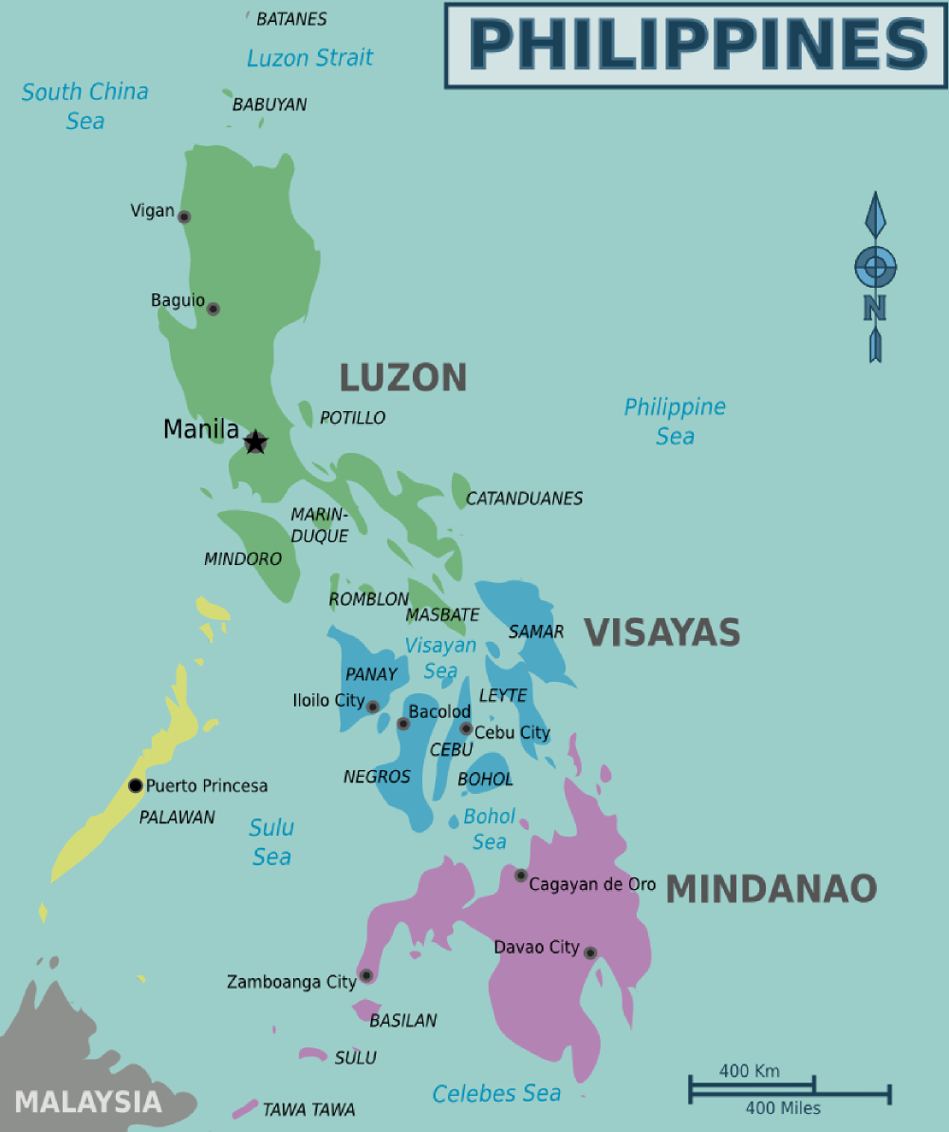

Slide 5
Filipinos in Hampton Roads formed organizations
Filipino Women’s Club of Tidewater in 1964
Professional
  American College of International Physicians
  Fil-Am Poastal Employees of Hampton Roads Association
  Philippine Nurses for Cultural Advancement
Philippine Regional and City
  Batangas Association of Hampton Roads
  Bataan Association
  Botolan Association
  Pampango Language Club
  Pangasinan Association of Virginia
  United Ilocano Association of Tidewater
Religious/Spiritual
  Holy Mary Mother of God
  Our Lady of Namacpacan
  Samahang Tagalog
Special Identities and for socialization
  Fil-Am Veterans of Hampton Roads (Seafarers)
  Fil-Am Bayanihan
  Kahirup Association
  Mrs. Philippines and Court Society
  United Fellowship Association
  United Ilocano Association of Tidewater, Seniors
  Young Filipino American Modern Dancers

Slide 6

Council of United Filipino Organizations of Tidewater established in 1976 as a 501C3 entity
Logo
  U.S. and Philippine Flags – 2 domiciles
  Map of Virginia – birthplace of CUFOT
  Firm Hand Clasp -friendship/cohesiveness
  Sampaguita flower- peace/purity
  Philippine Eagle- national bird; 6 feathers for founding organizations
  Manila rope- strength and unity

Slide 7
Council of United Filipino Organizations of Tidewater (CUFOT)
Established 1976; incorporated in 1979
Formed to unite Filipinos
Formed with mission to build a community center to showcase and perpetuate Filipino culture and traditions for future generations
School of Creative and Performing Arts (SCAPA) formed in 1982
Initial six organizations
  Batangas Assoc. of Hampton Roads, Bataan Assoc., Filipino Women’s Club of Tidewater
  United Ilocano Assoc. of Tidewater, Pampango Language Club, Seafarers

Slide 8
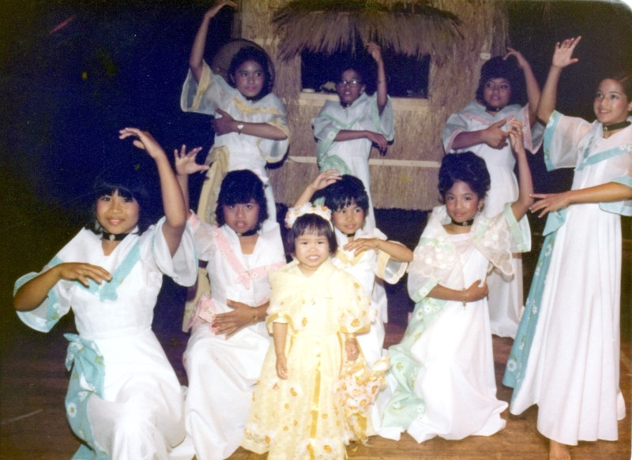

Slide 9
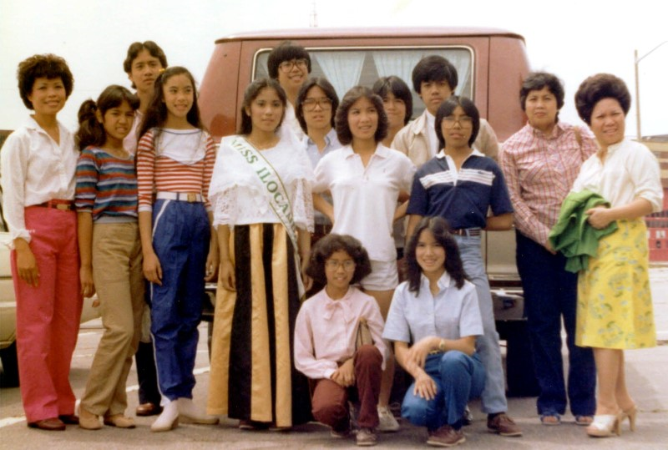

Slide 10
Envisioning PCCVA
Mrs. Philippines of Virginia contest launched as primary fundraiser
Member organizations held fundraisers then contributed to building fund
“Dollar-a-brick” and Millennium Tree campaigns started
Small house and property purchased

Slide 11
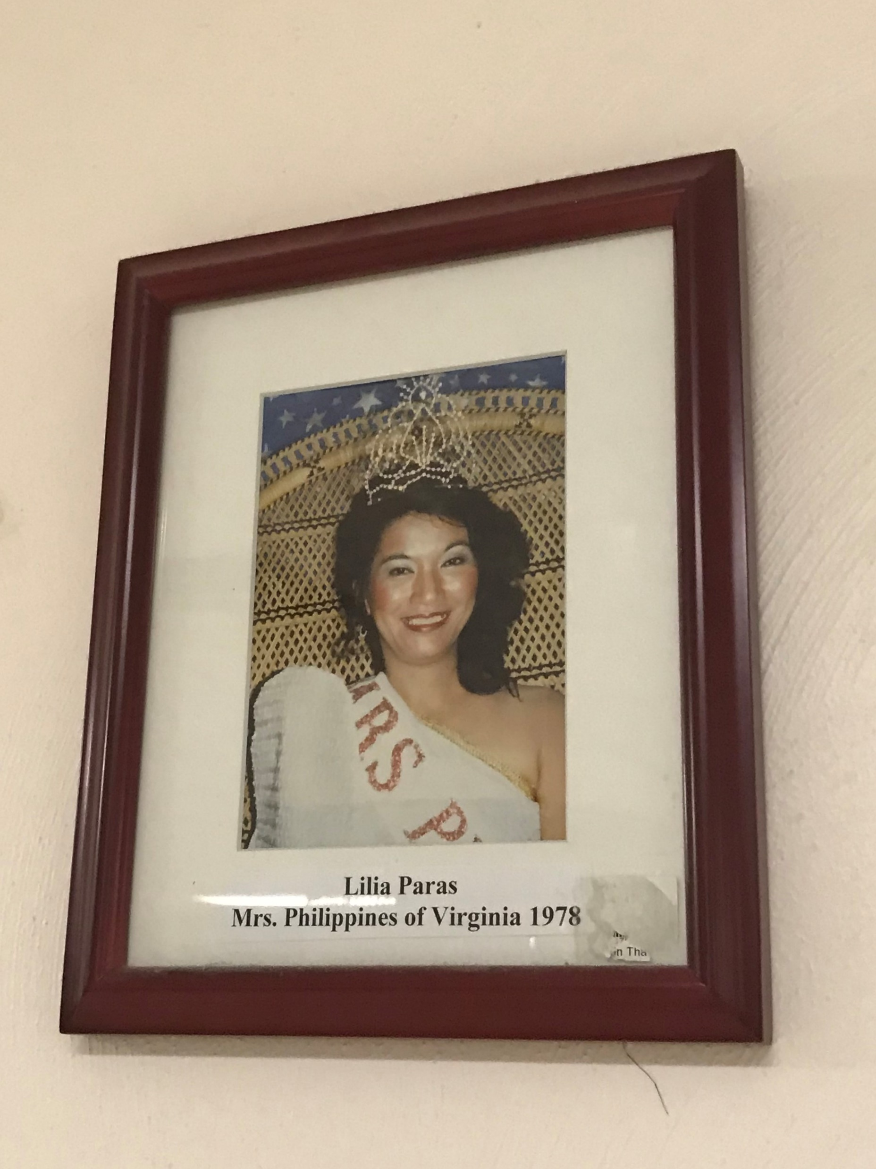

Slide 12
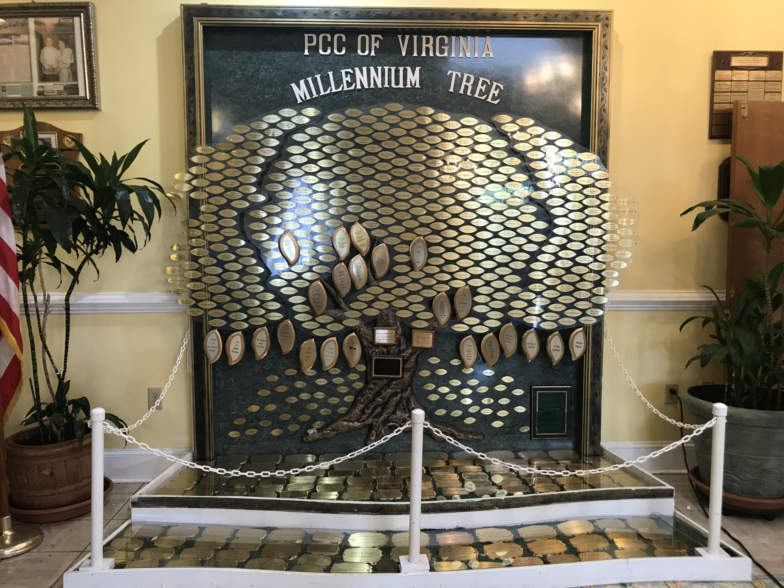

Slide 13
Board of Guarantors/Trustees
Initial 25-yr construction loan of $988,500
22 years of fundraising not close
32 families stepped forward and financially backed the initial loan
Loan paid off in 14 years
  Leadership of 32 BOT families
  Joint effort with Fil-Am community

Slide 14
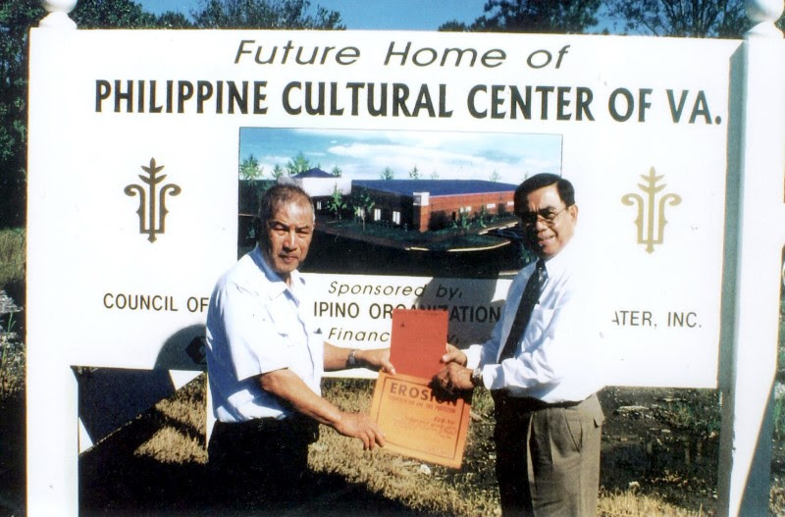

Slide 15
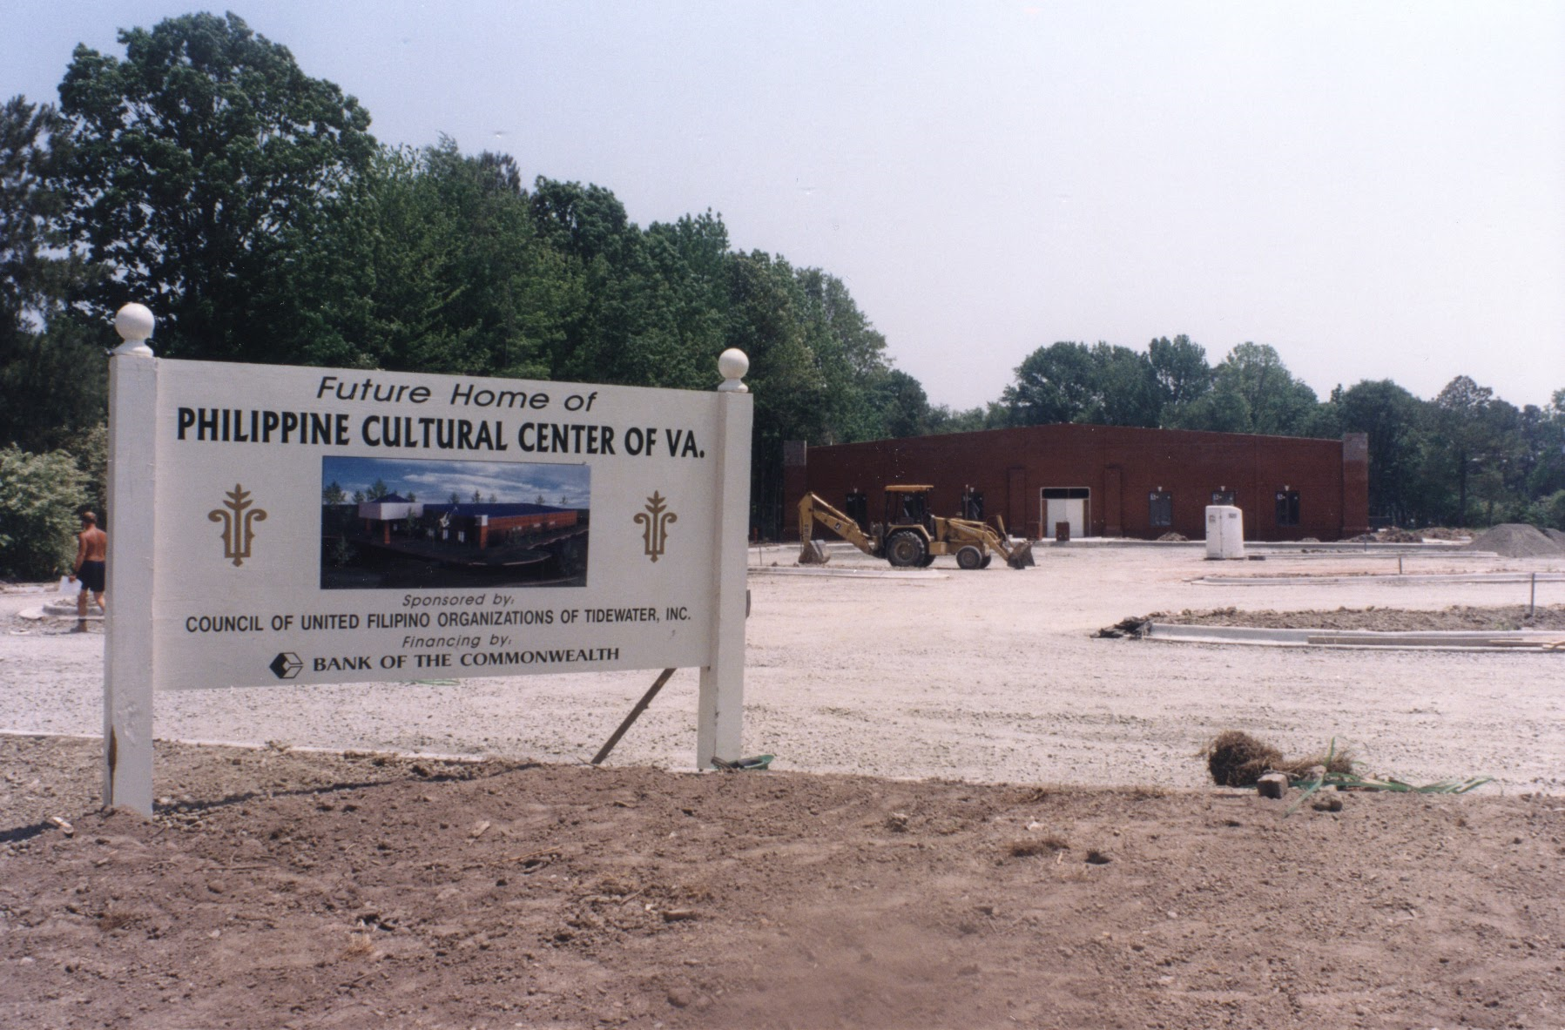

Slide 16
Philippine Cultural Center of Virginia (PCCVA)
Dream became a reality June 24, 2000
Operated and maintained by the
Fil-Am community
Place for Fil-Am activities
  Pageants
  Meetings
  SCAPA classes and performances
  Classes (zumba, Kuntaw – karate, rondalla)
Place for community events
  Receptions
  Celebrations

Slide 17
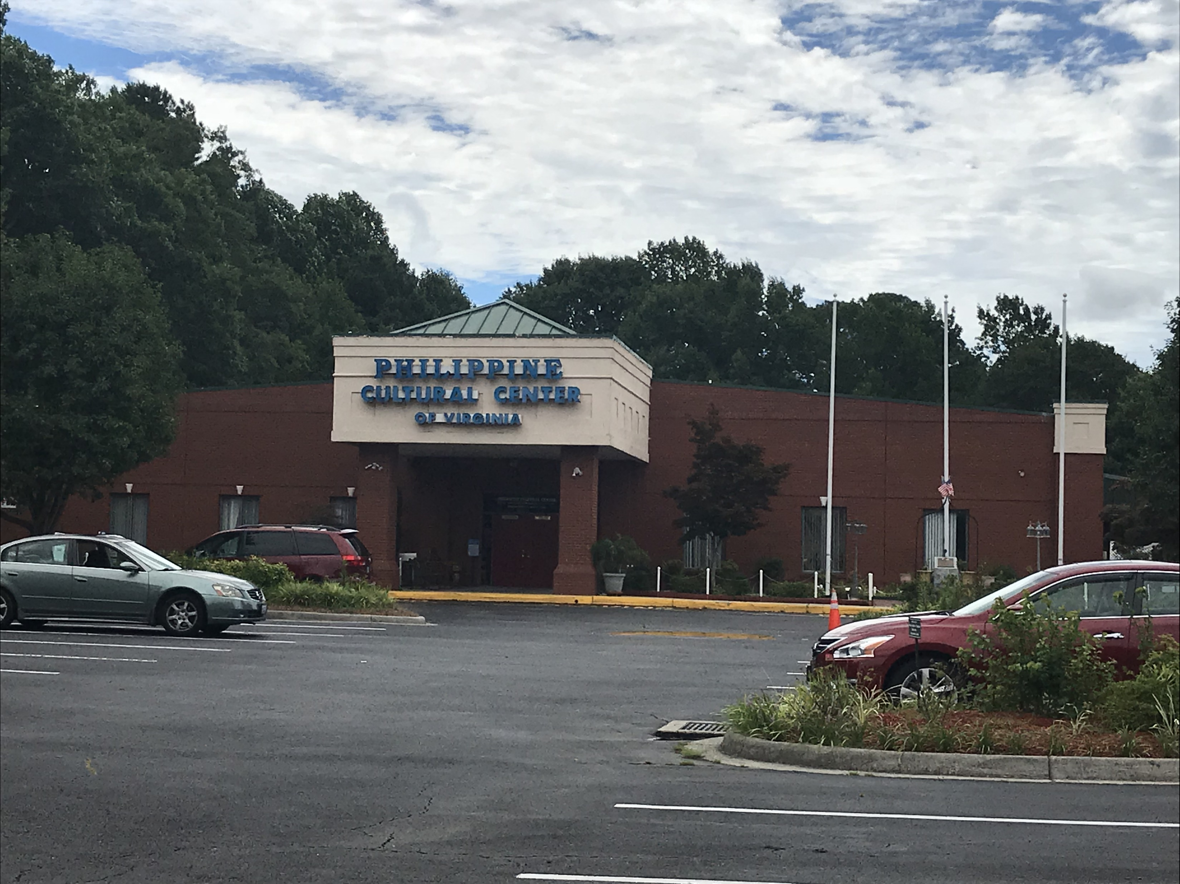

Slide 18
PCCVA as an
Educational Resource
Site of history
  Filipino immigrants’ journeys
  Resilience, determination and perseverance of Filipinos
  Birth and growth of the Filipino-American community of Hampton Roads

Slide 19
PCCVA as an
Educational Resource
Site of donated historical artifacts
  Wooden sculptures and statues
  Paintings and drawings
  Dr. Jose Rizal Library (named after Philippine national hero and physician)
    Original copy of “Noli Me Tangere” written in 1887
    Selected books from collection of Dr. Alex and Annie Fangonil

Slide 20
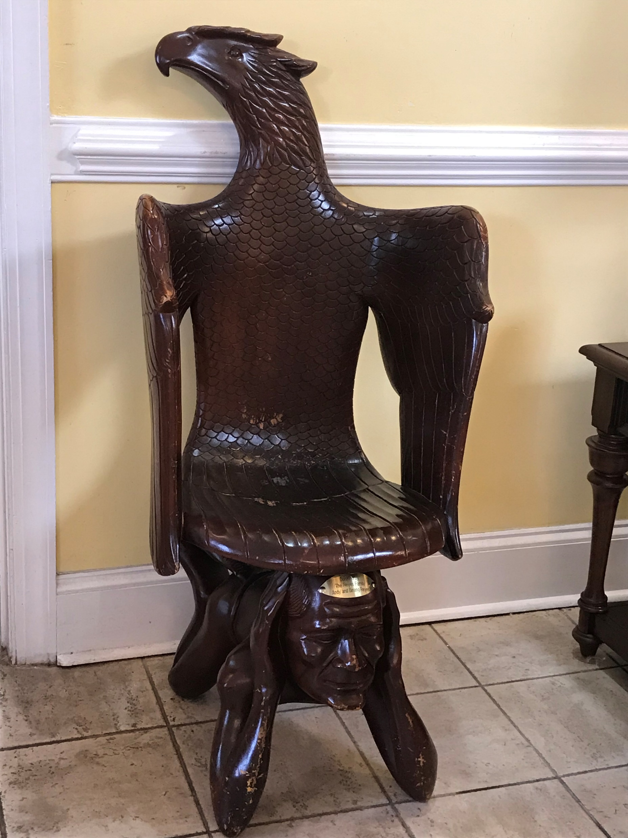
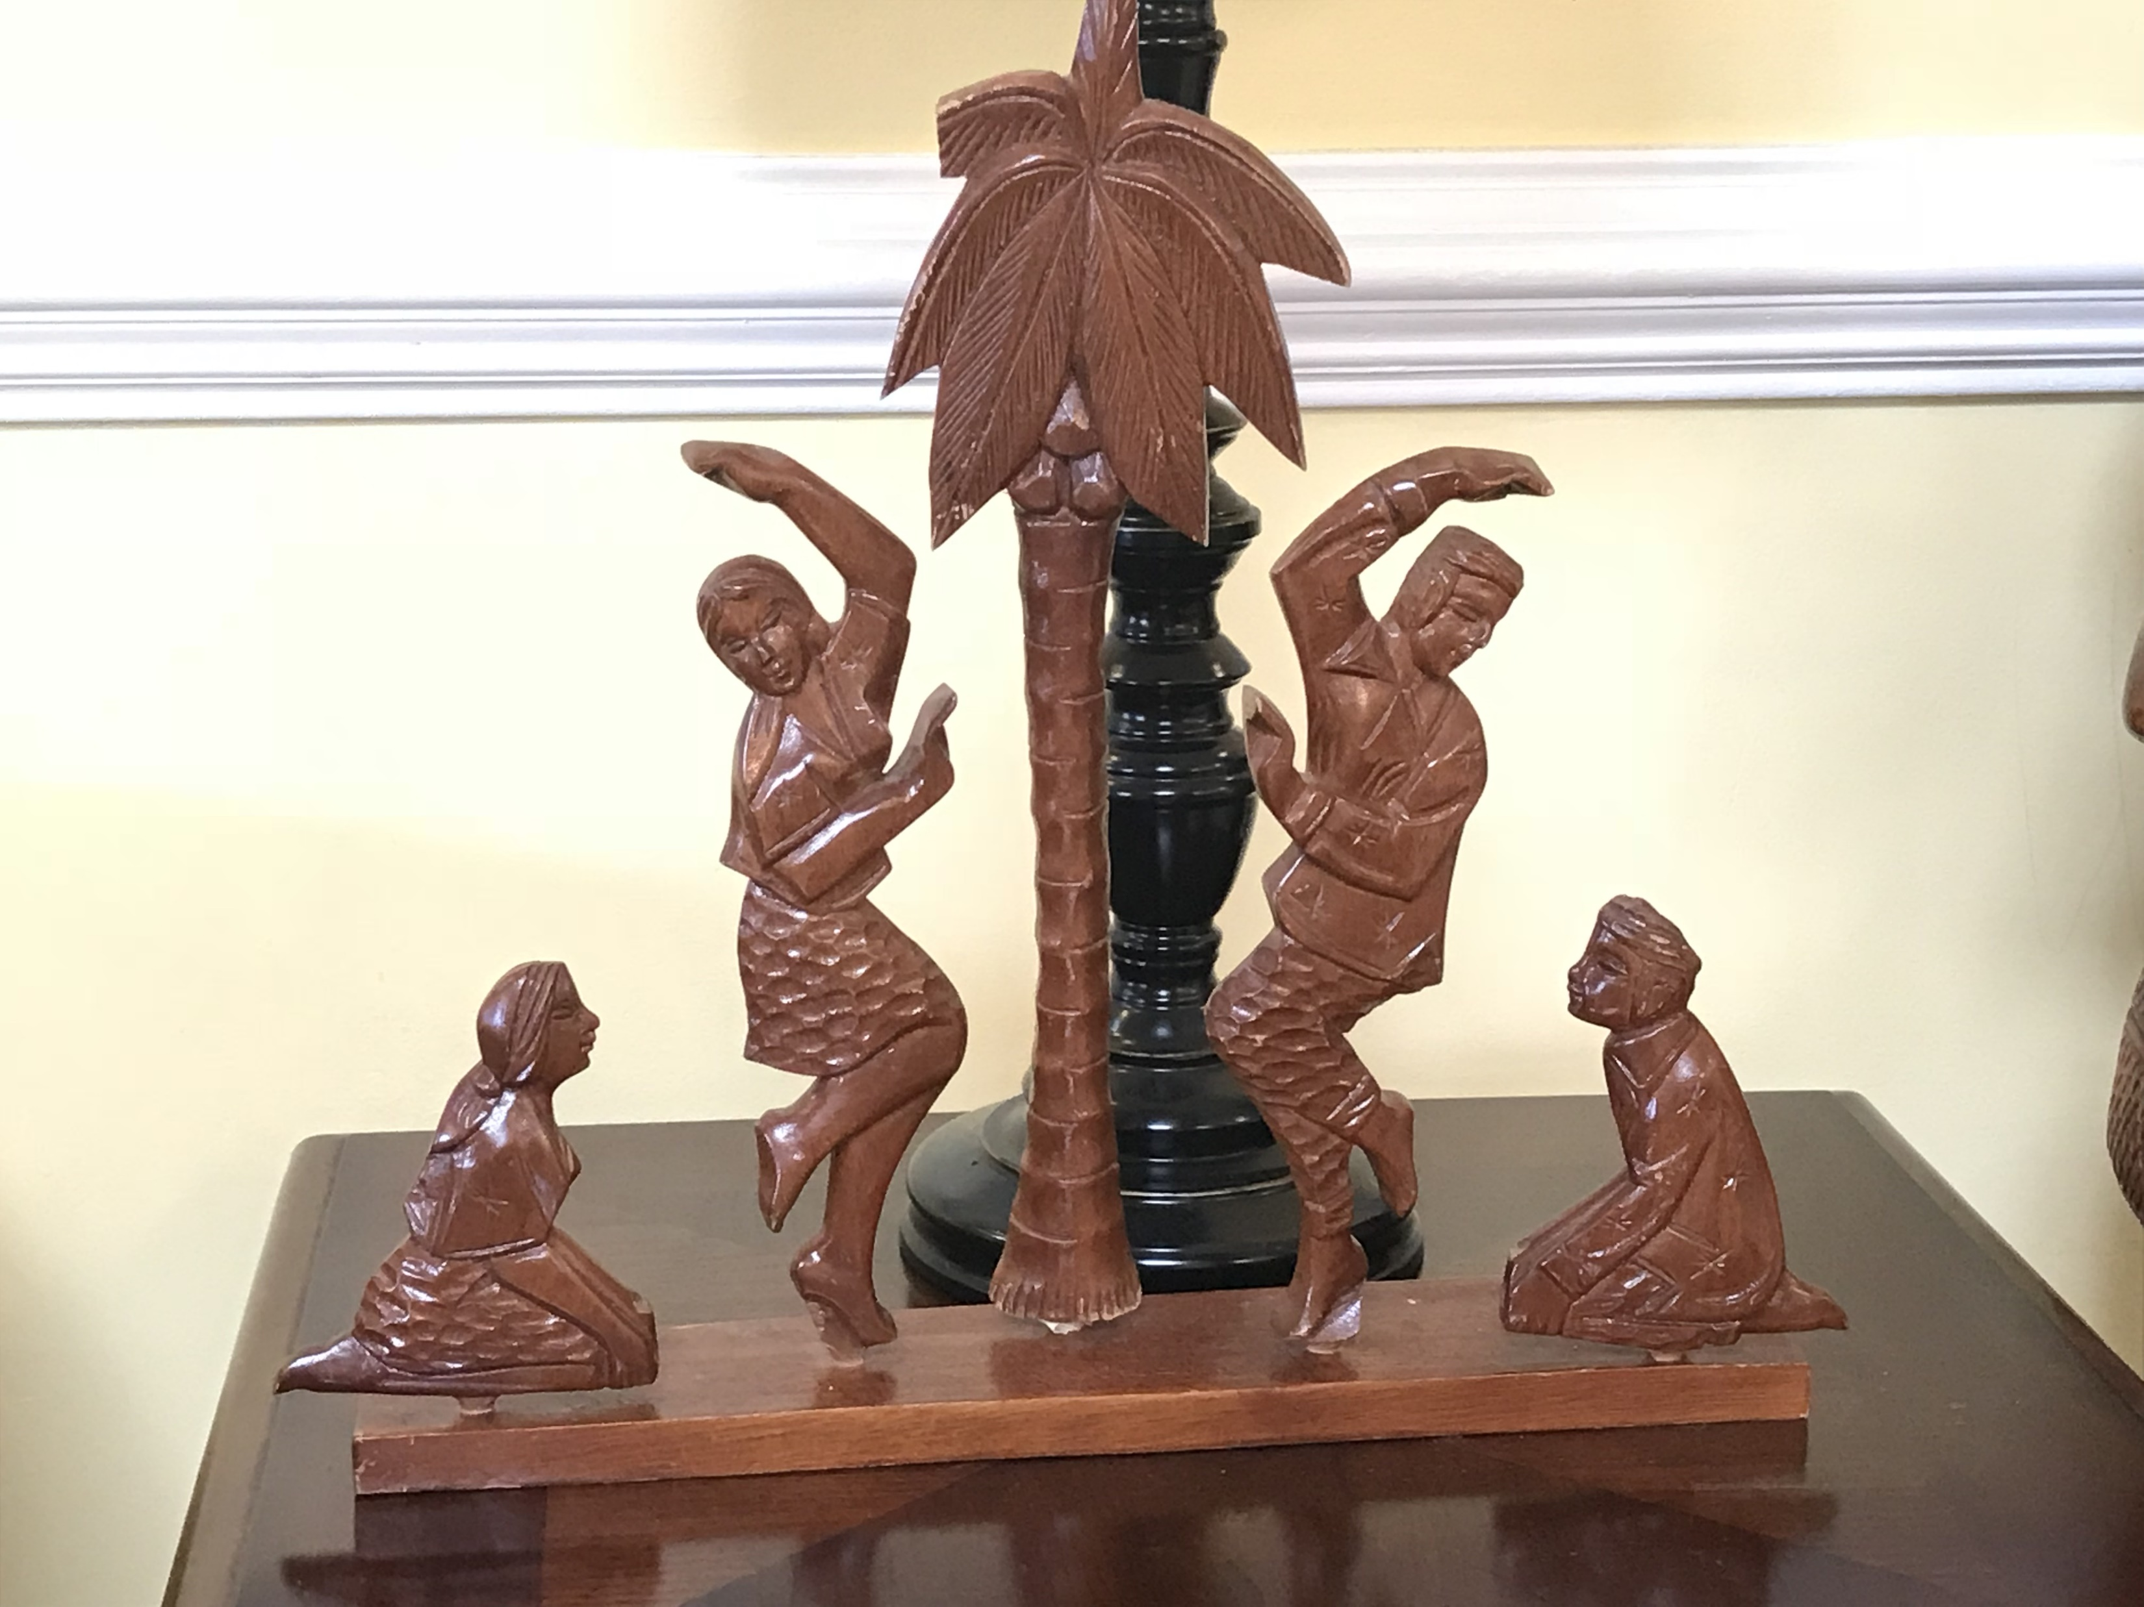
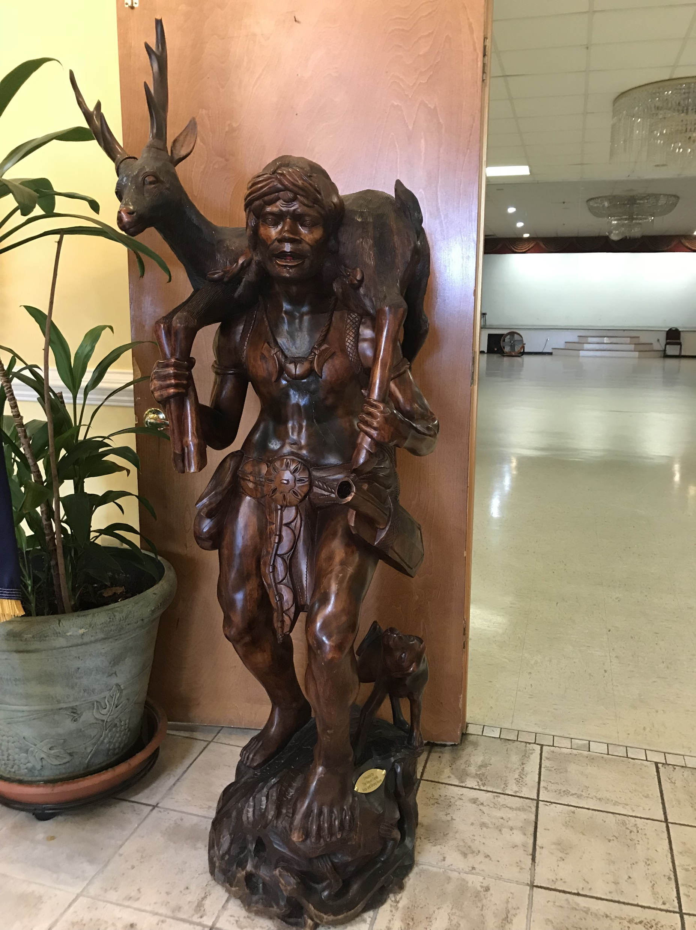

Slide 21
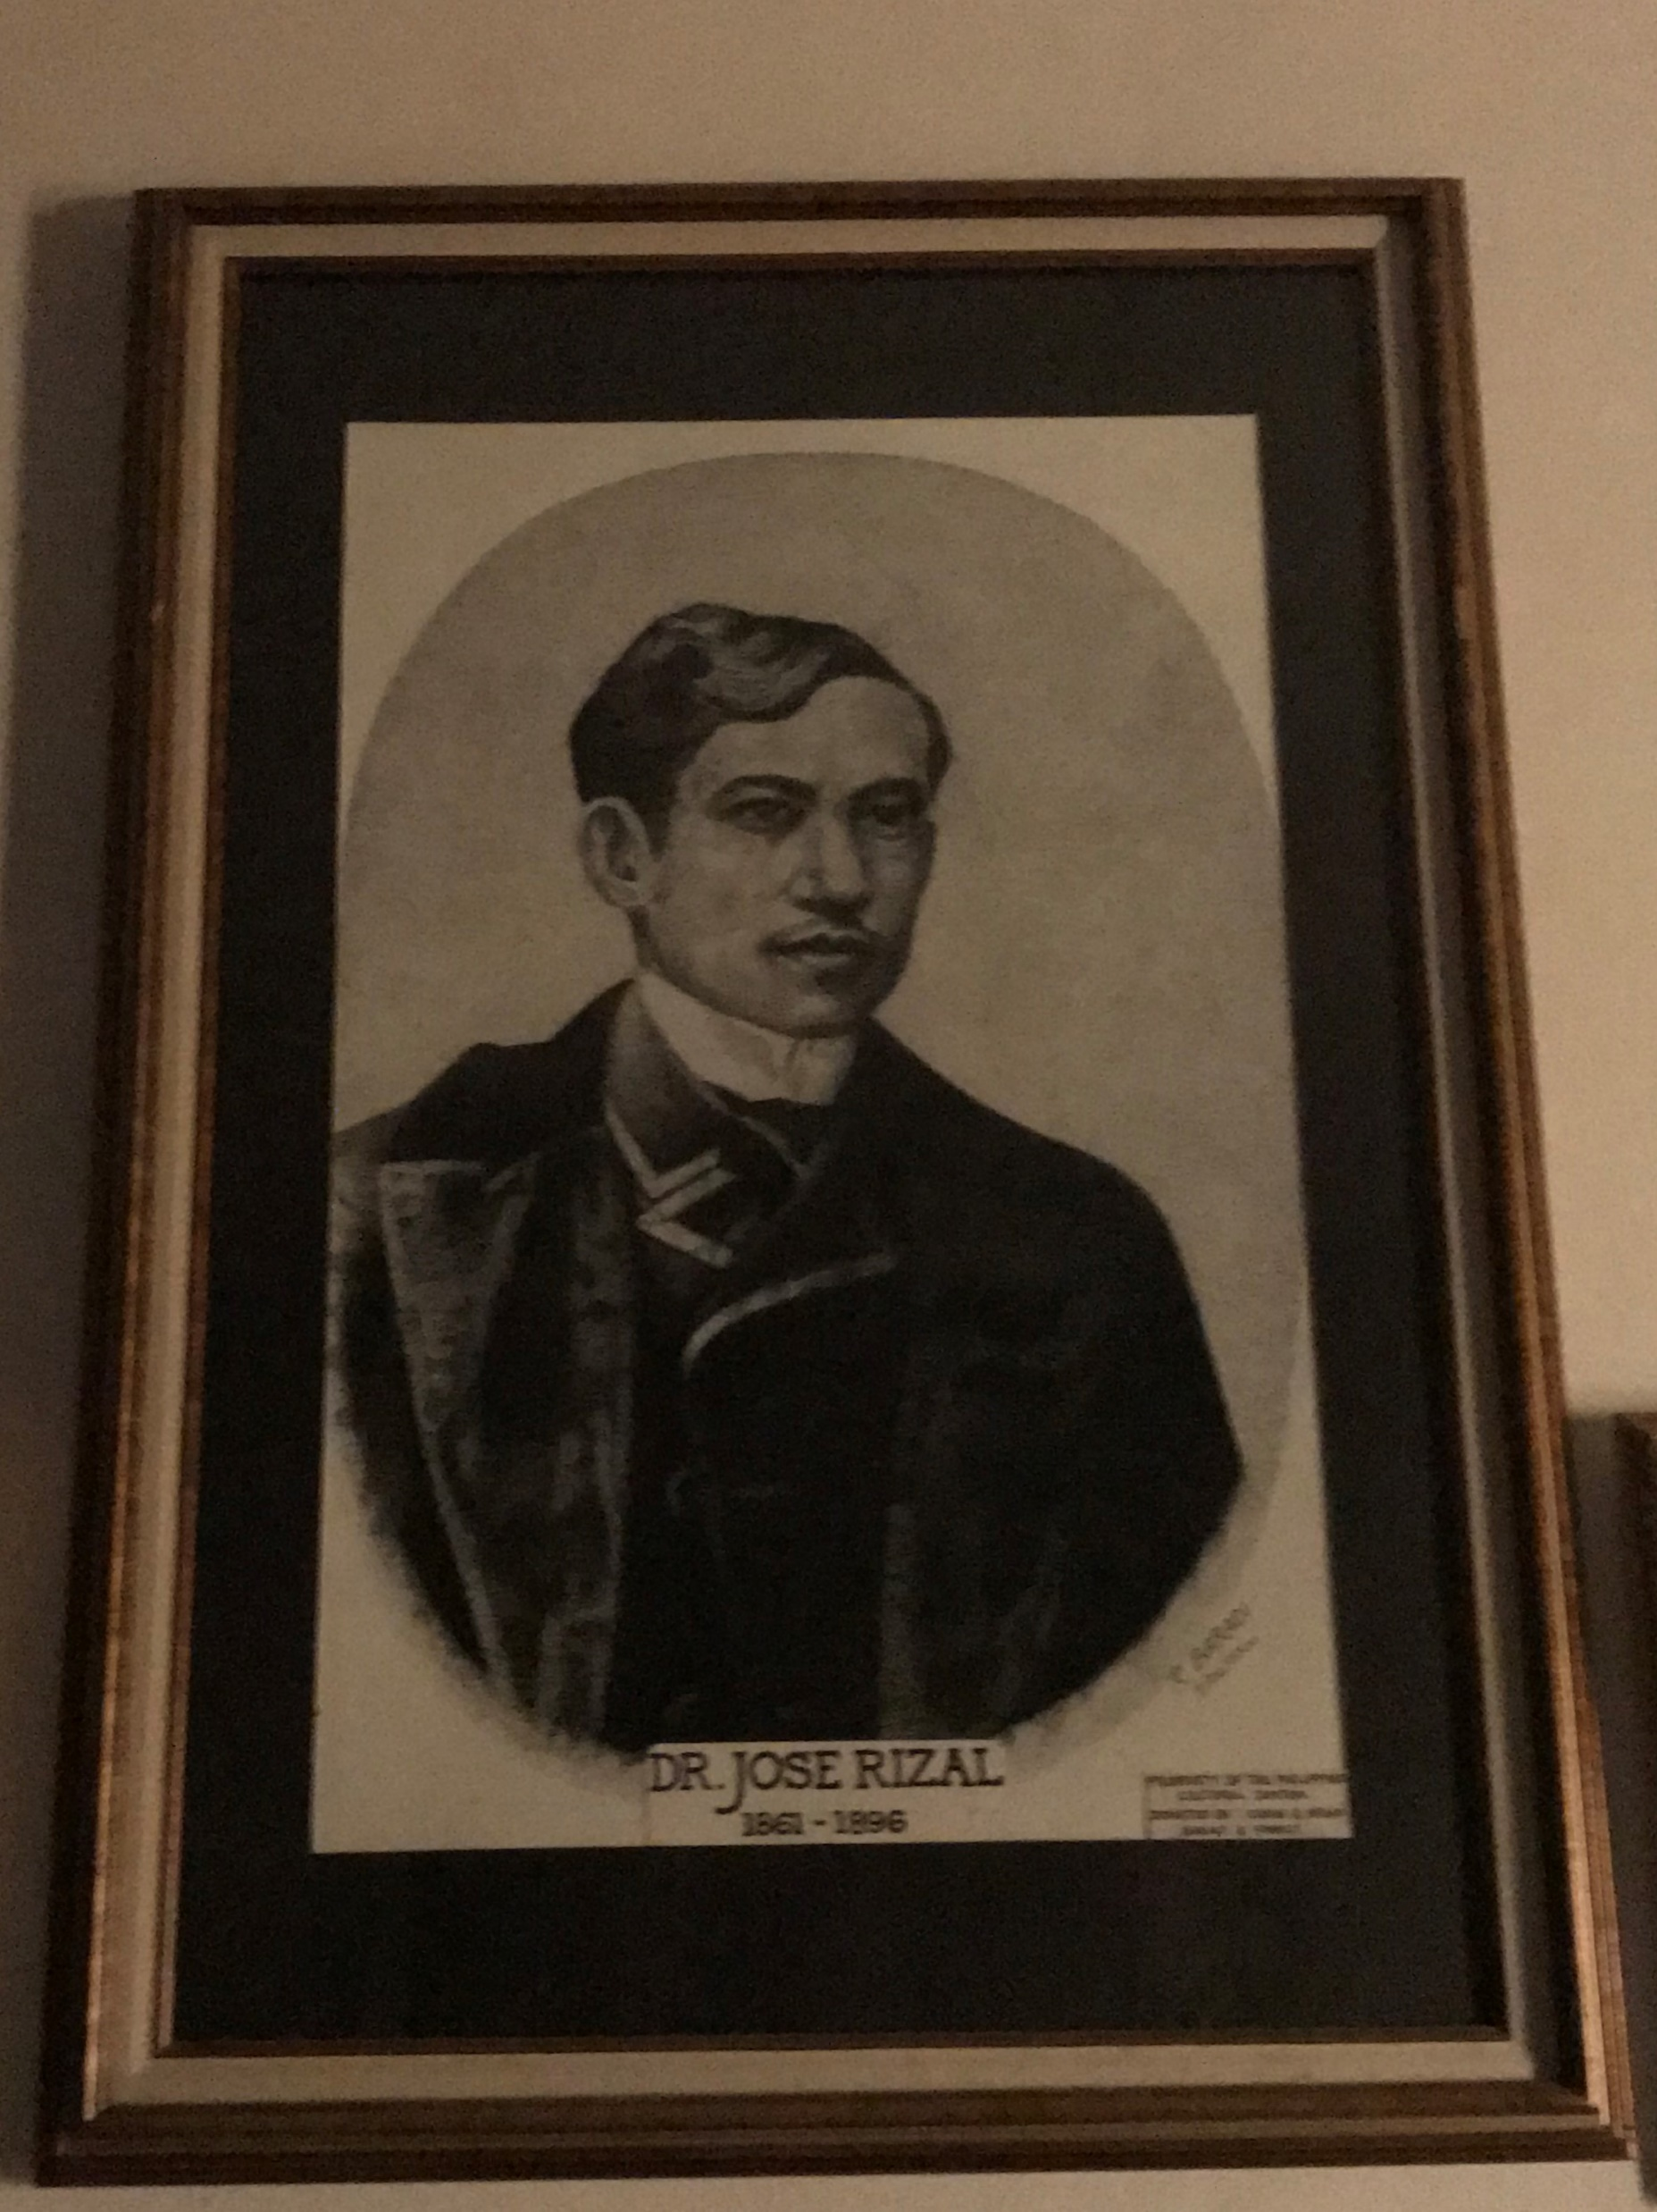
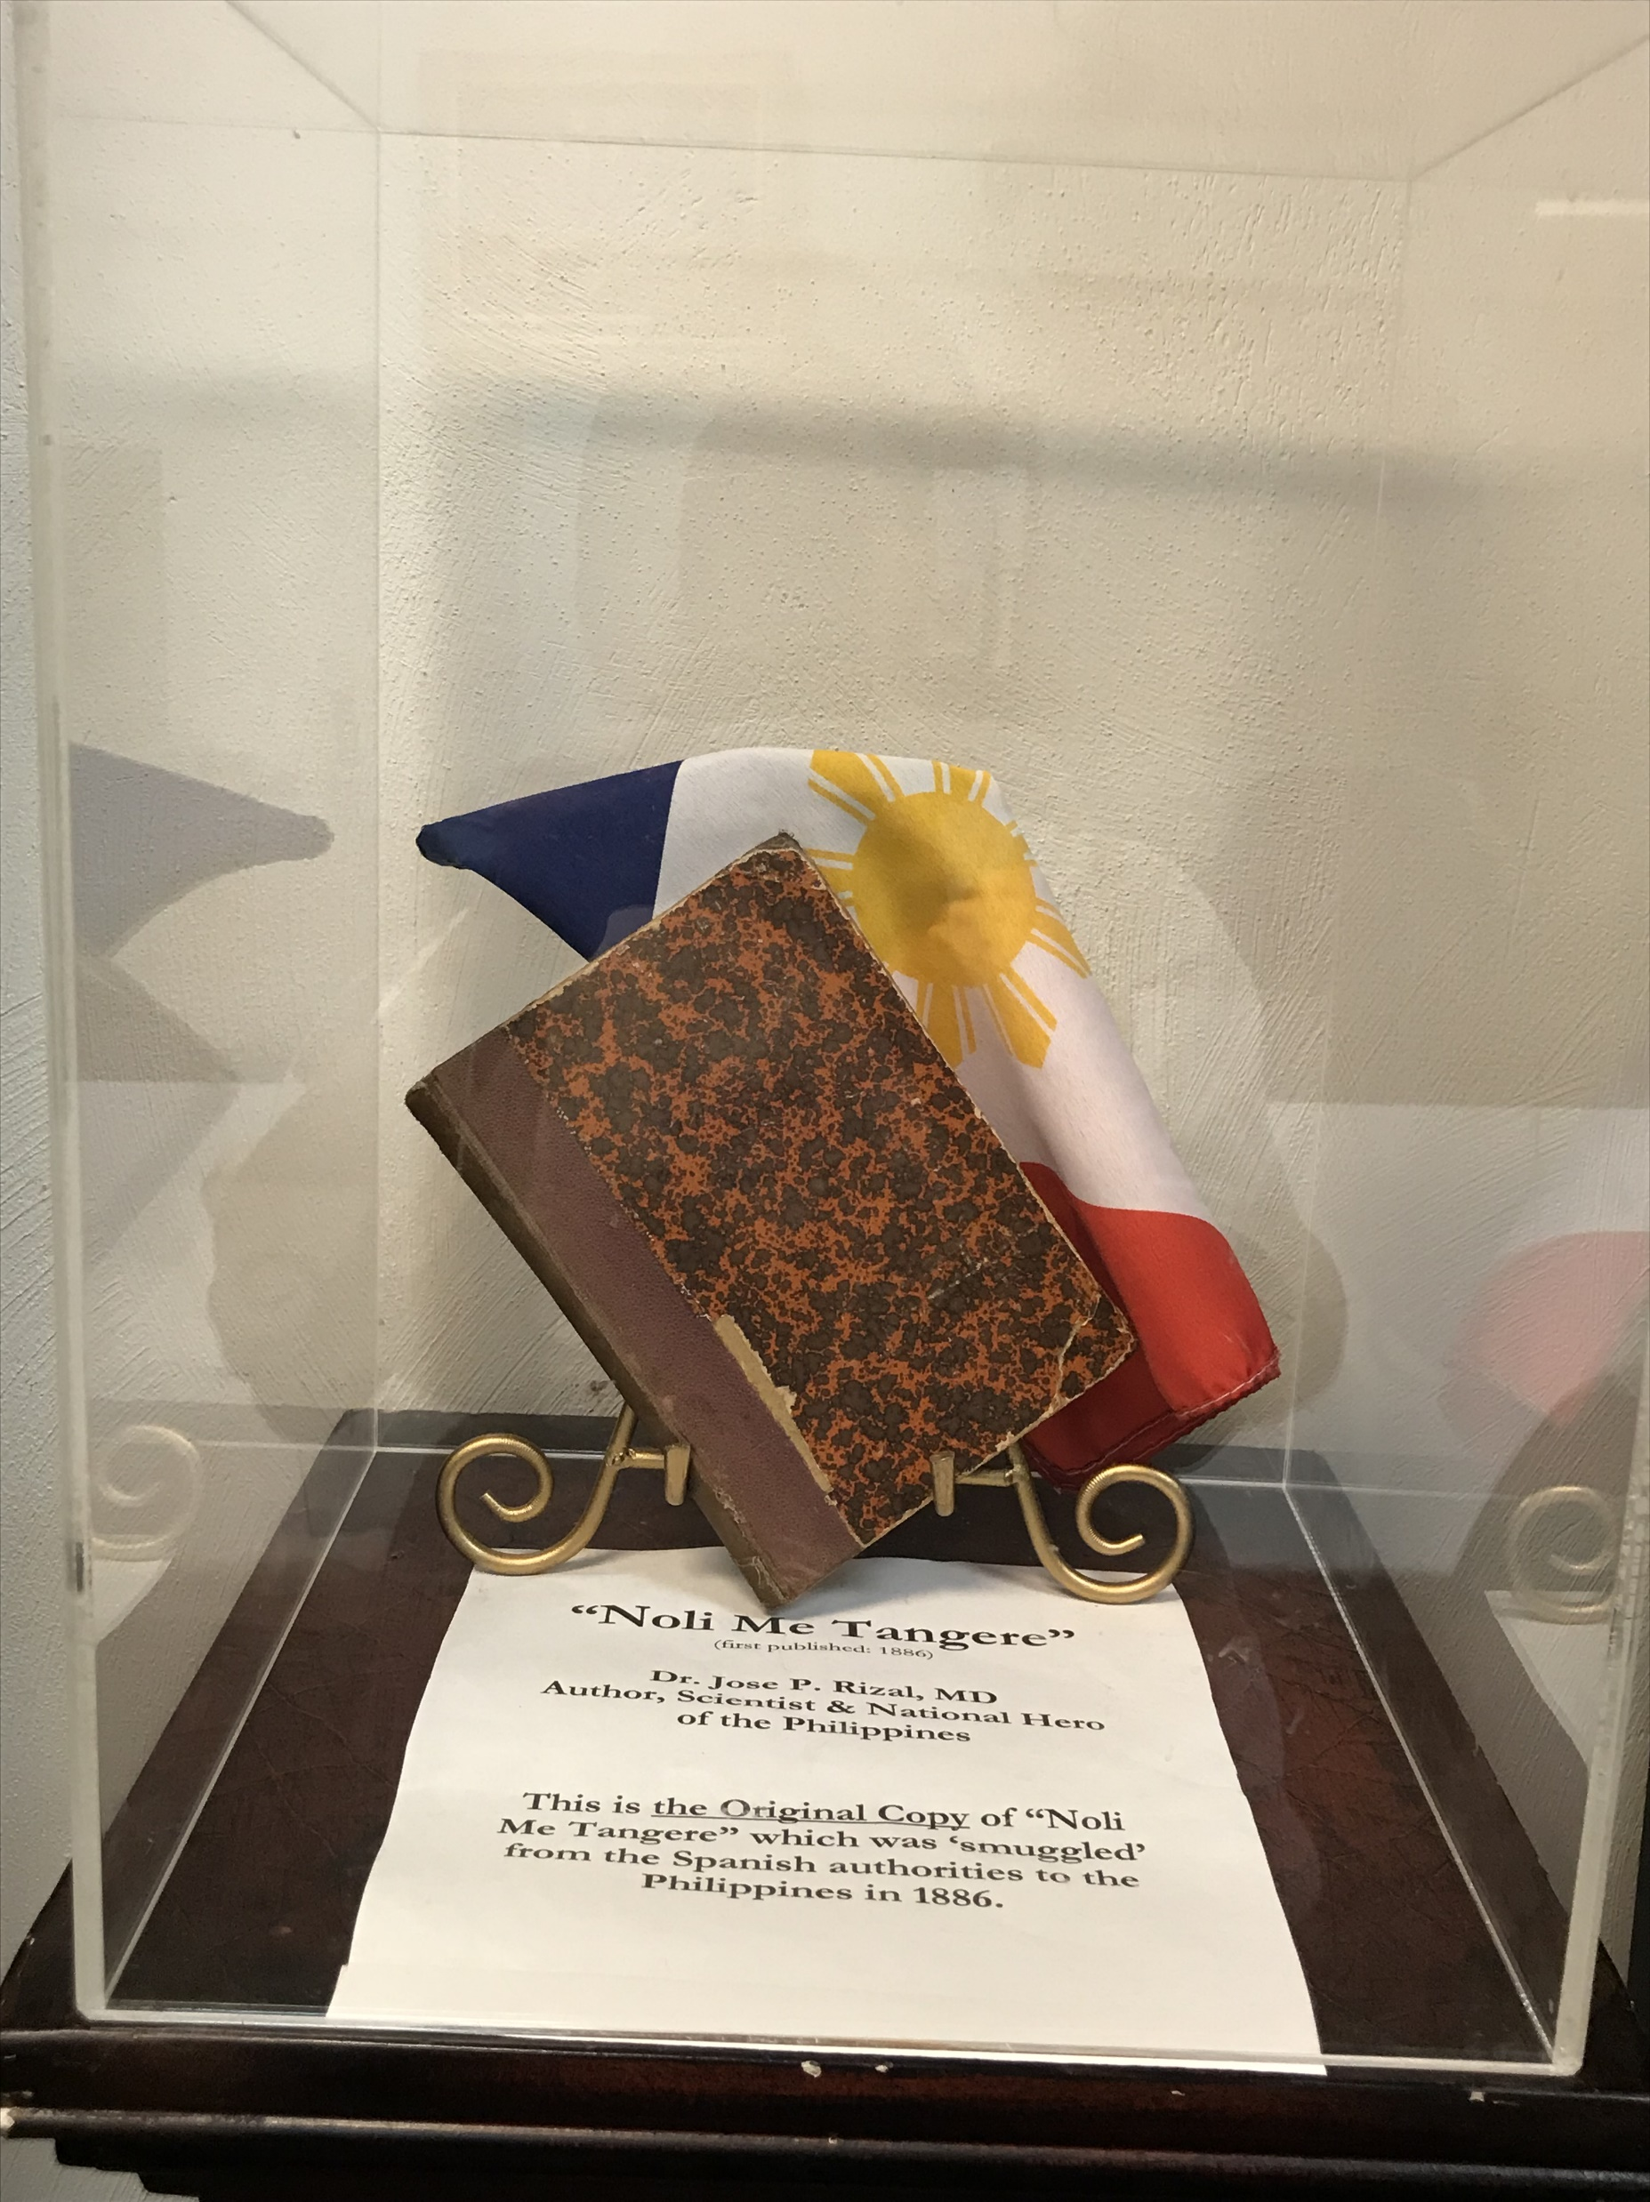

Slide 22
PCCVA as an
Educational Resource
Site to celebrate Philippine Independence Day – June 12, 1898
  Re-enact public reading of the Act of Declaration of Independence from Spain by General Emilio Aguinaldo
  Review the Evolution of the Philippine Flag with replicas of the 10 flags
  Incorporate the Philippine national anthem and youth dance and instrument performances

Slide 23
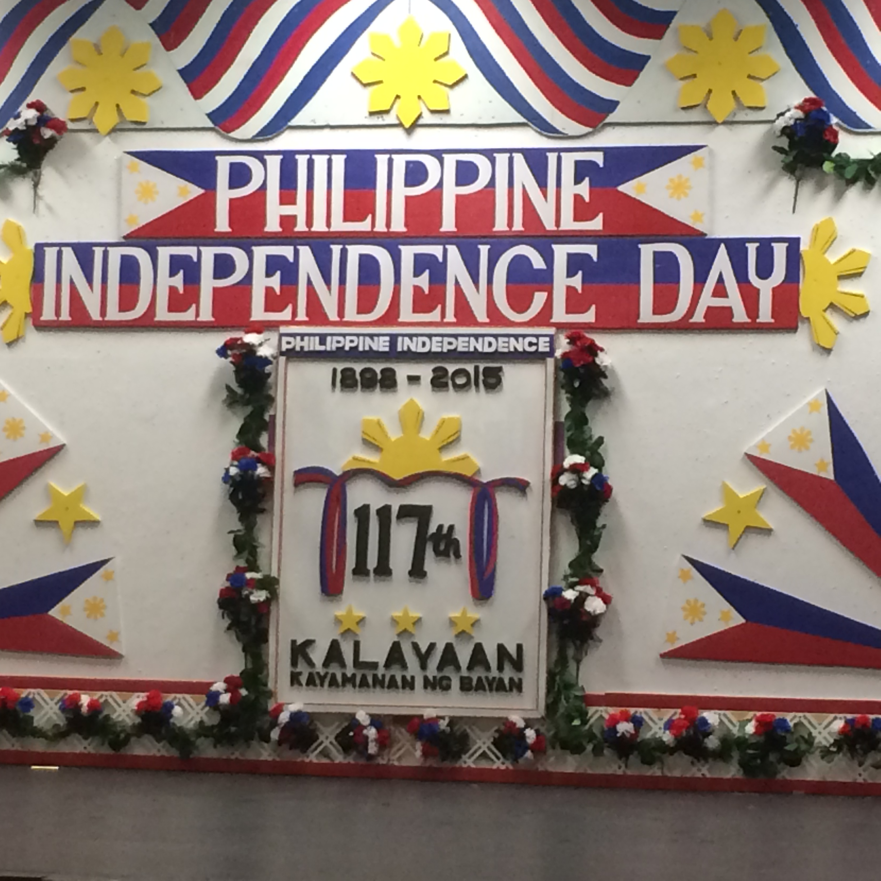

Slide 24
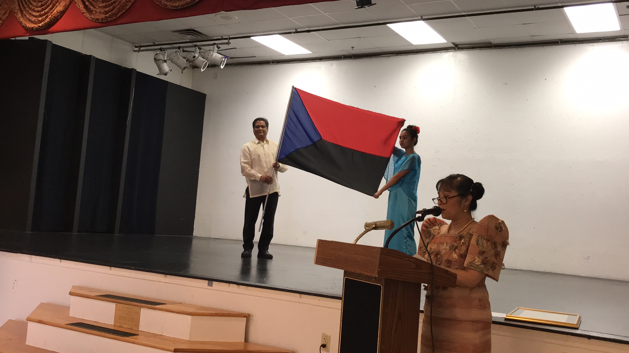
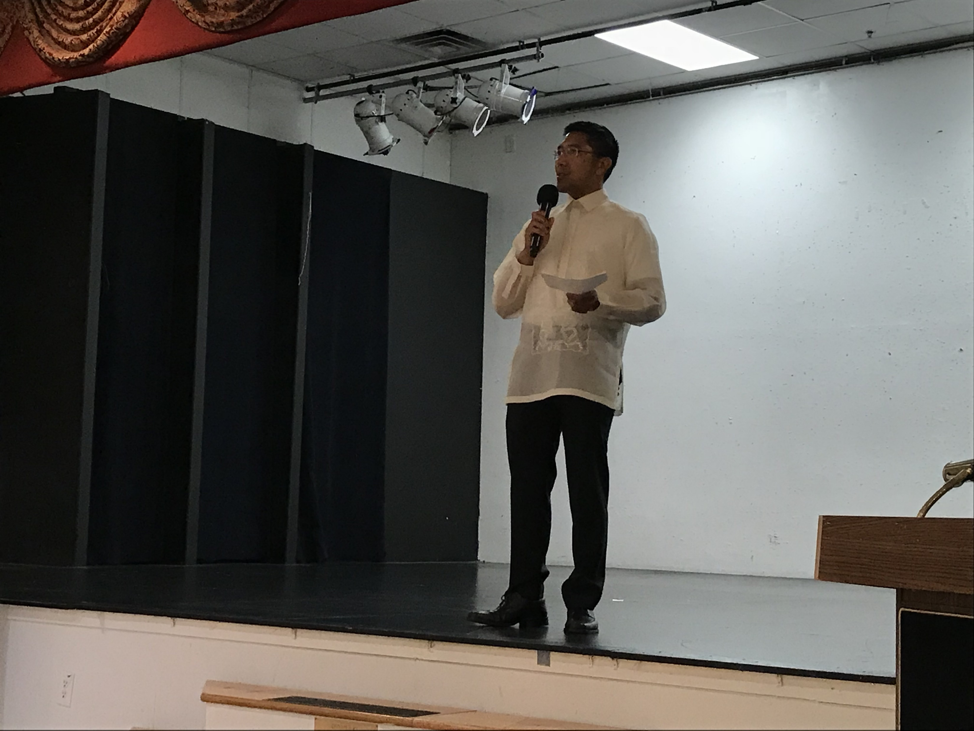

Slide 25
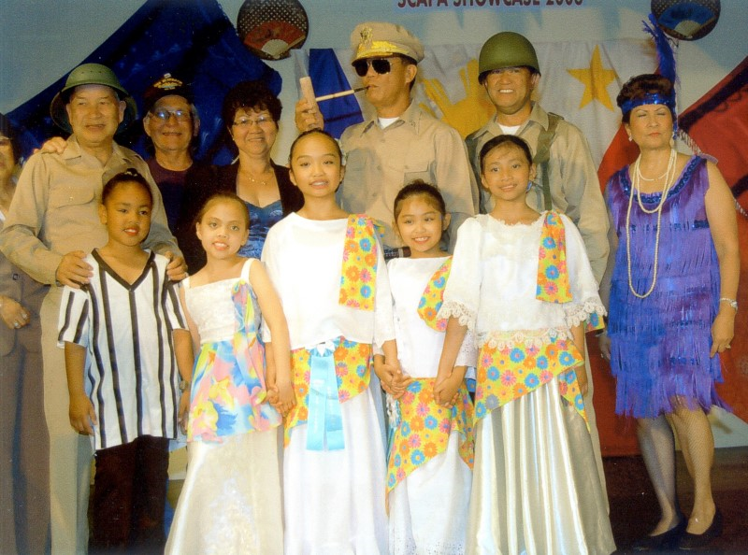

Slide 26
PCCVA as an
Educational Resource
Site of Filipino-American Veteran Memorial Garden – FilAm Vets of Hampton Roads
  Memorial service on Veterans Day
  Memorial service on Memorial Day
Replica model of USS Philippine Sea CG-58
  Flight II Ticonderoga-class guided missile cruiser on active service in the United States Navy.
  Named for the Battle of the Philippine Sea during World War II and is the second ship to bear the name.

Slide 27
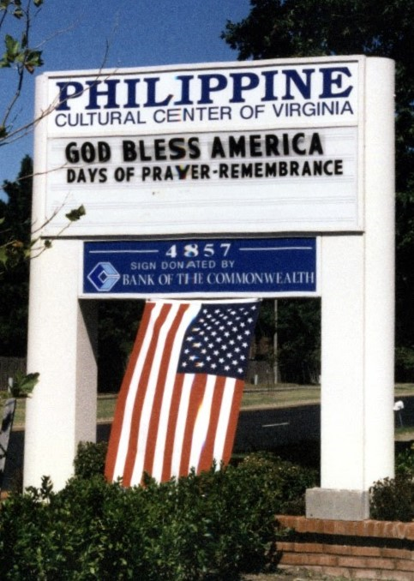

Slide 28
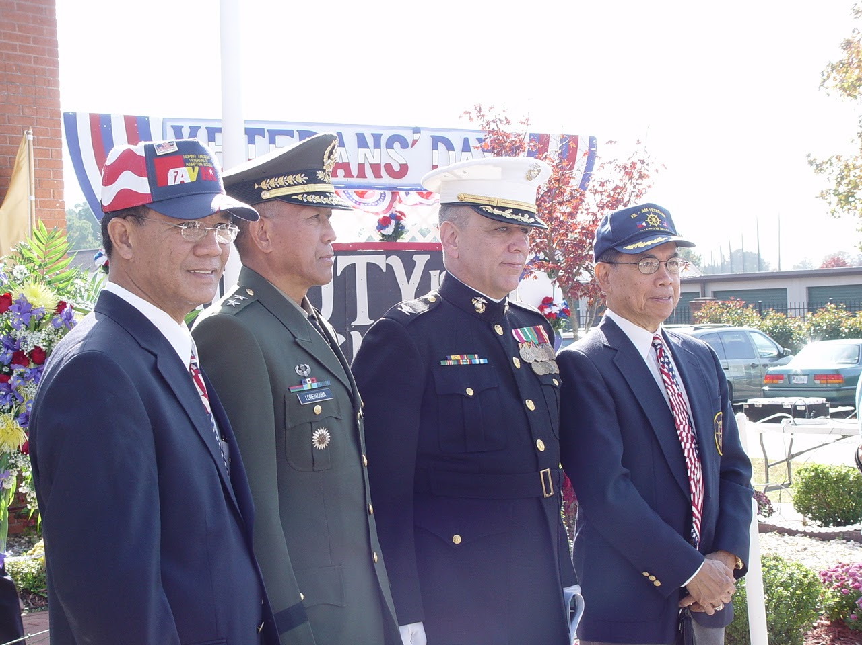

Slide 29
PCCVA as an
Educational Resource
Organizational identities
  Provincial language, food, attire, music, dances, family/social structures
  Religious activities of prayer services, novenas, devotional fiestas
  Pageants
  Parades

Slide 30
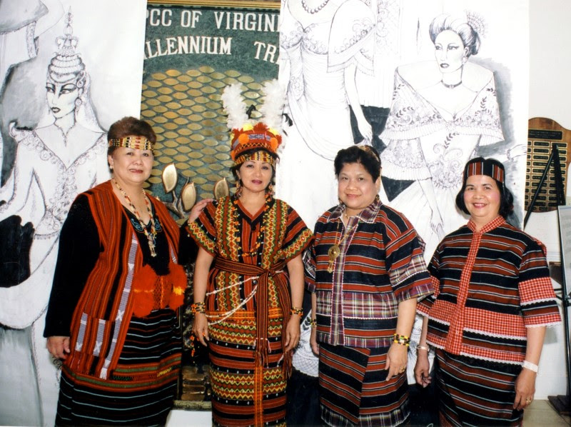

Slide 31
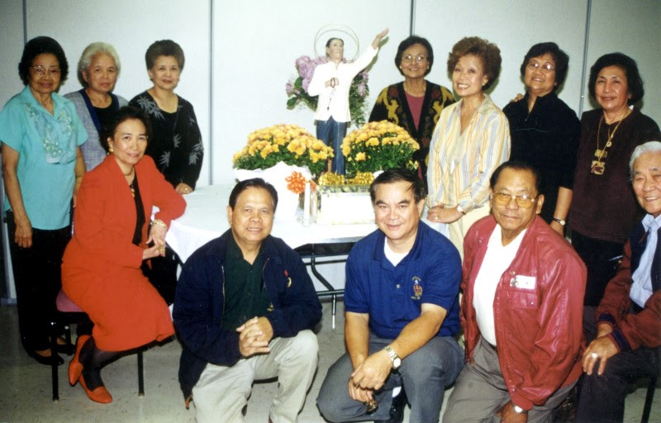
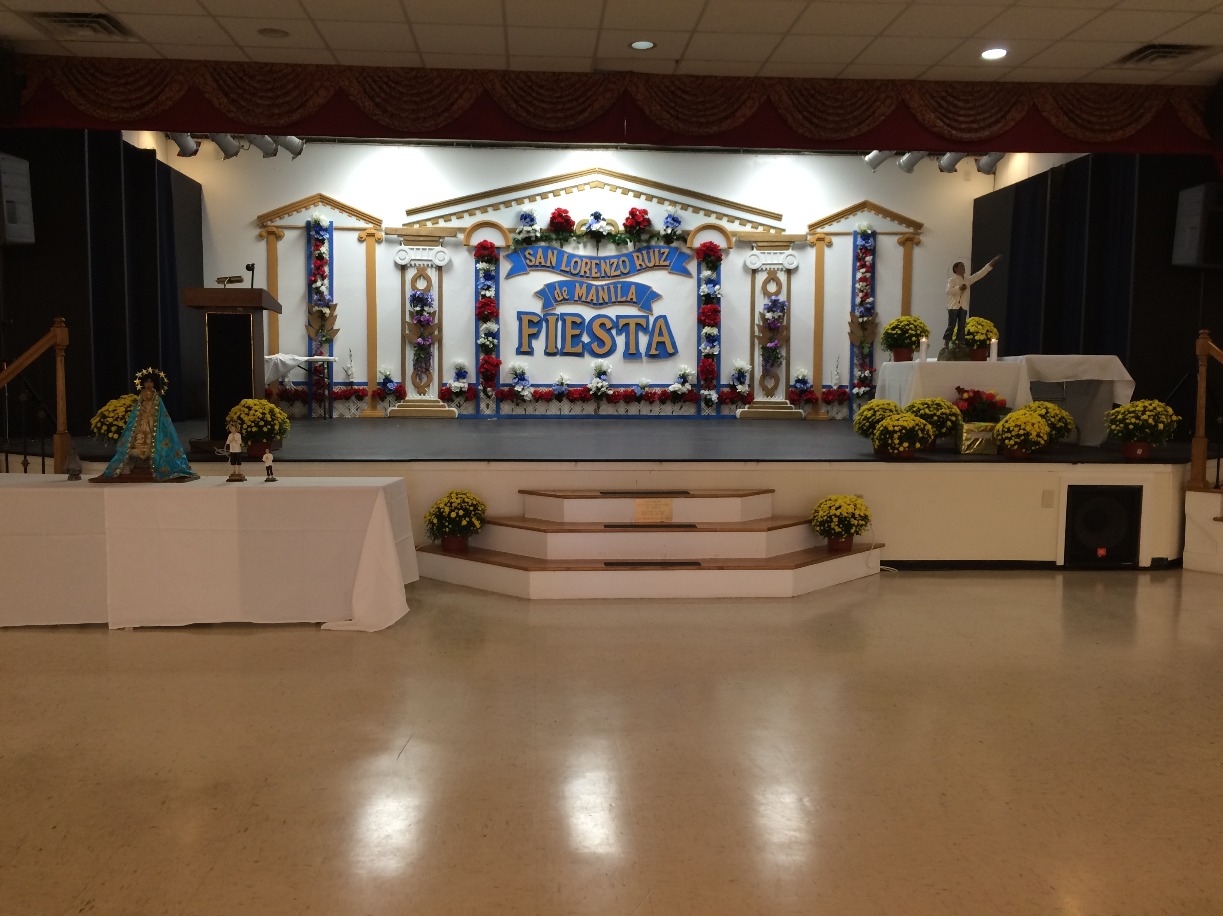
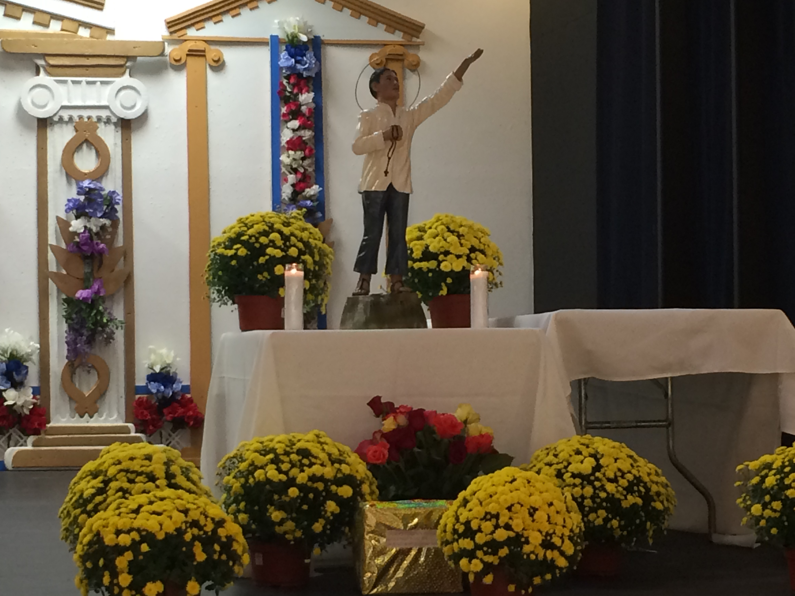
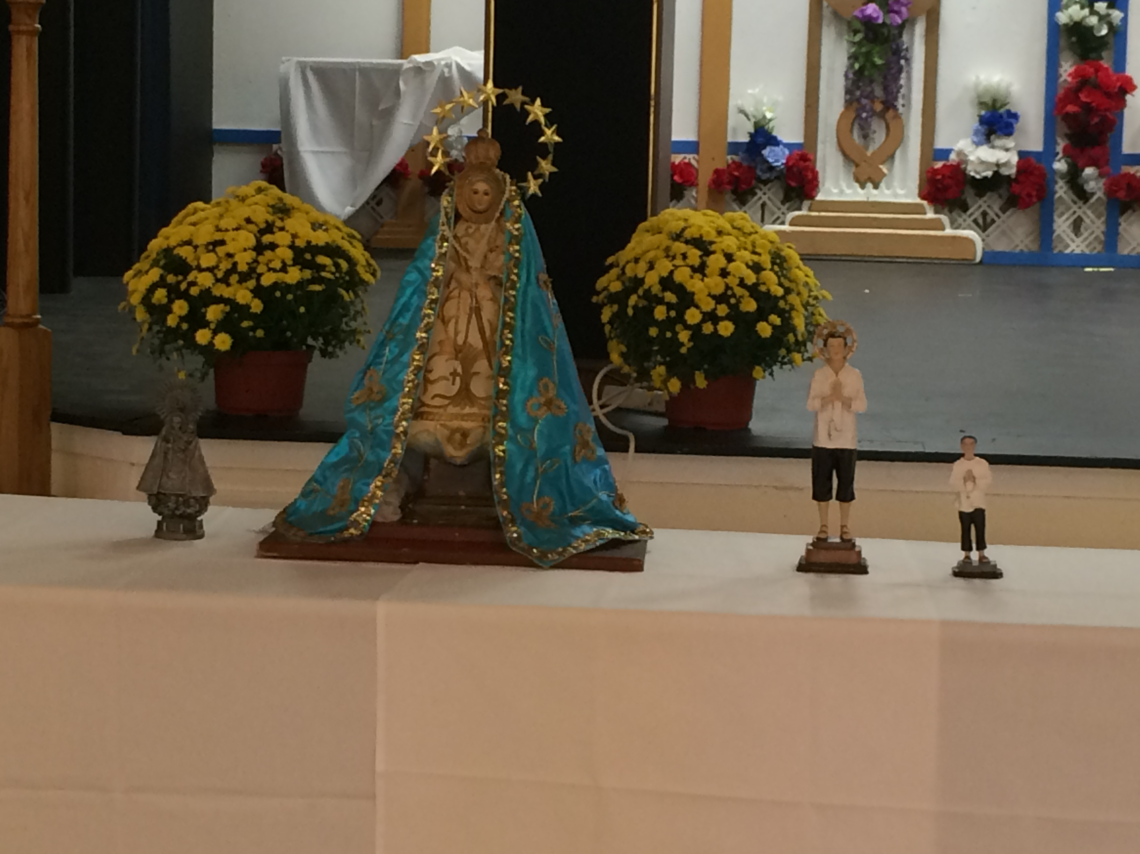

Slide 32
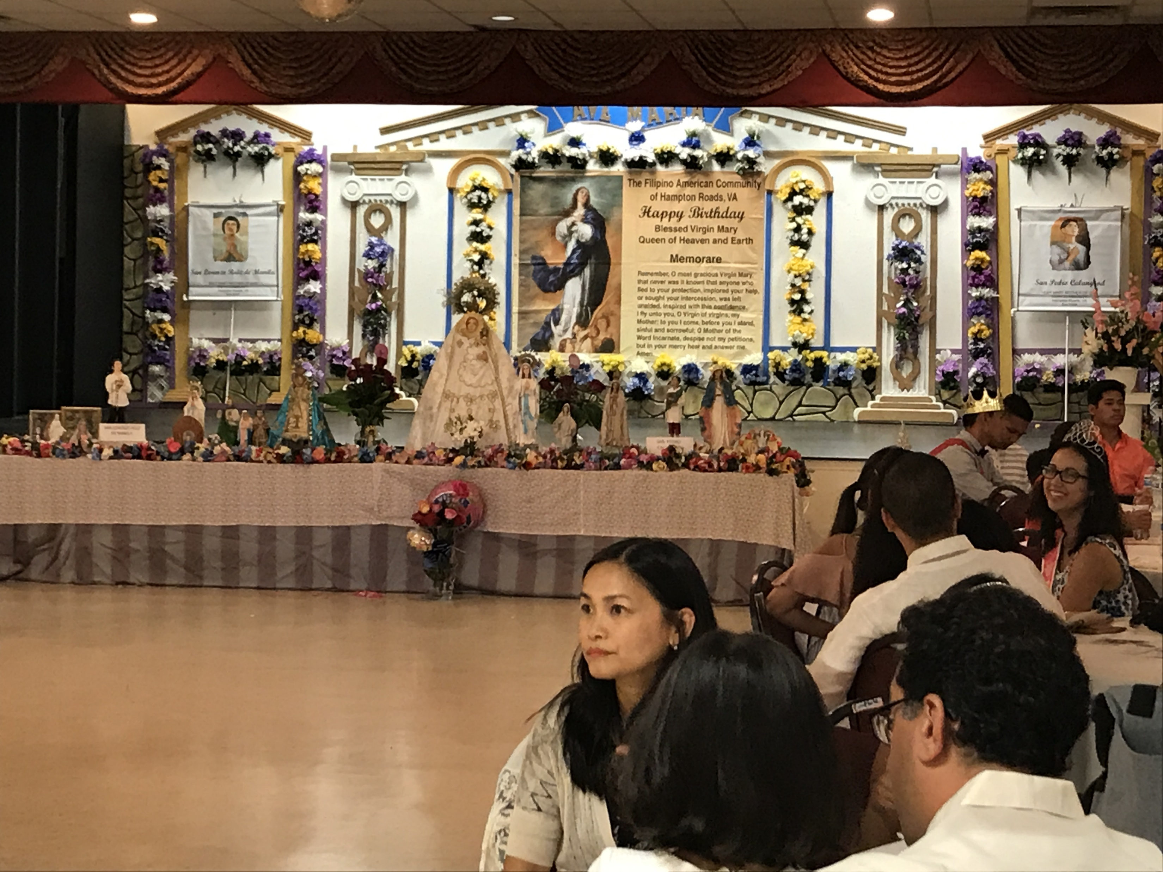
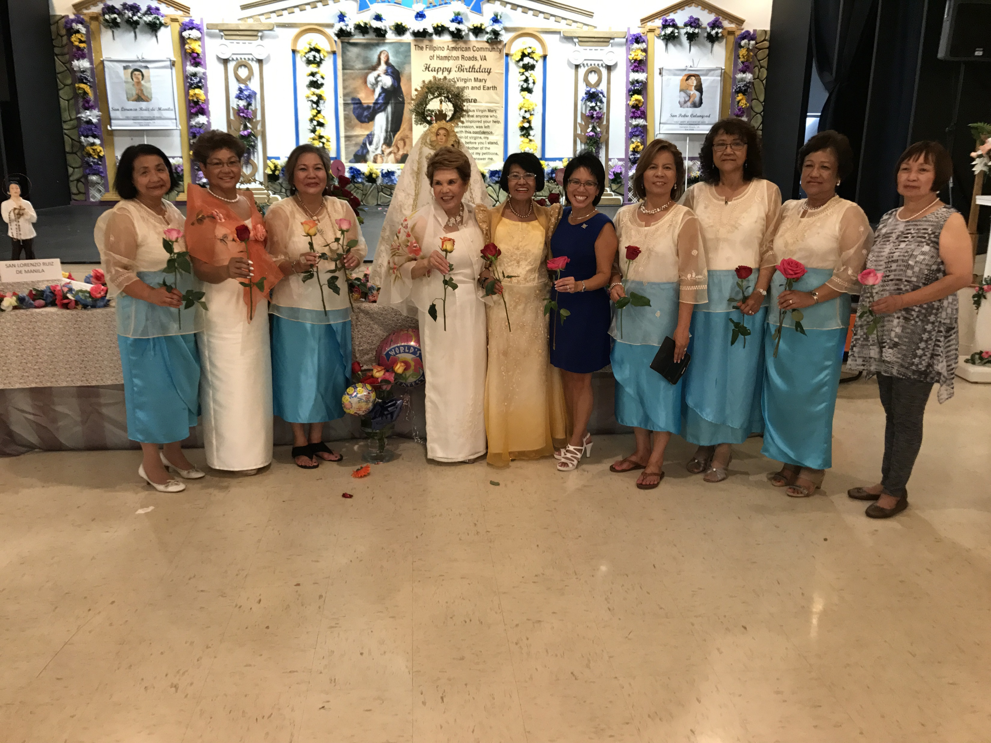
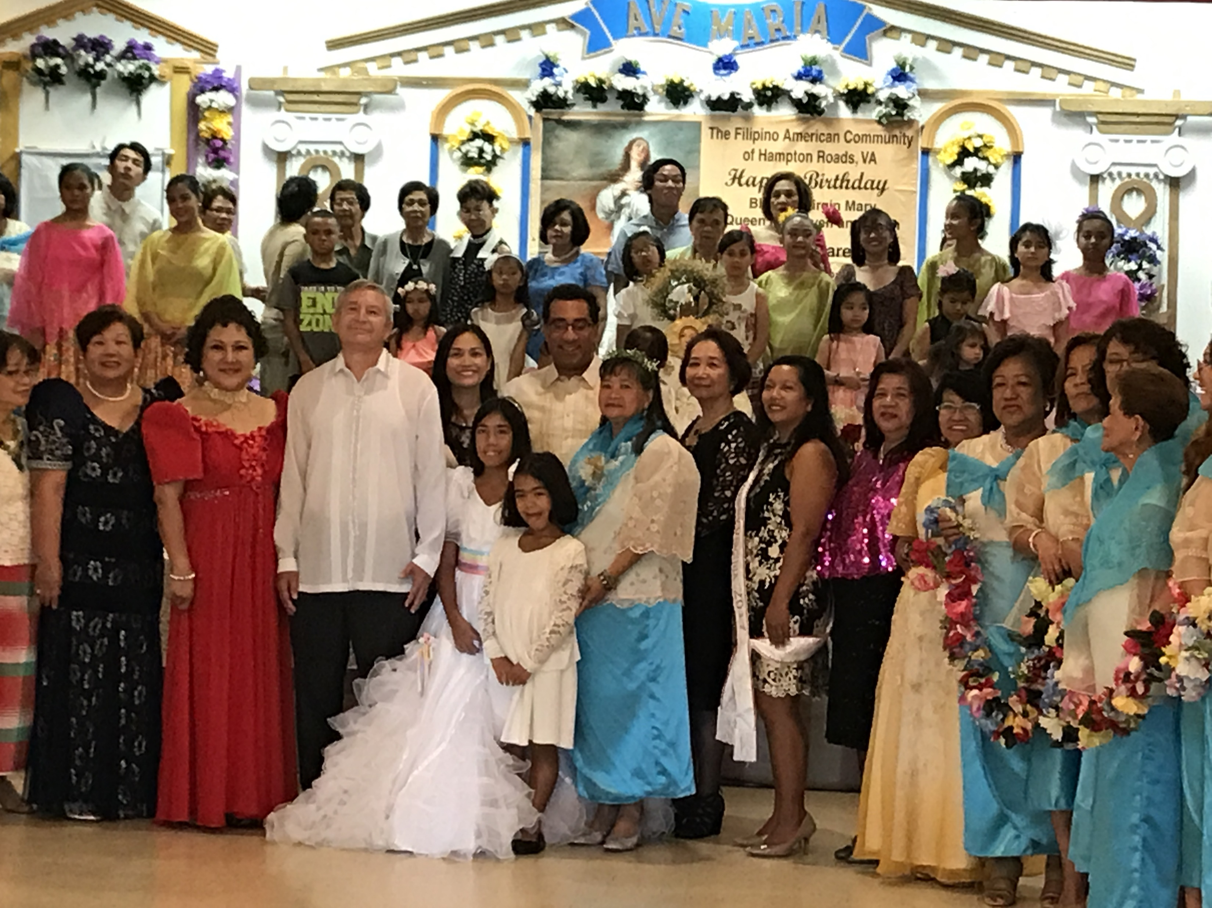

Slide 33
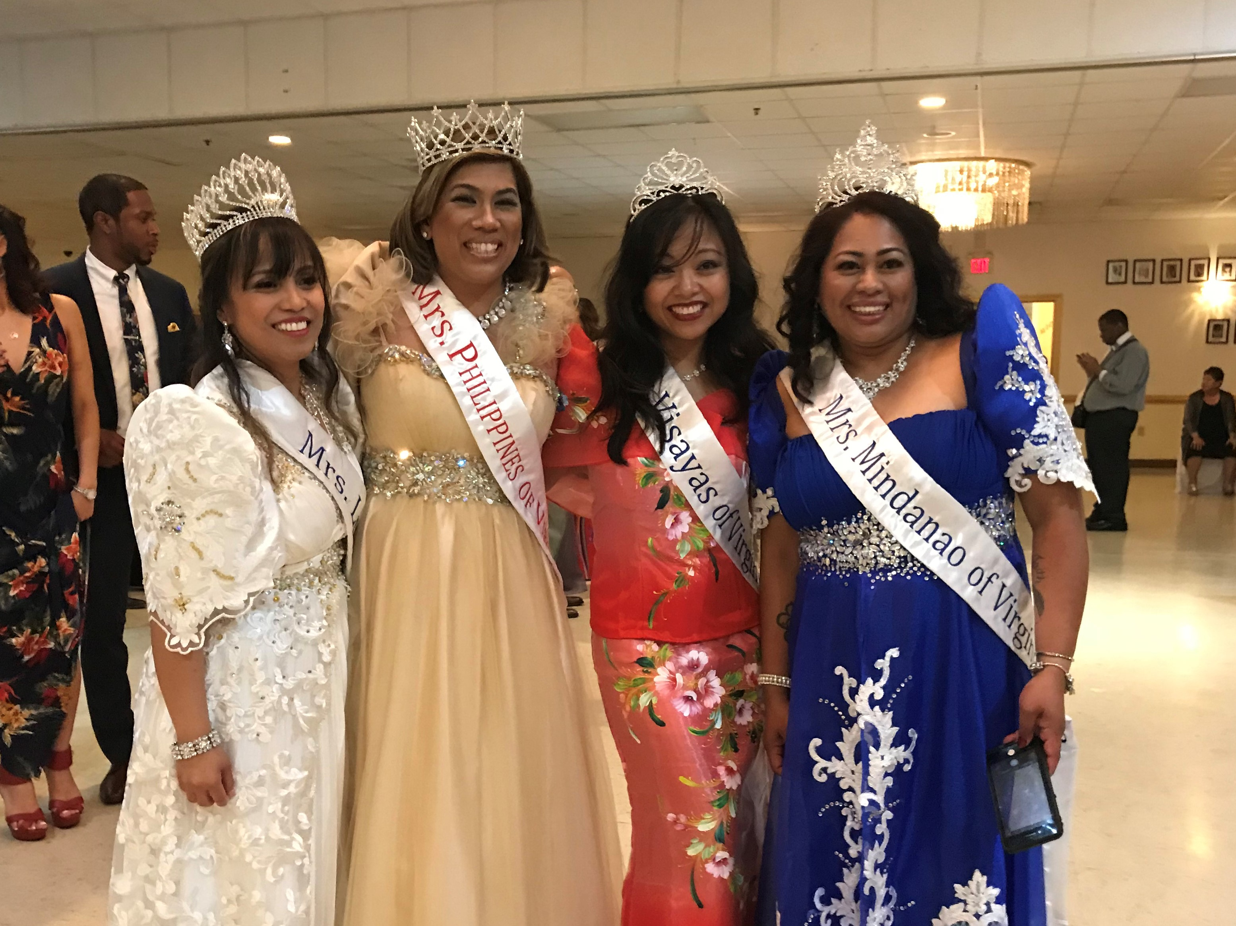

Slide 34
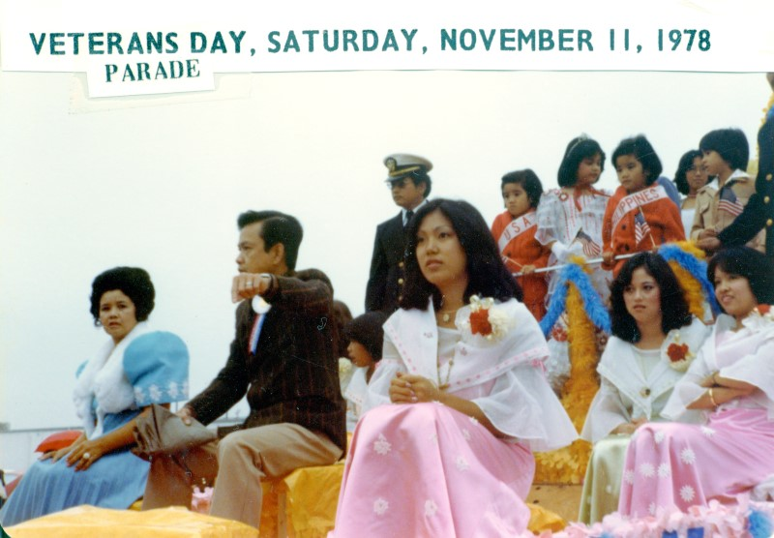
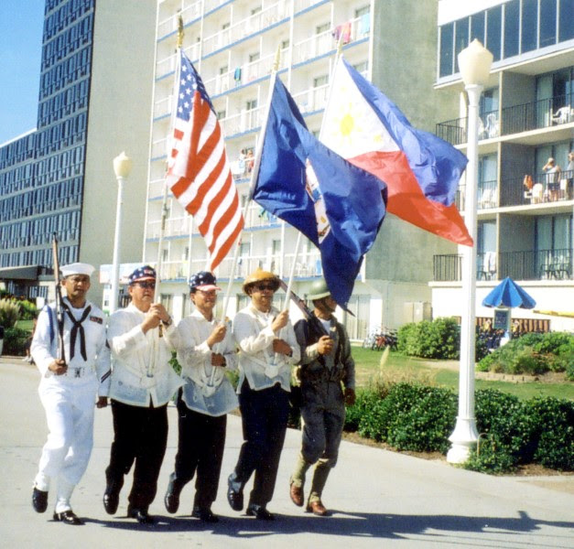
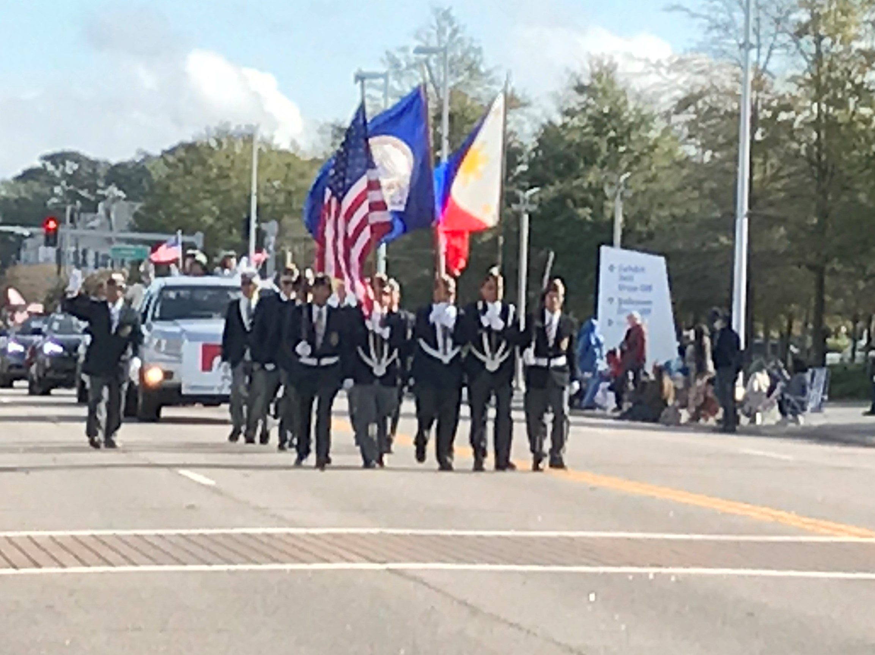
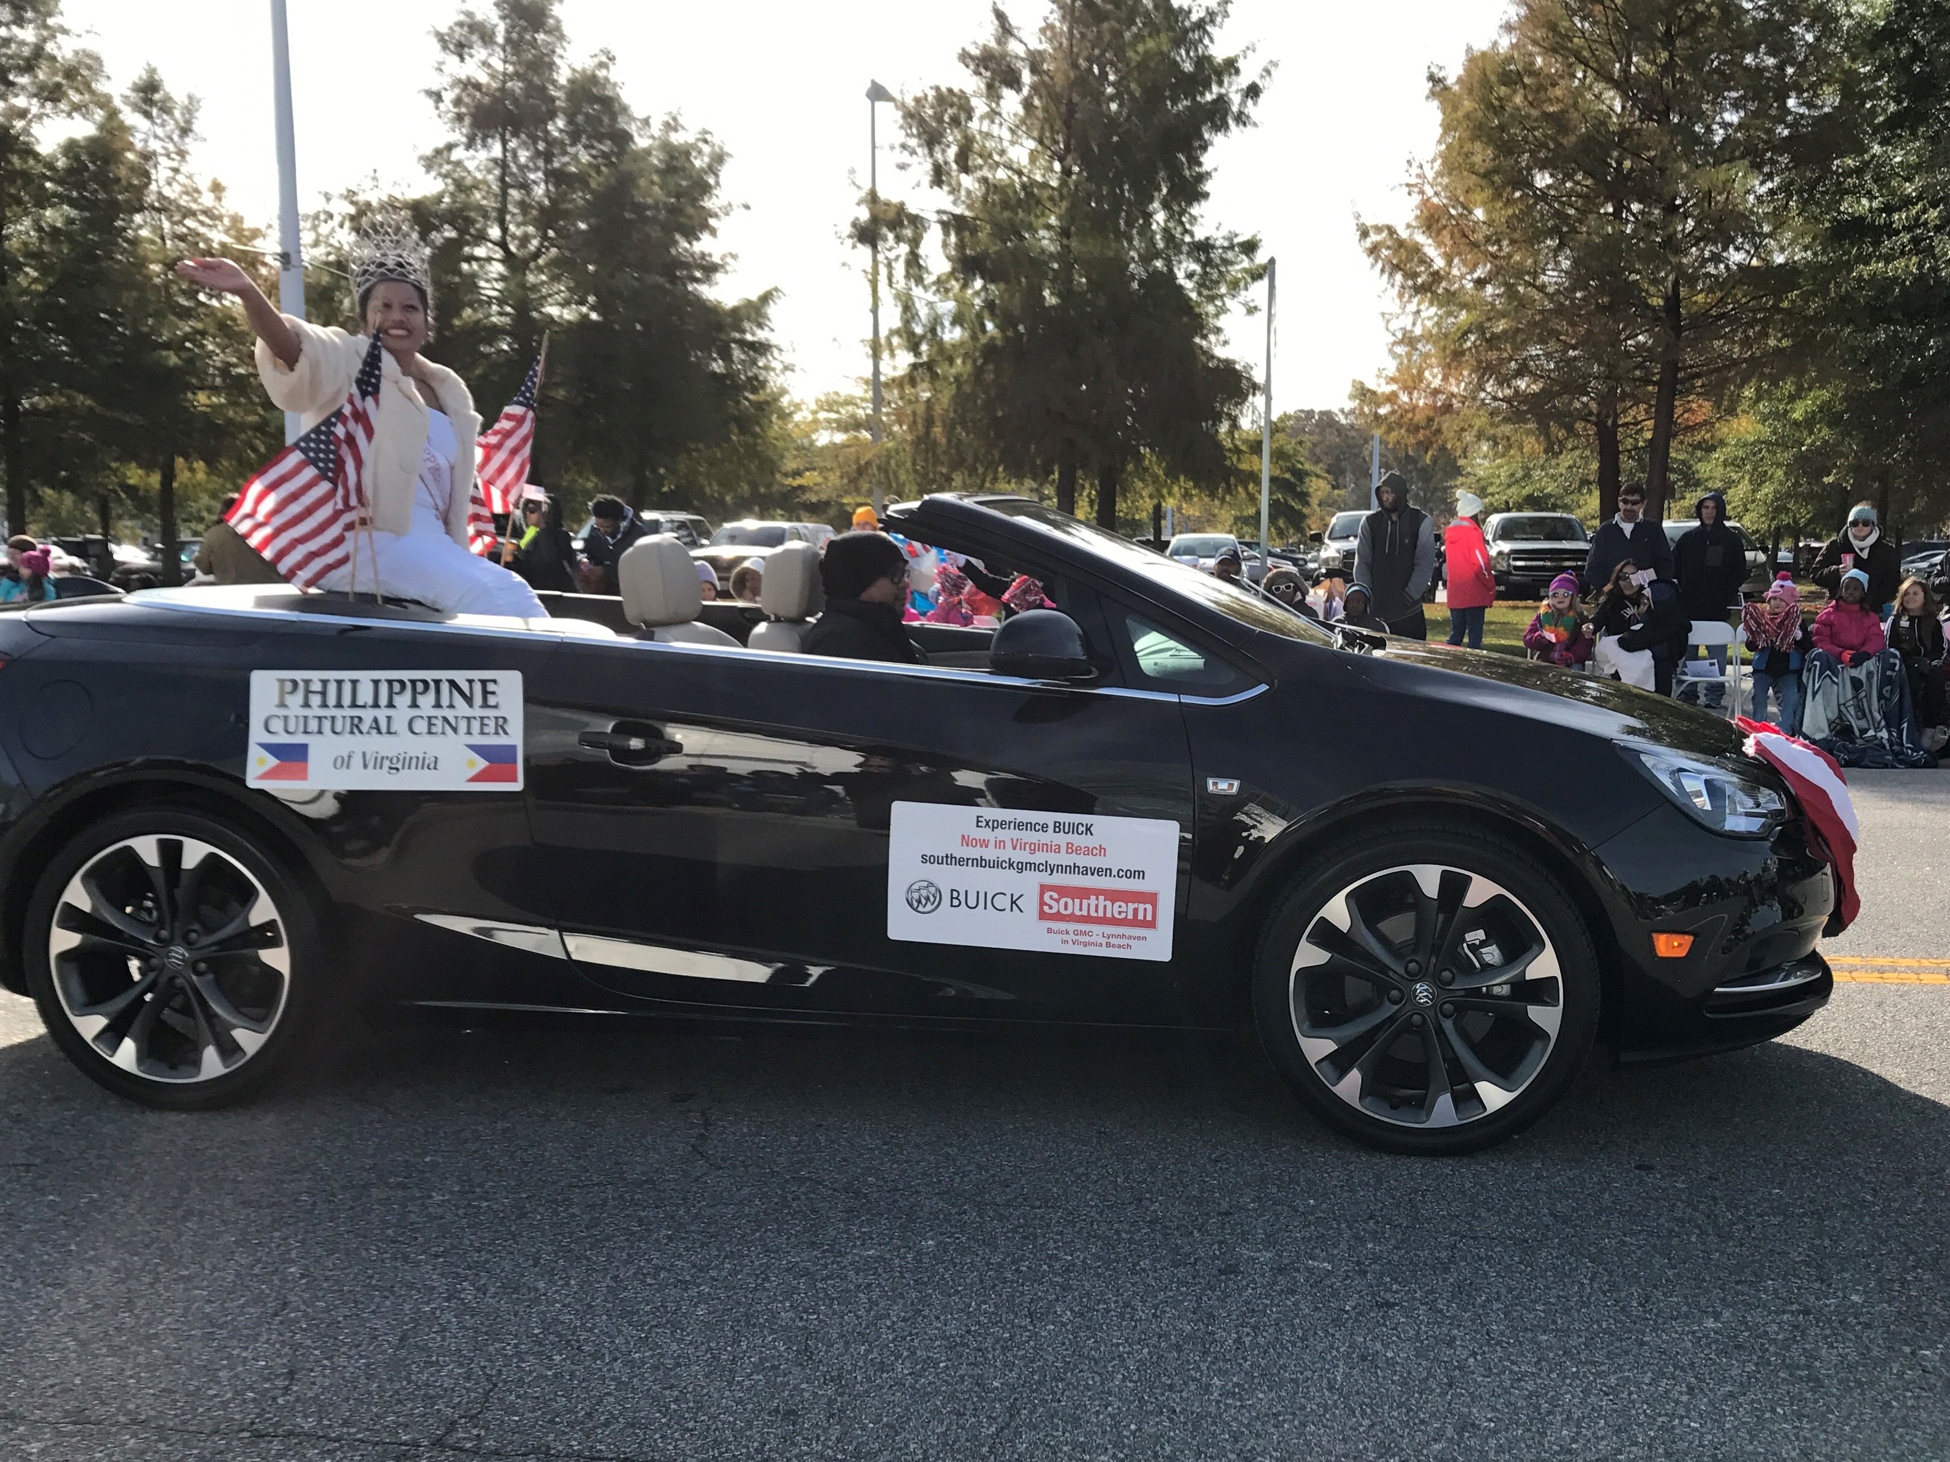

Slide 35
PCCVA as an
Educational Resource
School of Creative and Performing Arts (SCAPA)
  Volunteer dedicated trained faculty to execute lesson plans
  Recognized by Virginia Beach Arts & Humanities
  Self – sustaining

Slide 36
PCCVA as an
Educational Resource
School of Creative and Performing Arts (SCAPA) - continued
  Main purpose to preserve and share the culture and tradition of the Philippines by passing it on to our youth
  Objective to teach children 5 yrs old +
    Creative arts
      Language arts
      Singing
      Dancing
      Folklore
      Theater
    Heritage workshop

Slide 37
PCCVA as an
Educational Resource
School of Creative and Performing Arts (SCAPA) – values for students
  Love and respect of immediate and extended family
  Importance of religion and its practice in our daily lives
  College education is a must in this competitive world

Slide 38
PCCVA as an
Educational Resource
School of Creative and Performing Arts (SCAPA) – continued
  Saturday classes, 1030am-1230pm
  October- February; Spring Showcase
  Invitations to perform approx. monthly
    Philippine Embassy, Wash., DC competitions
  Exposed to world of Arts
    Enhance cognitive and intellectual abilities
    Attend stage plays, symphony, ballet

Slide 39
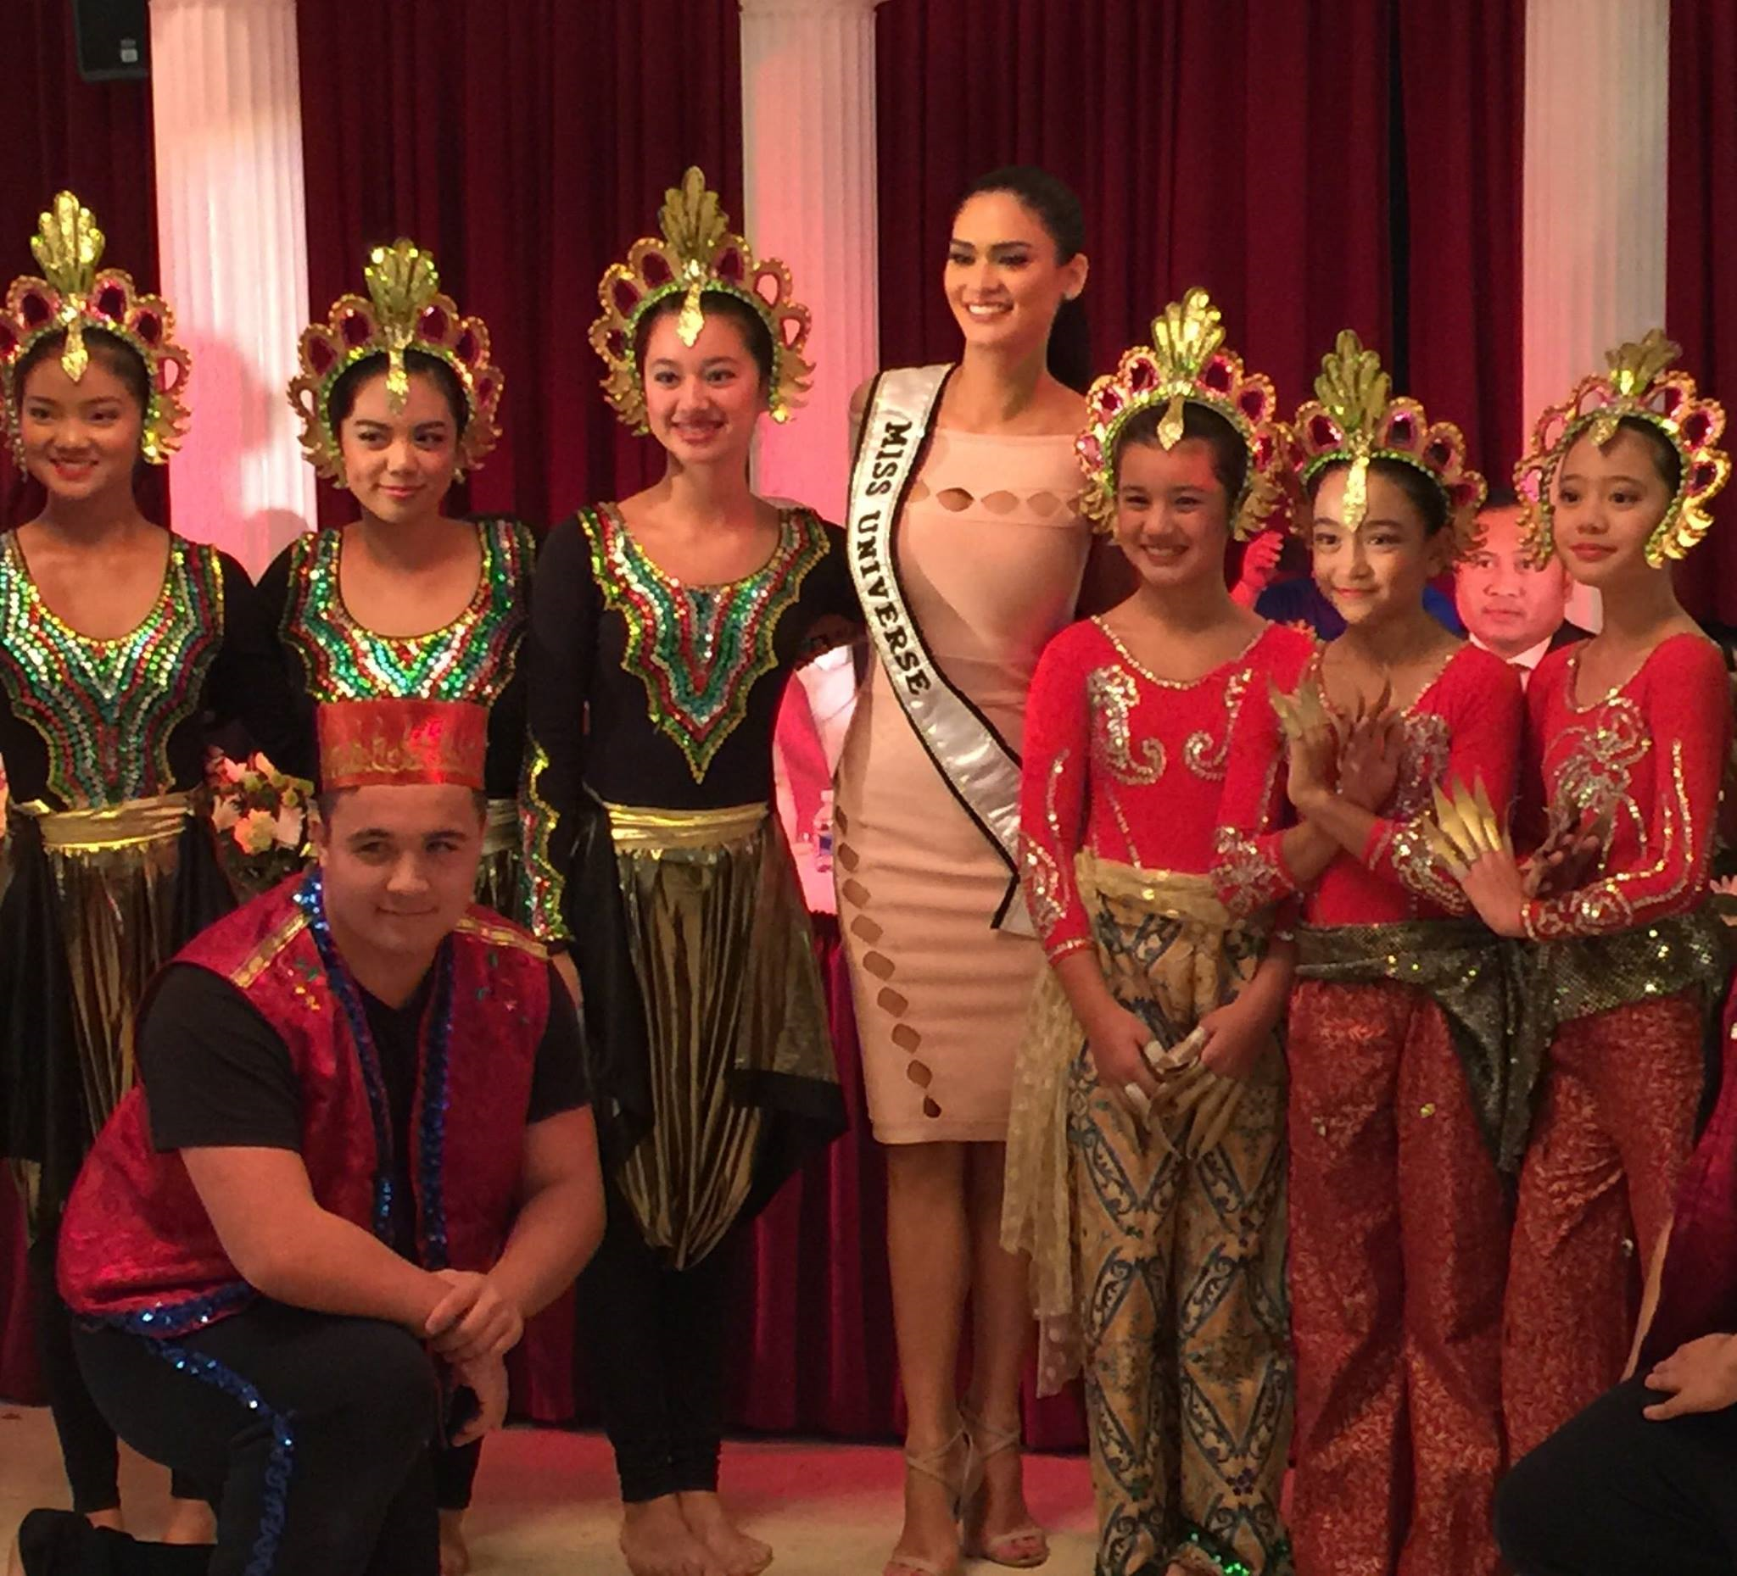

Slide 40
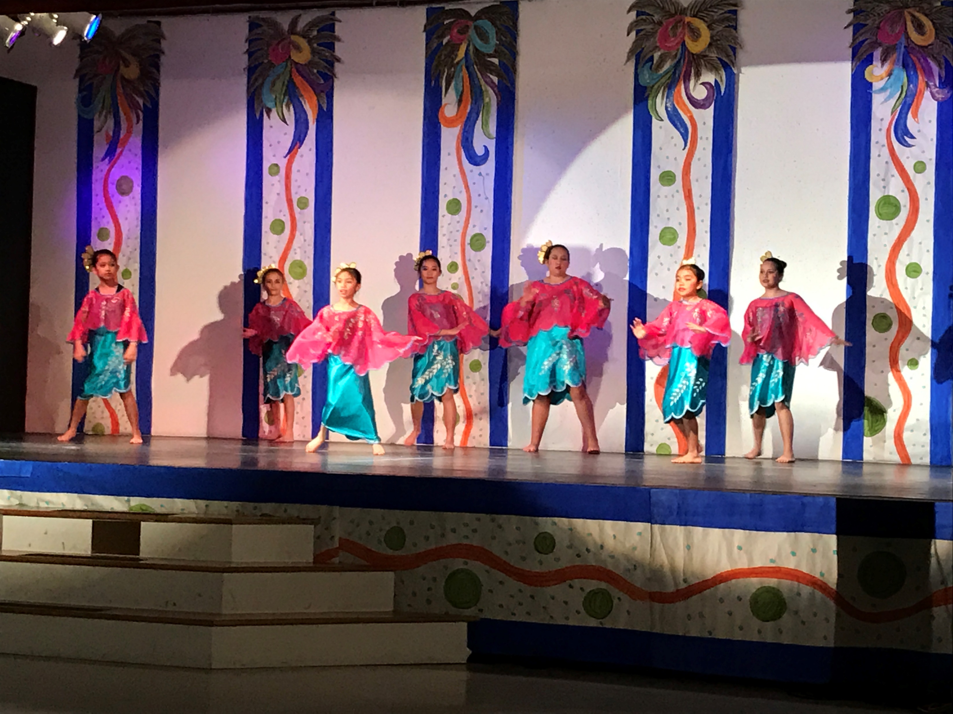

Slide 41
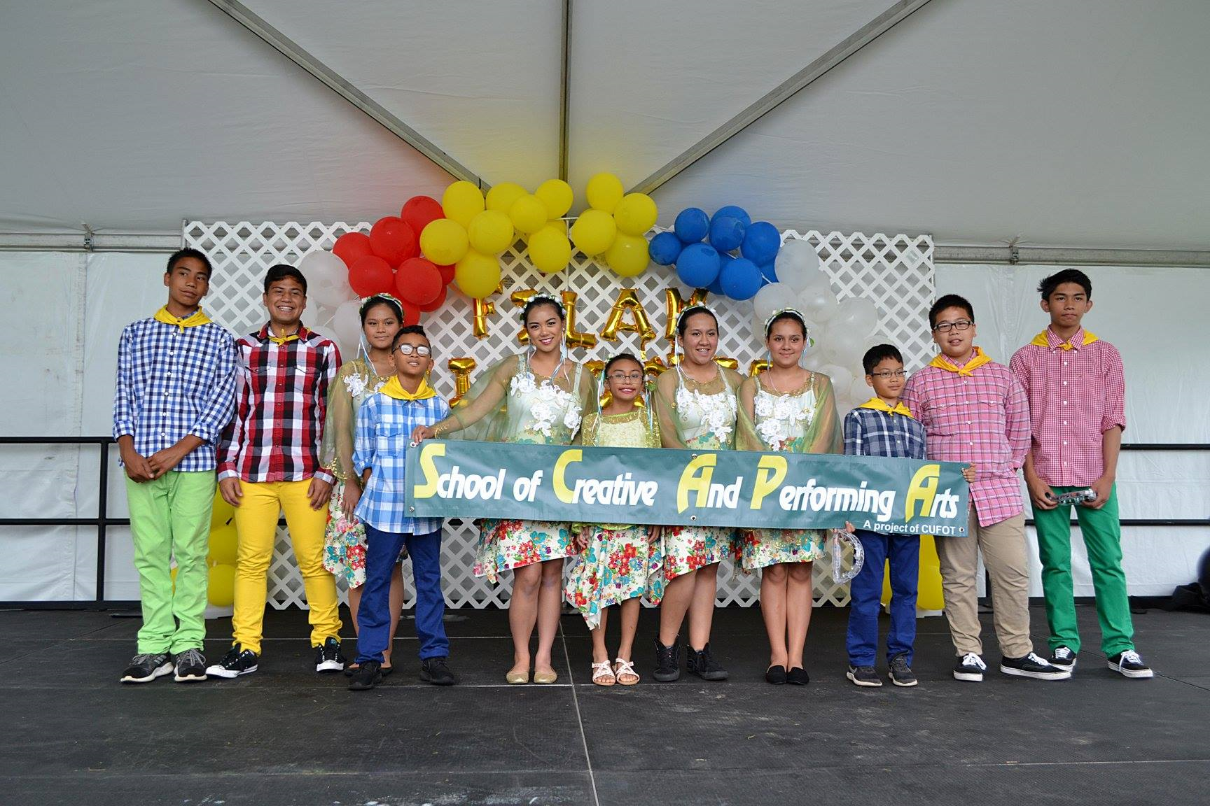

Slide 42
PCCVA as an
Educational Resource
Kuntaw Classes- Karate originated in Philippines
Philippine Rondalla Ensemble of Virginia- ensemble of stringed instruments
Tagalog Classes for adults
Filipino Christmas Star “Parol” workshop during holiday season

Slide 43
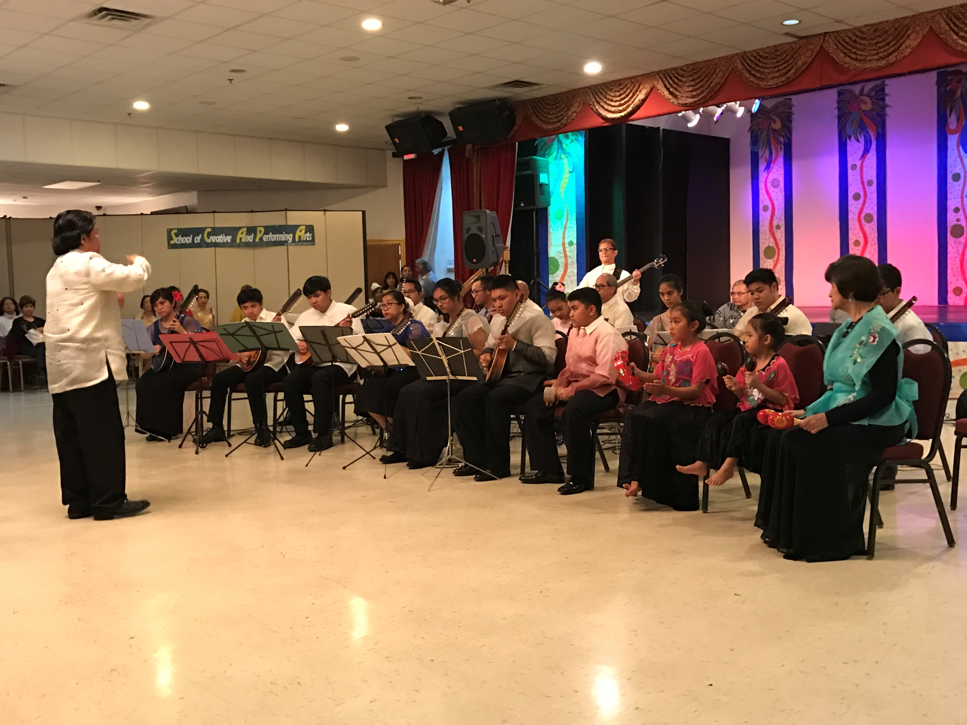

Slide 44
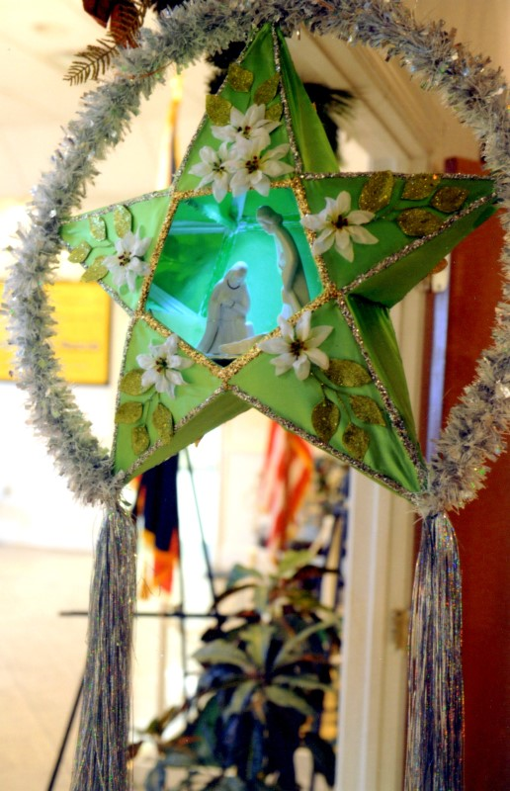
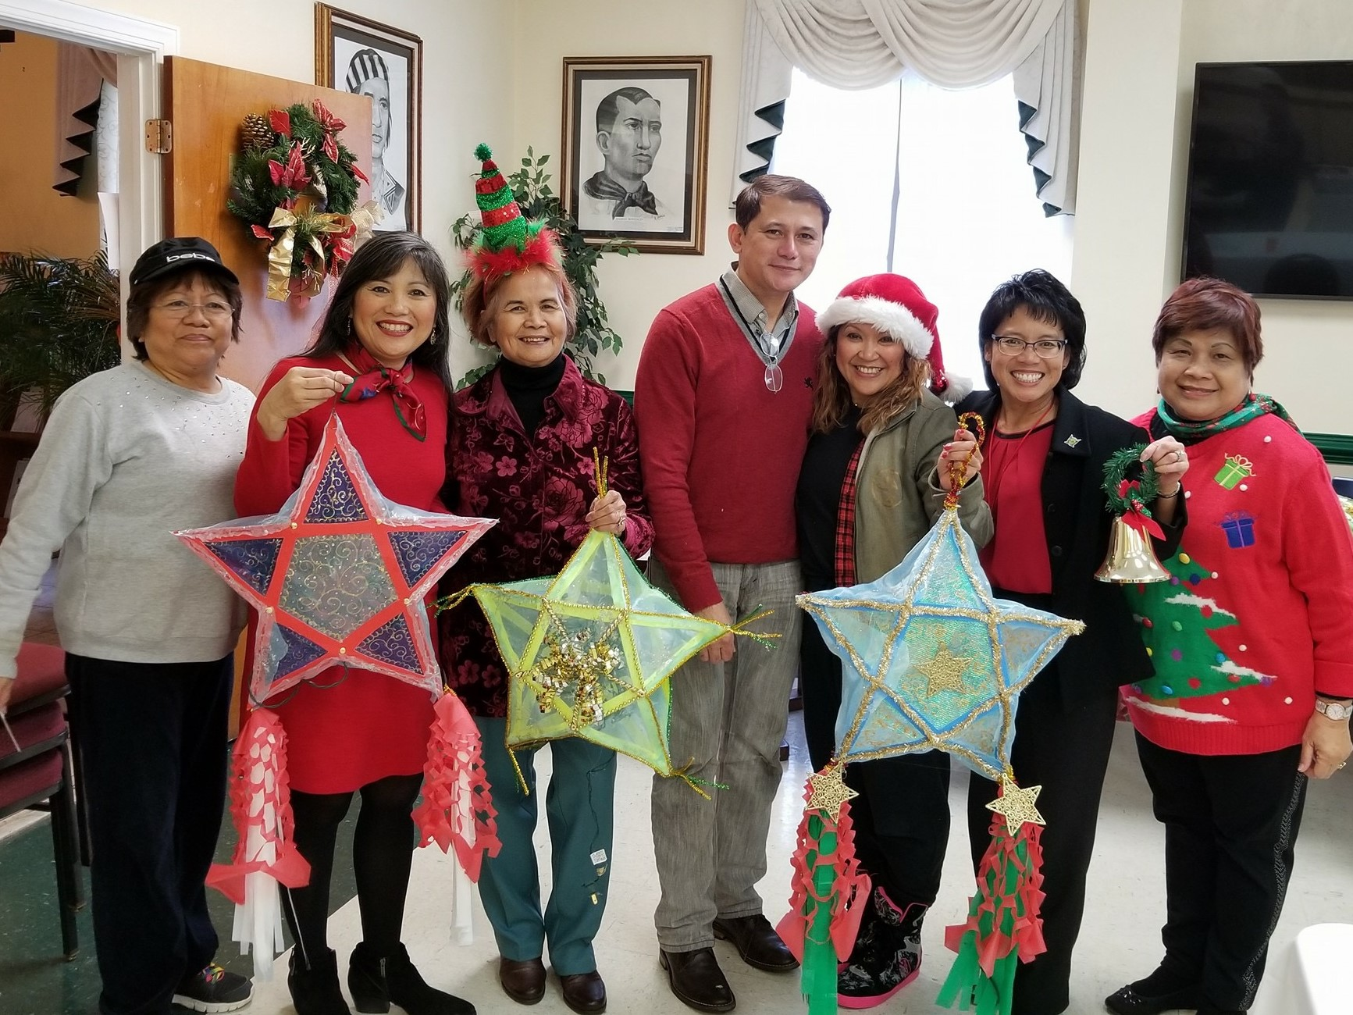

Slide 45
PCCVA as an
Educational Resource
Wellness and Fitness Classes
  Zumba Fitness
  Zumba Strong
  Zumba Toning
  MixxedFit
  Line Dancing
Hip Hop
  Beginners
  Interim/Adult
  Young Fil-Am Dancers Advanced
Line Dancing for Seniors

Slide 46
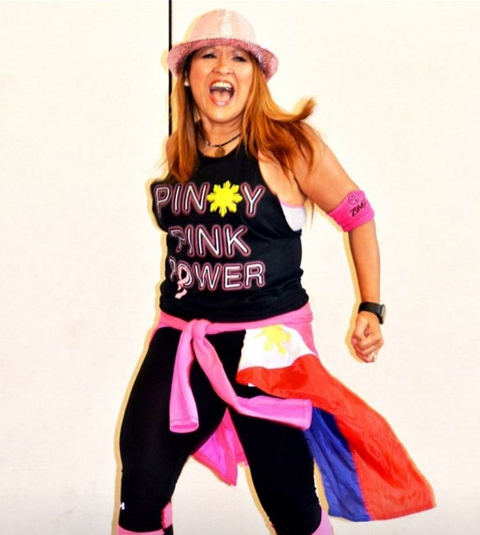
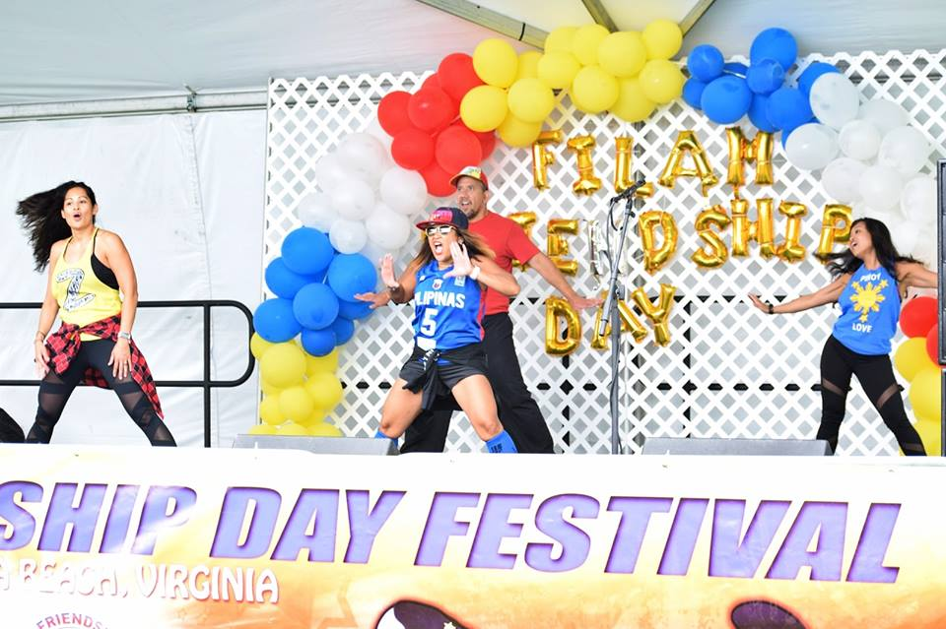

Slide 47
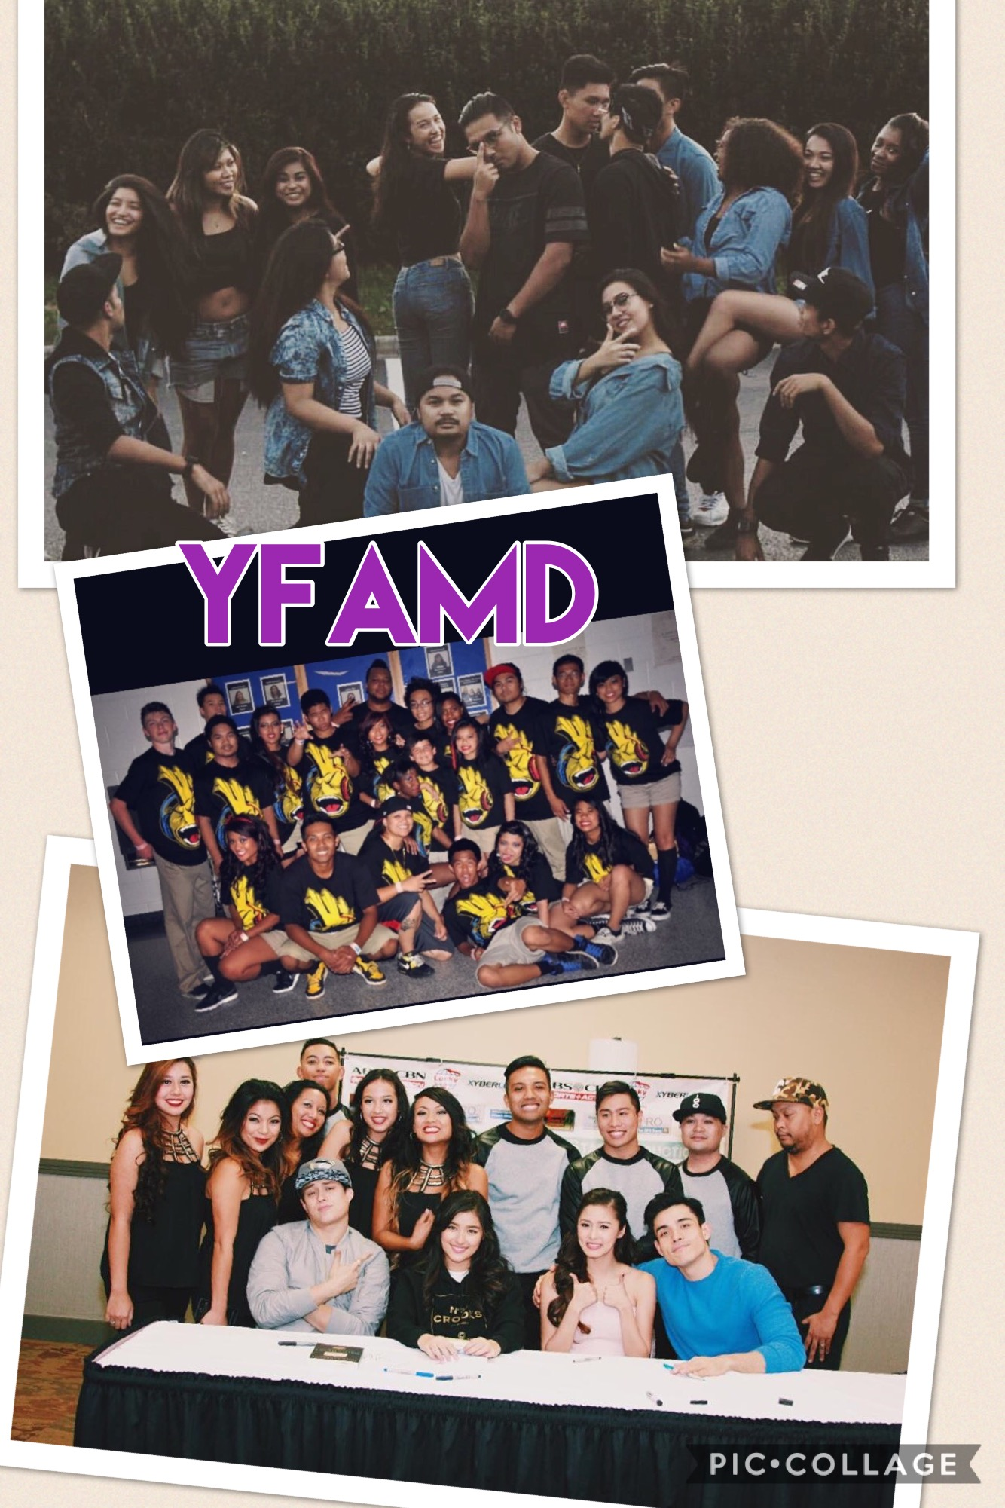

Slide 48
PCCVA as an
Educational Resource
Annual Scholarship Events
  Celebrate academic accomplishments
  Encourage further academic effort
  Express Fil-Am community support
United Ilocano Assoc. of Tidewater
  Recognize outstanding students in each grade
  Has endowed scholarships
Council of United Filipino Orgs. of Tidewater
  Honors graduates

Slide 49
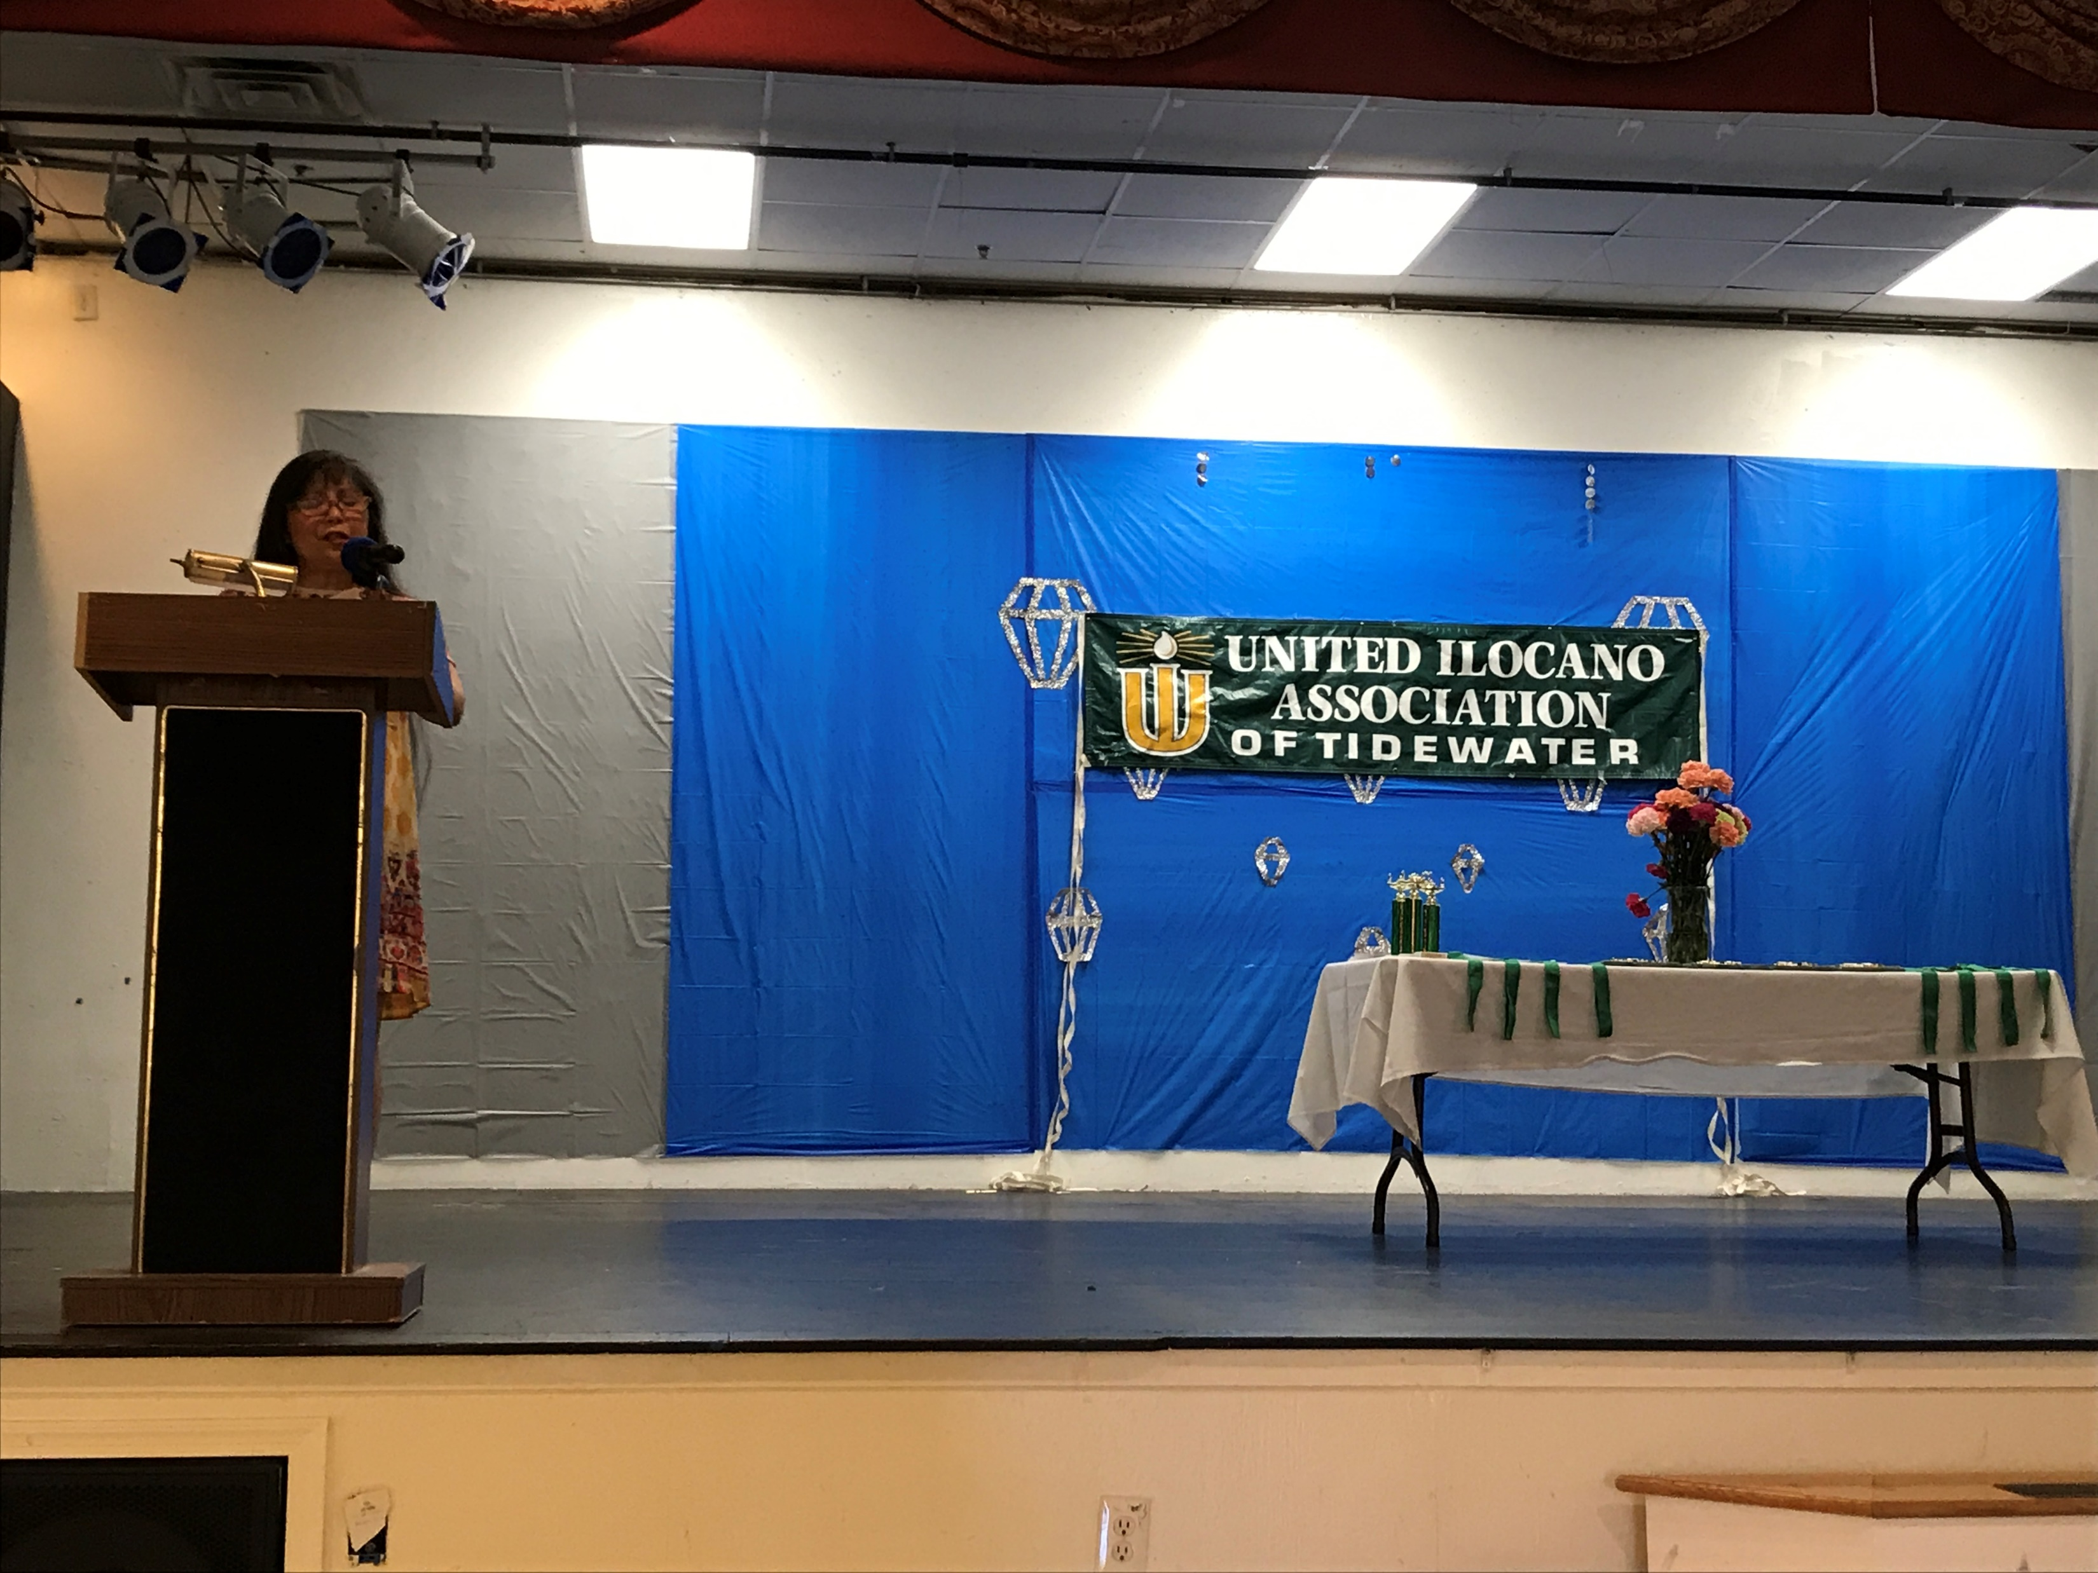
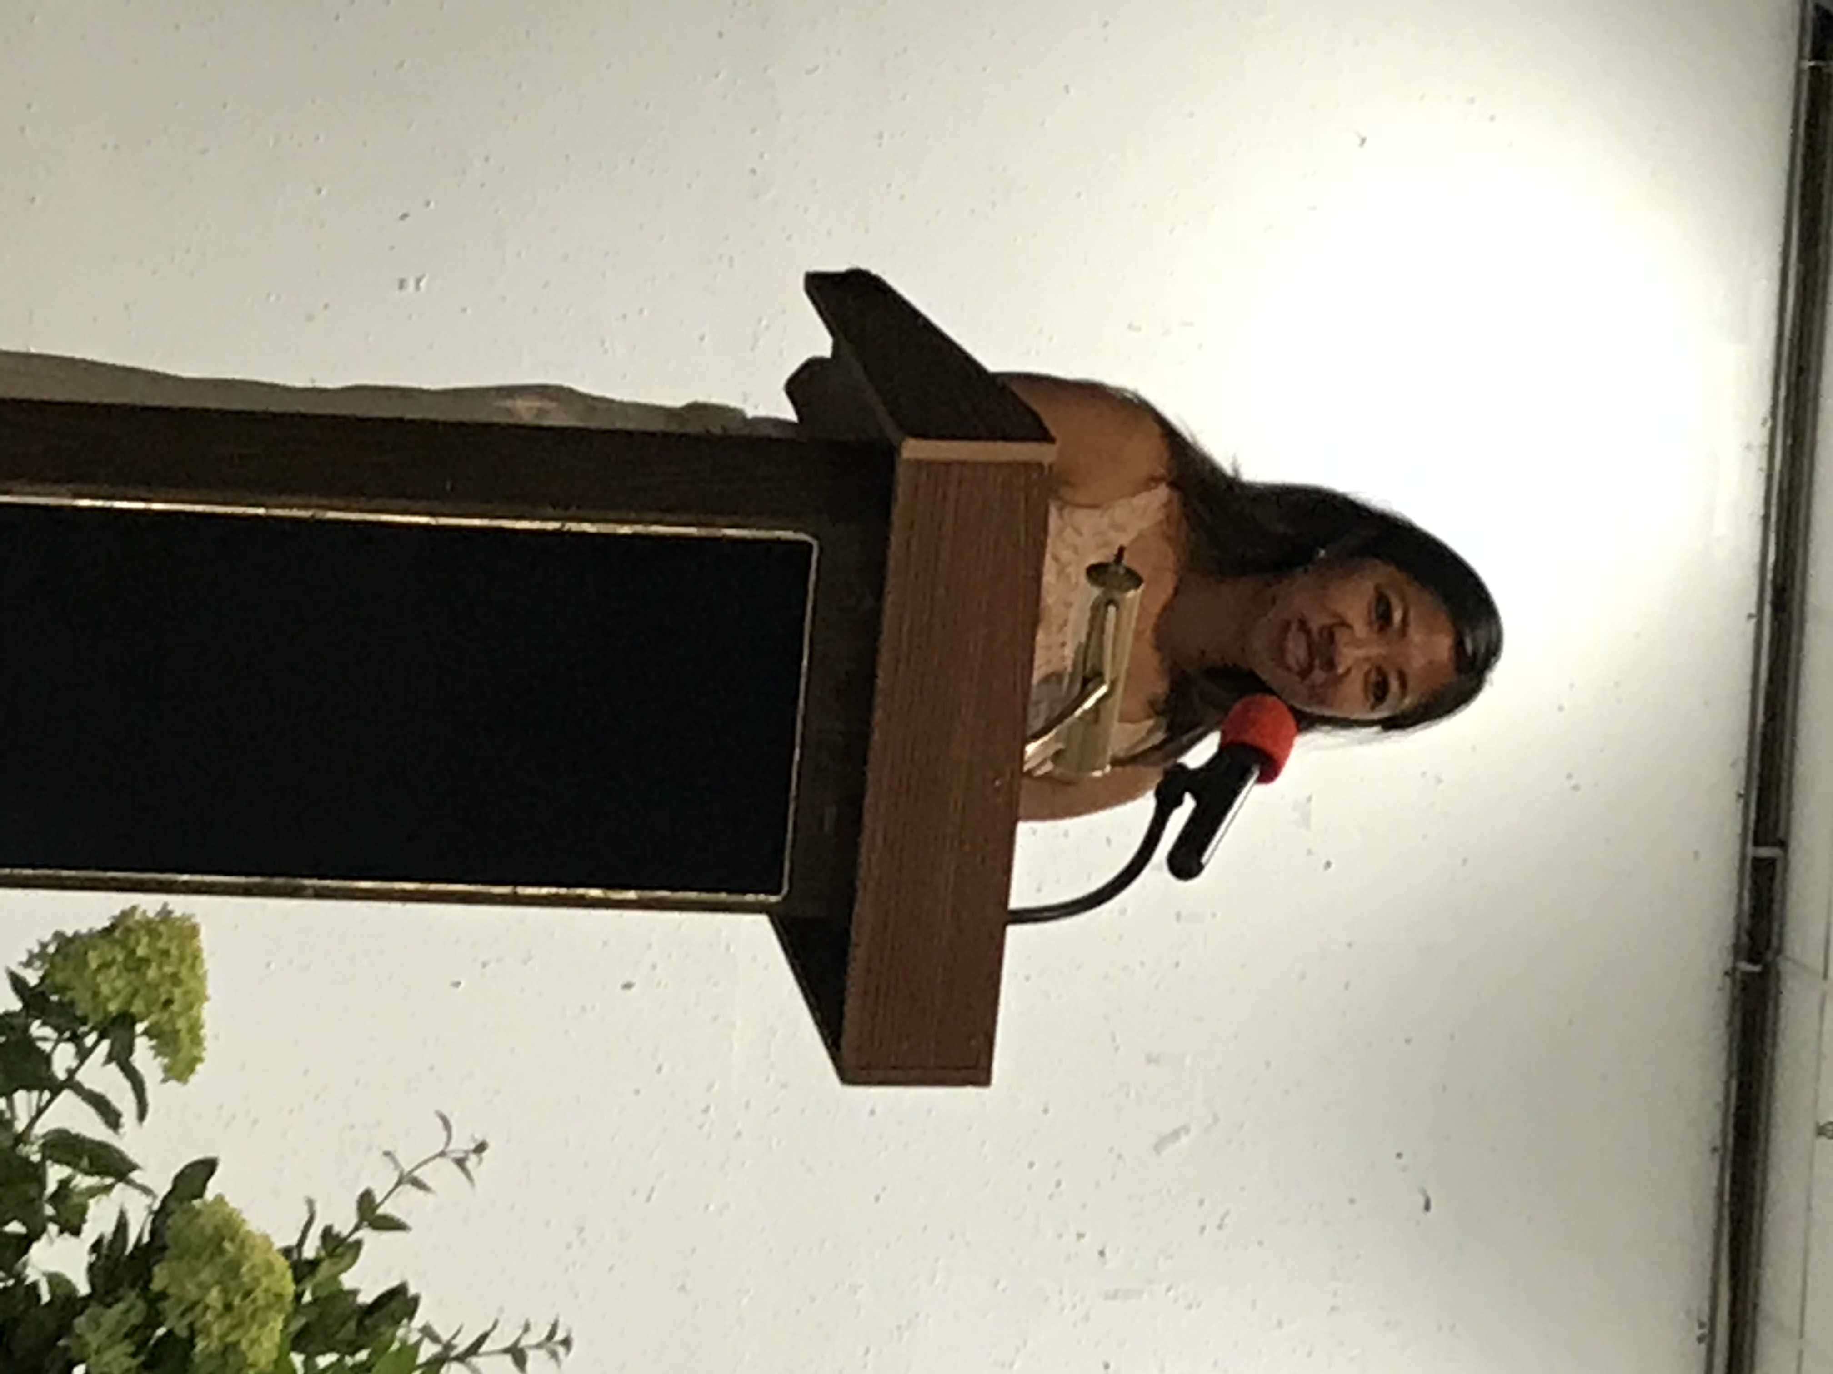
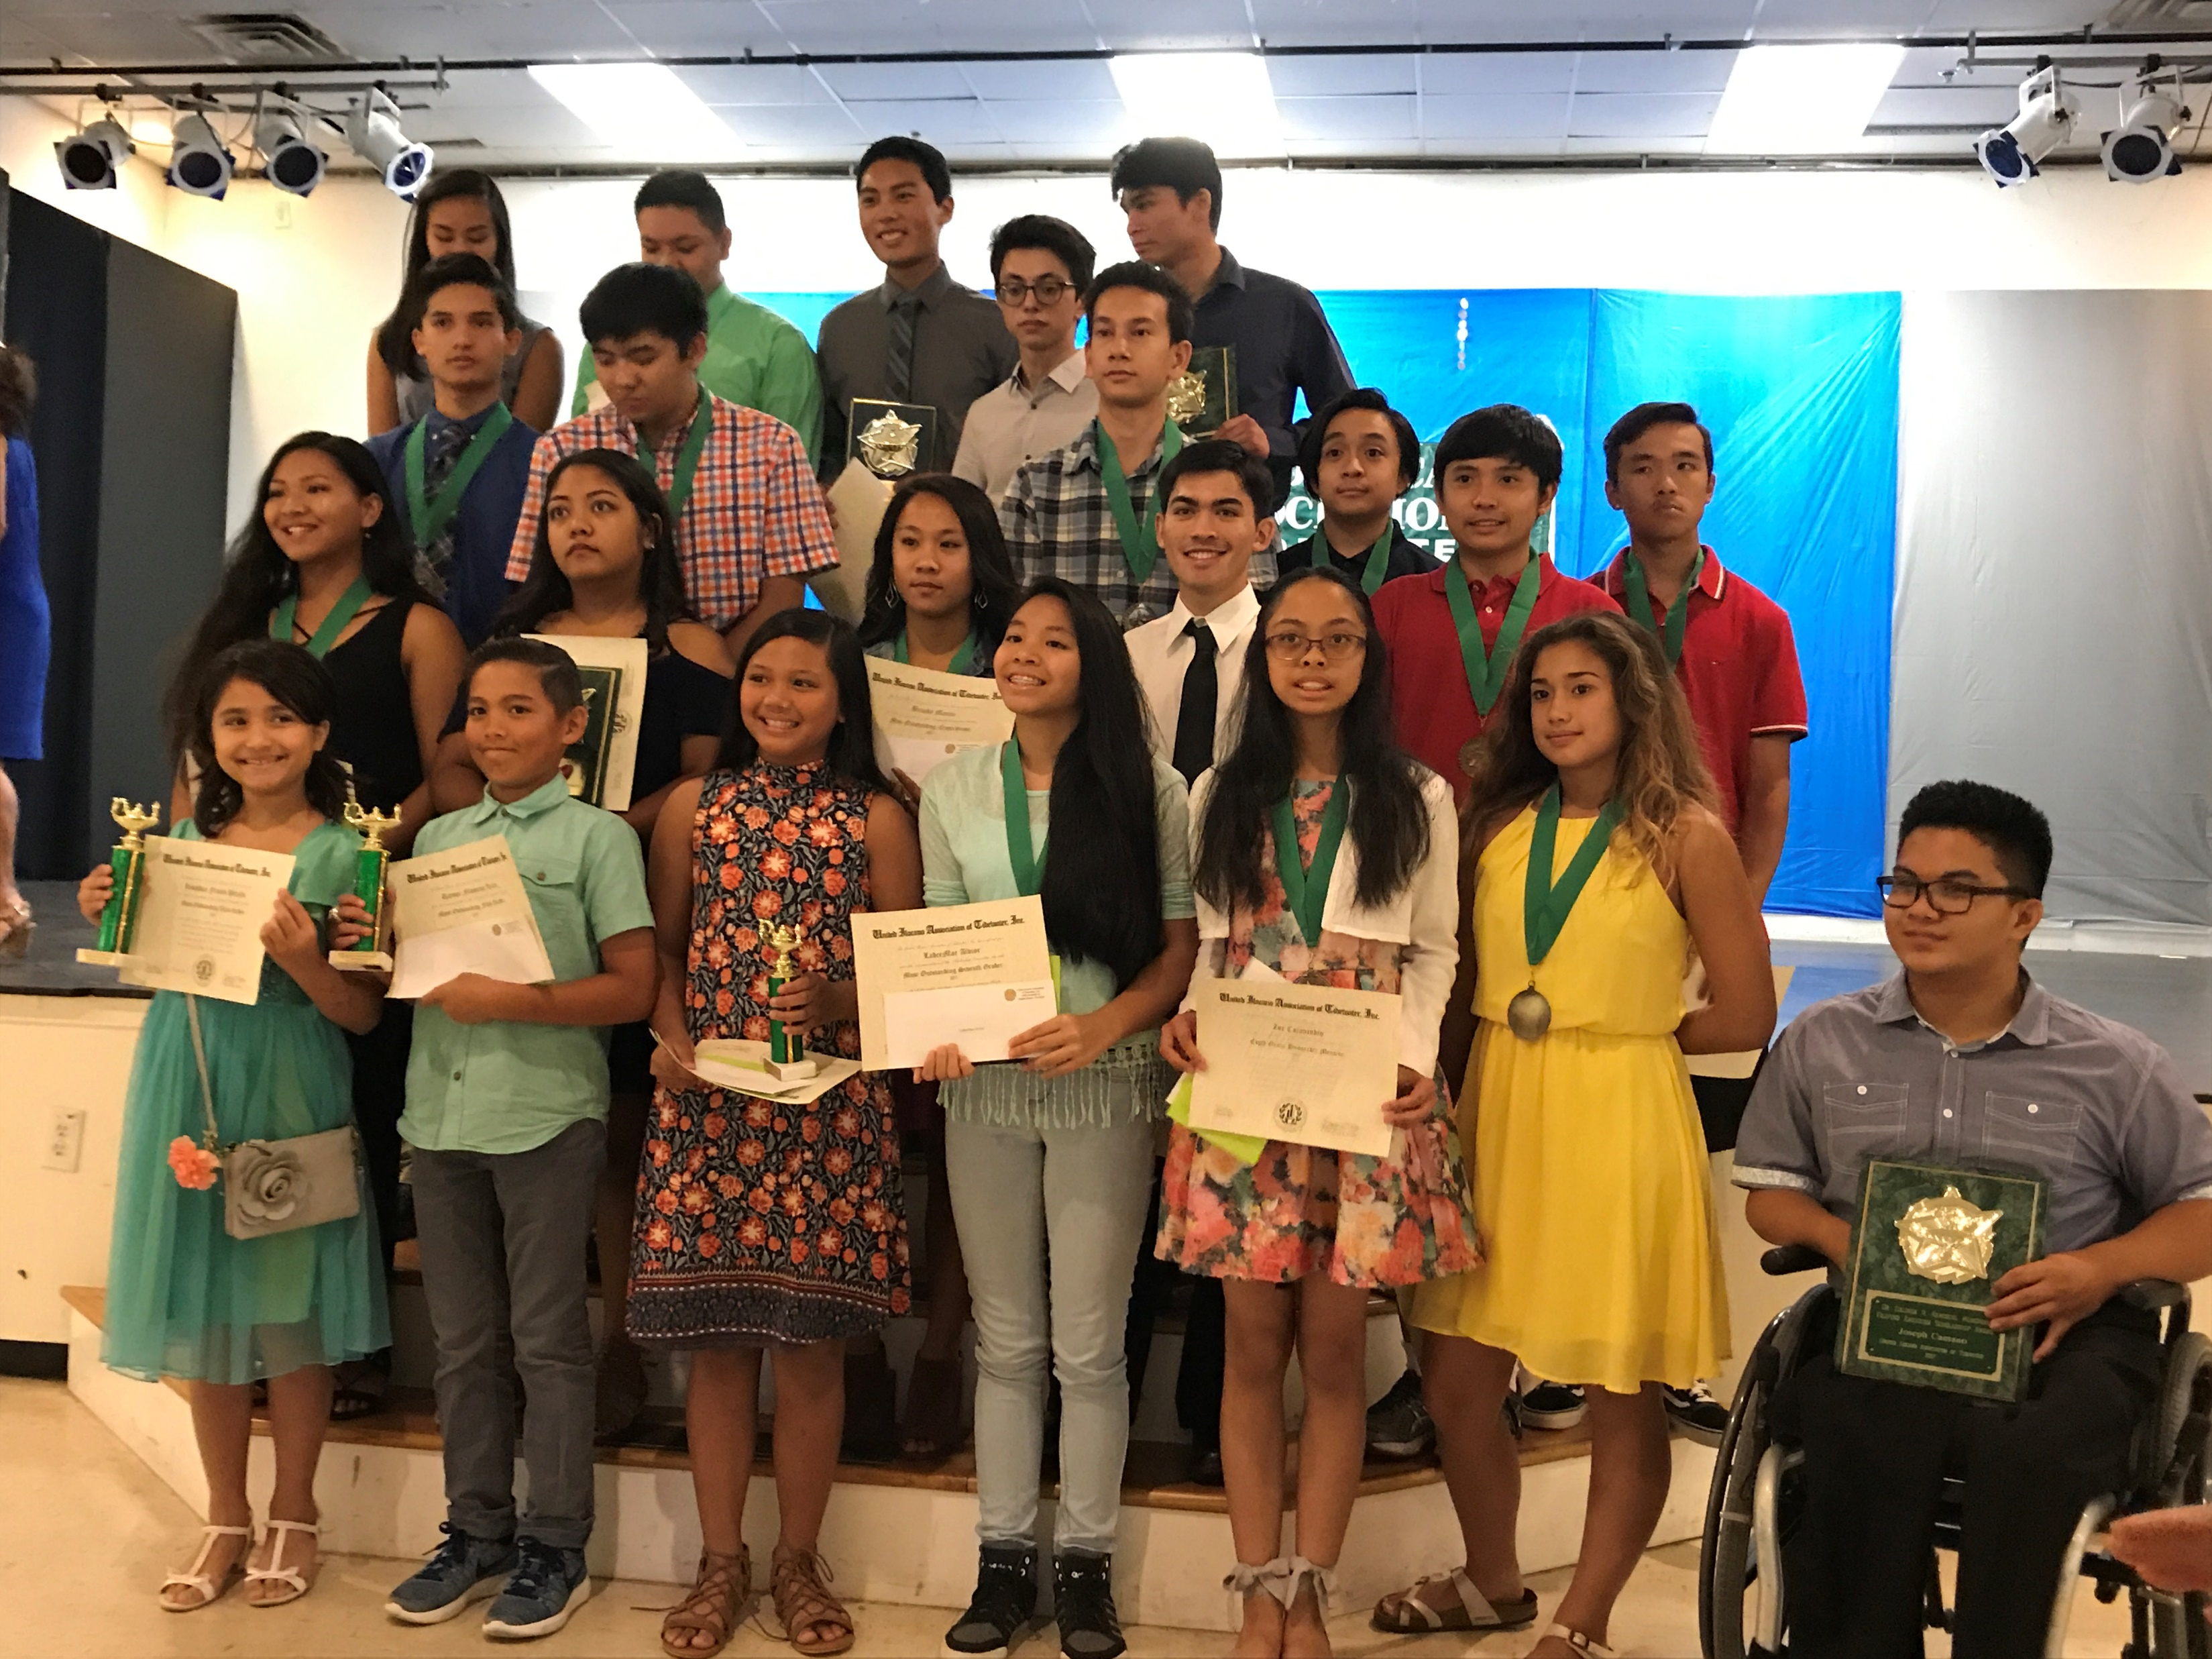

Slide 50
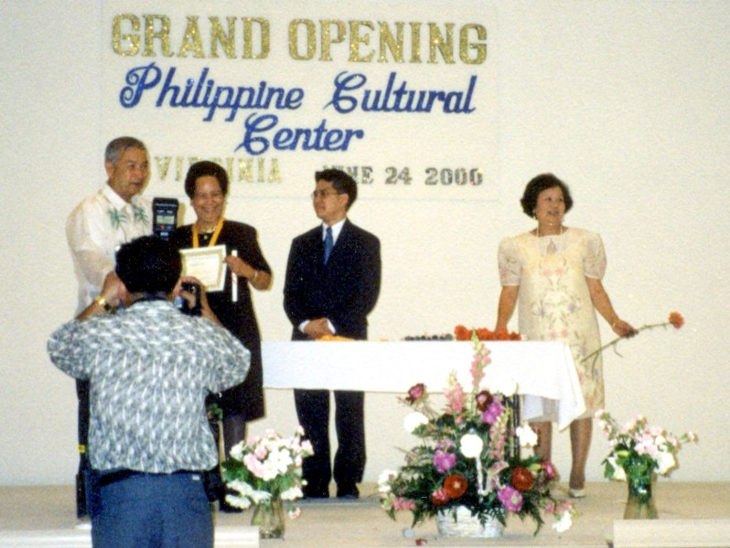
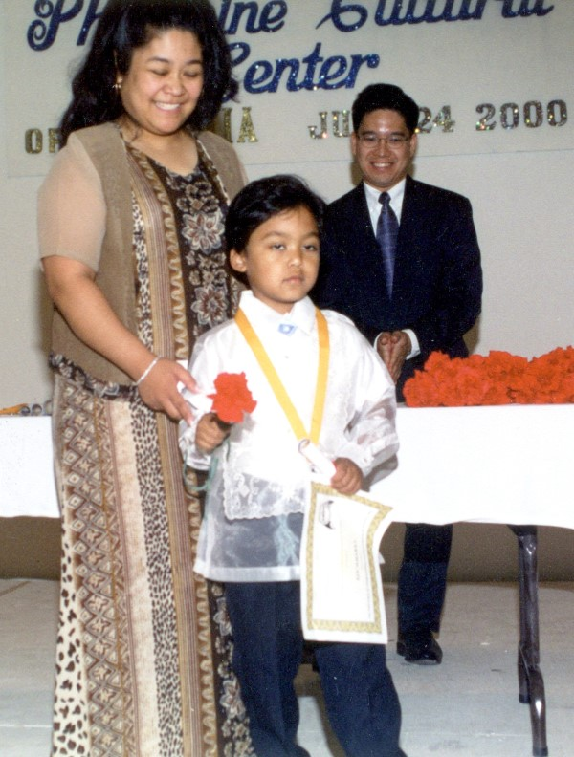

Slide 51
PCCVA as an
Educational Resource
Services and Community outreach
  AARP-supported senior health fairs
  Philippine Embassy Consular Events
  Fundraisers for disasters in Philippines
    Eruption of Mt. Pinatubo & Mayon Volcano
    Floods, typhoons
  Site for search party planning and press conference for missing mother – Bellamy Gamboa
  New school supply drive during Aug. 2018 for students and teachers of Virginia Beach Title 1 schools

Slide 52
PCCVA as an
Educational Resource
Convener for Filipino generations
  Taste of Art drew young Filipino culinary, visual and performing artists to share their crafts
  Legacy Celebration bringing founding mothers and fathers together with next generations
Source for Filipino guidance
  Filipino families from same province
  Filipino professionals and services
  Filipino restaurants
  Trusted recommendations for newcomers to the region

Slide 53
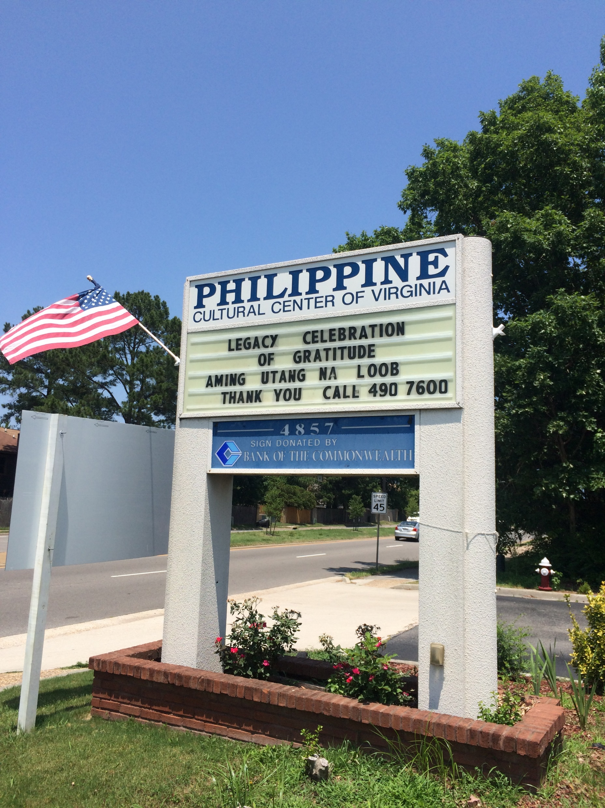

Slide 54
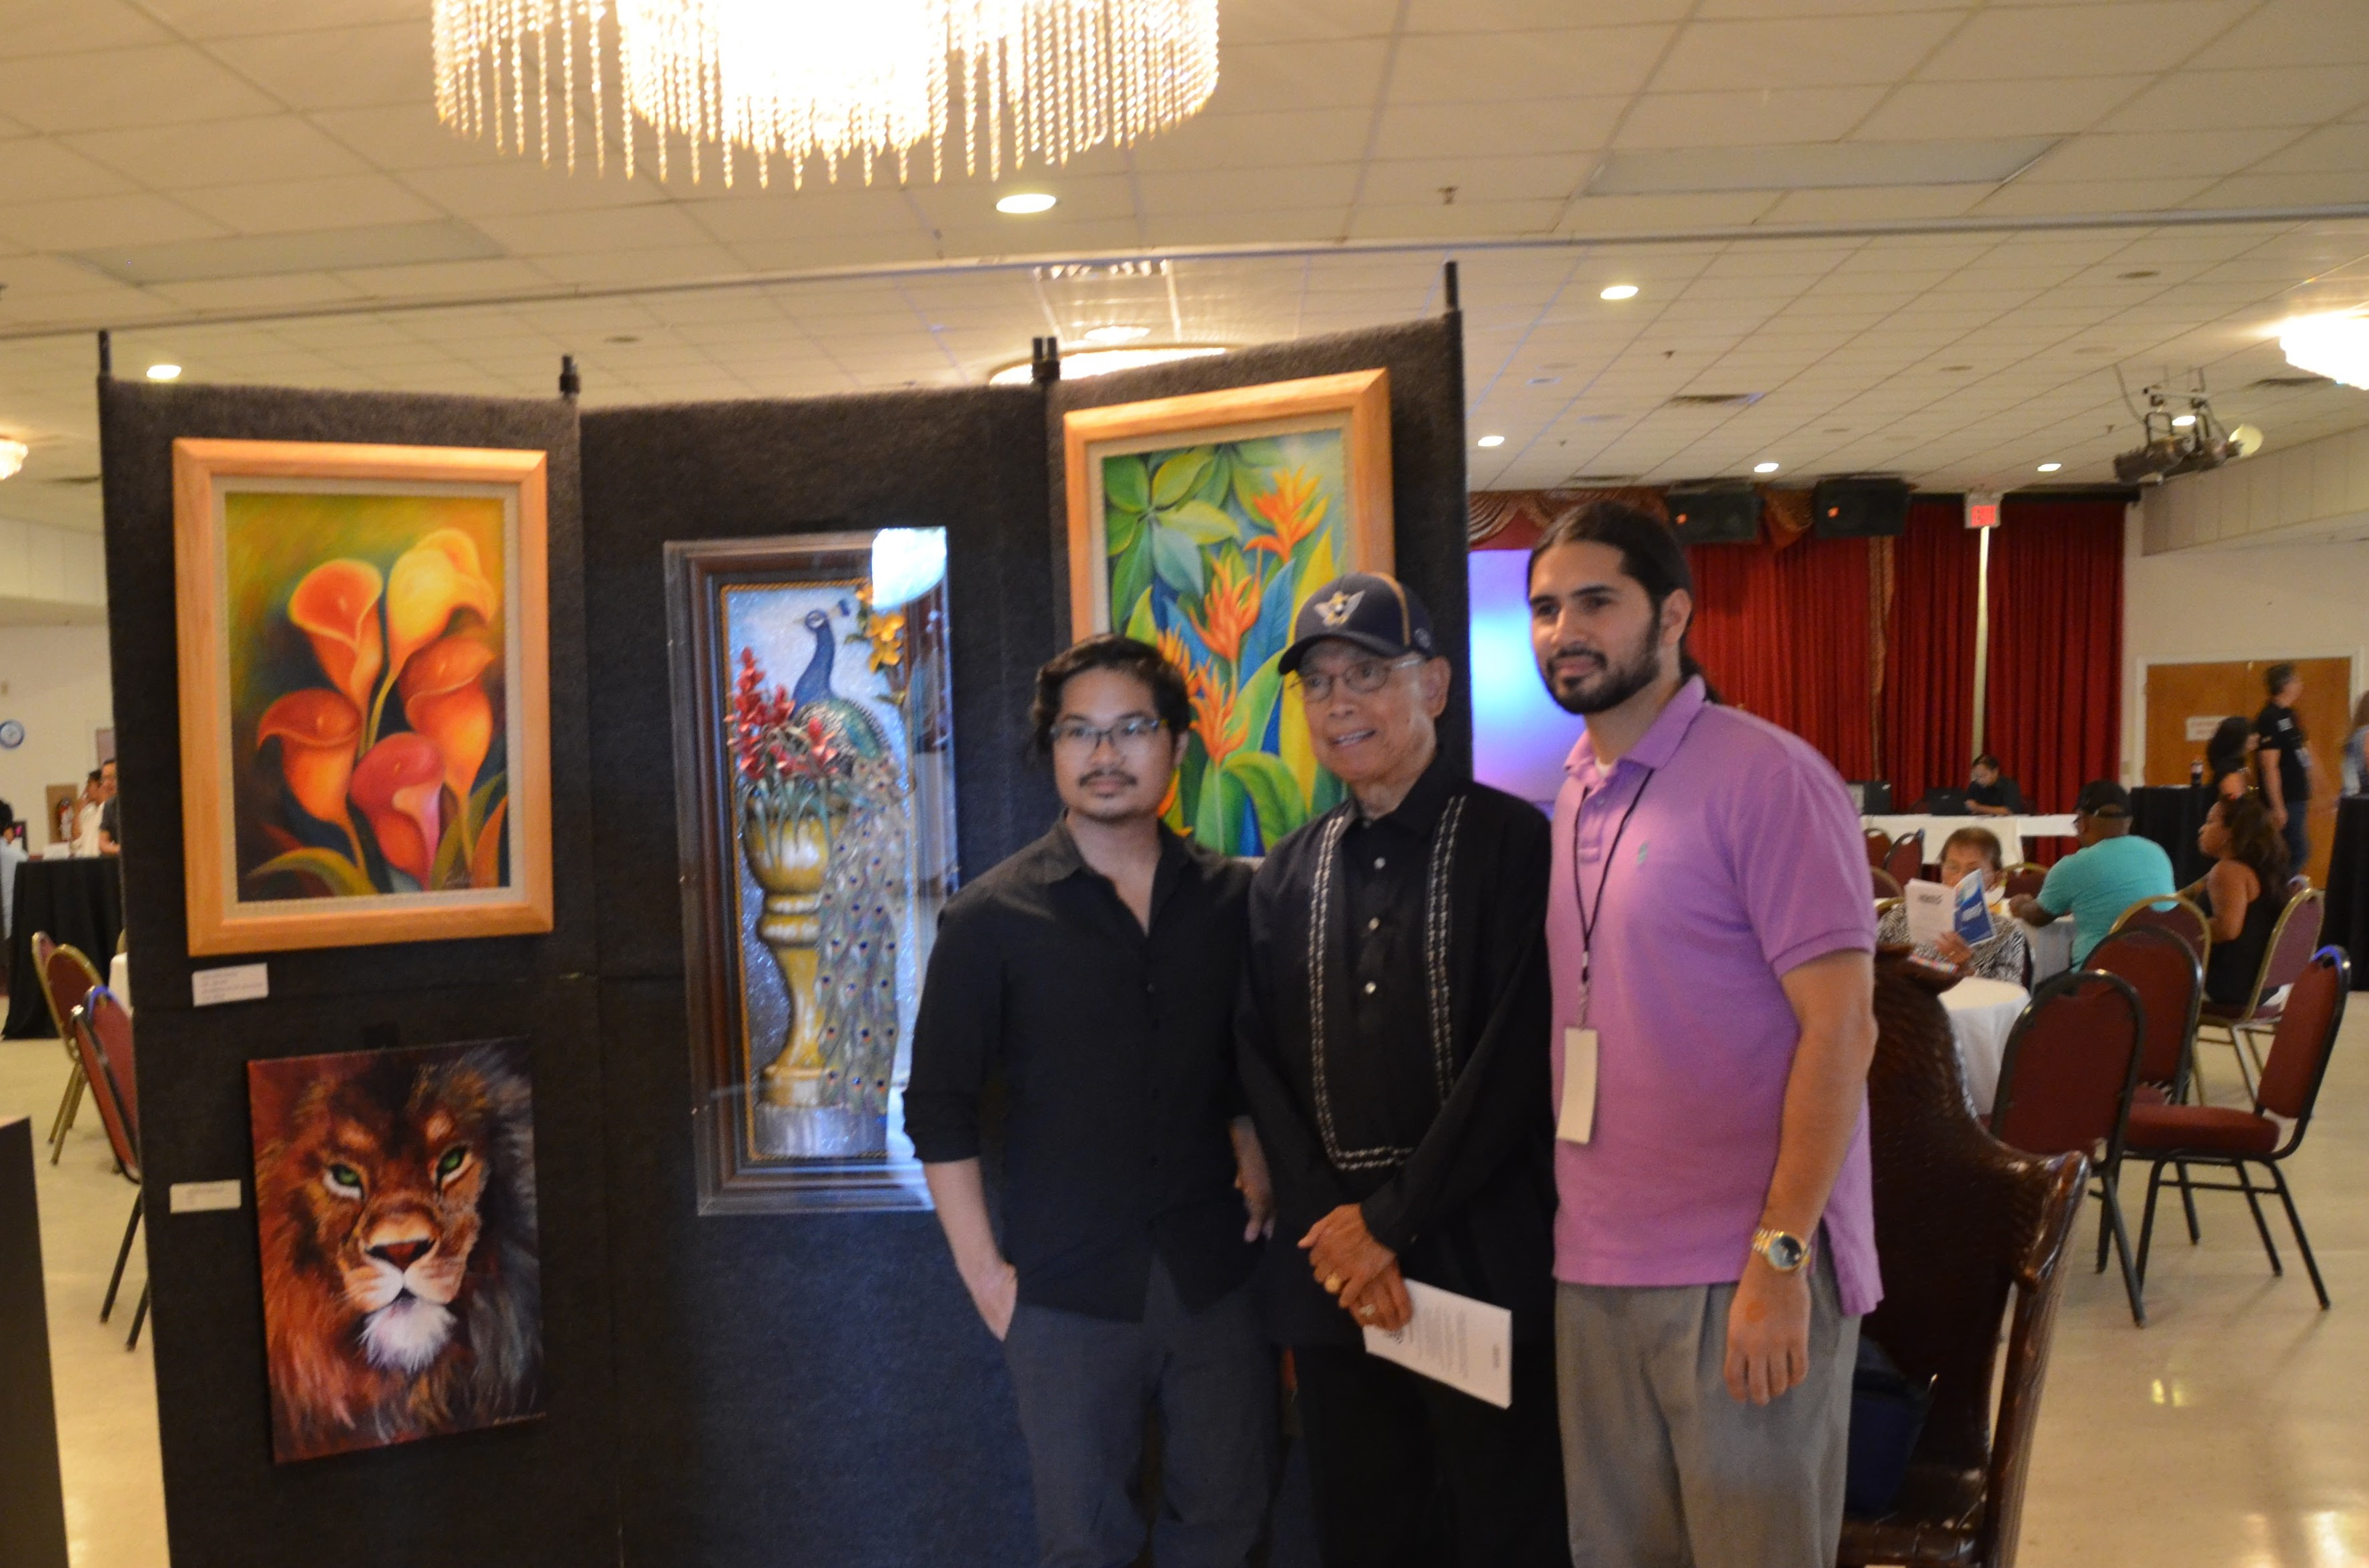

Slide 55
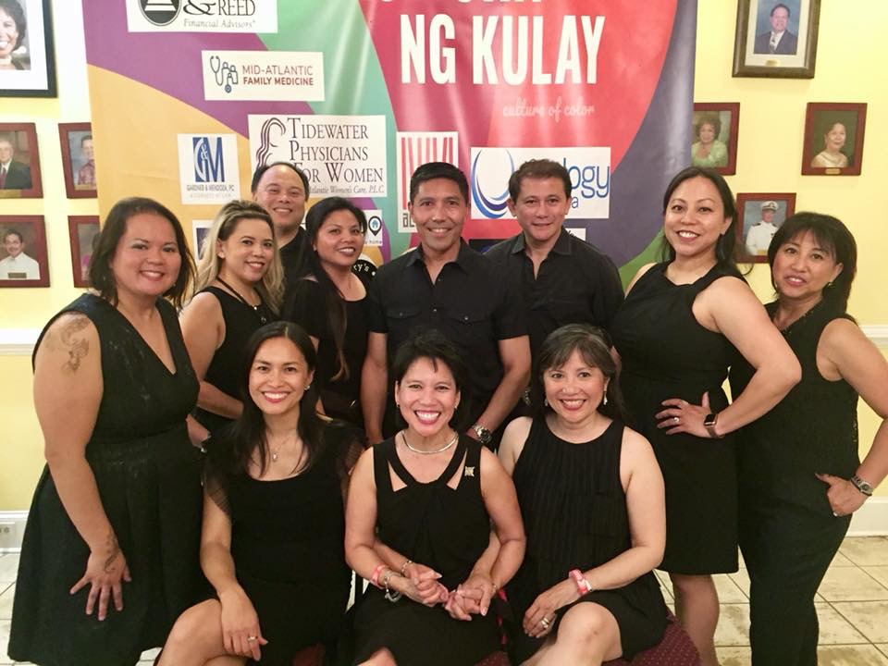

Slide 56
PCCVA as an
Educational Resource
Hub of regional Filipino activities and collaborations
  Visit of Miss Universe Pia Wurtzbach during FilFest 2016
  Fil-Am Friendship Day
  Support Filipino and other leaders

Slide 57
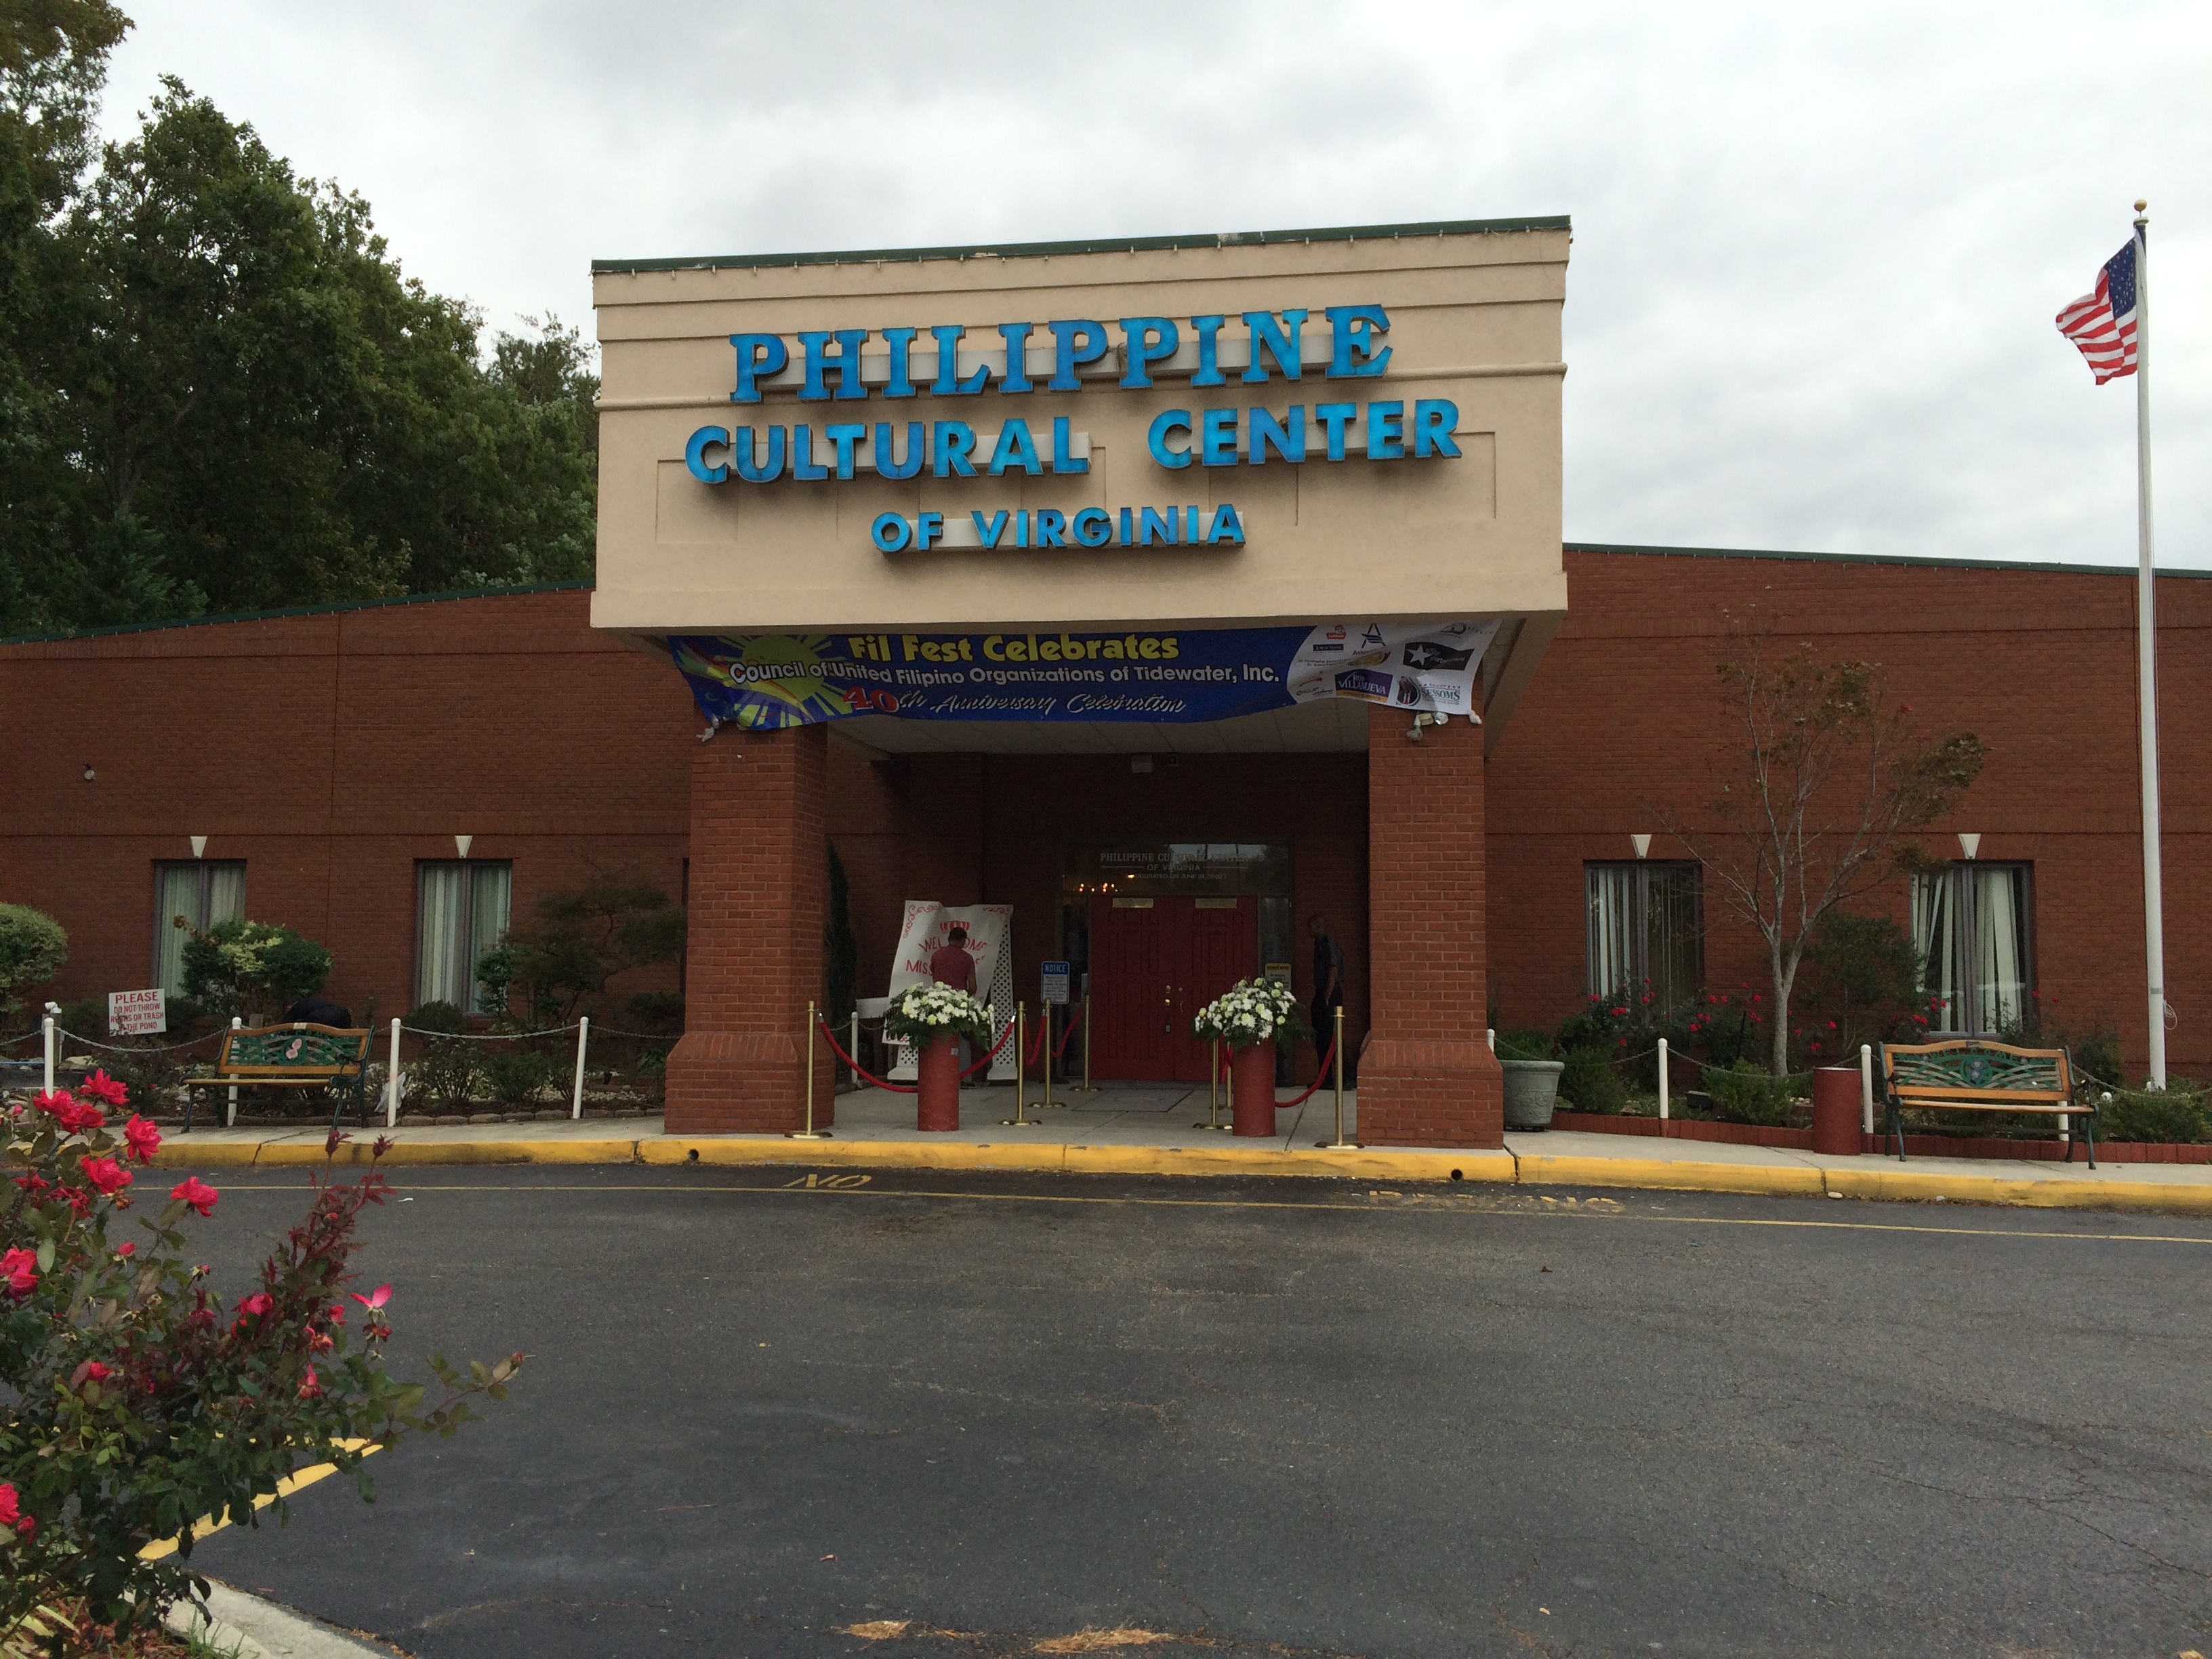

Slide 58


Slide 59


Slide 60


Slide 61
Maraming Salamat, po!
Thank you very much!
Mabuhay, PCCVA!
Cheers and long live, PCCVA!
Philippine Cultural Center
4857 Baxter Road
Virginia Beach, Virginia 23462
Telephone: 757-490-7600
Web: http://philippineculturalcenter.com

