Slide 1
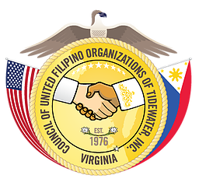
In-House Content Academy for Born of Empires: Filipino Americans in the United States and Virginia, 1565 to the Present Presentation for: Filipino Americans in the U.S. Armed Forces: We Fought for Freedom Monday, 6 August 2018, 3:30-4:30PM
Prepared by:
Jeffrey Acosta
Vice President
Filipino American National Historical Society-Hampton Roads (FANHS-HR) Chapter
Copyright Jeffrey Acosta, 2006
All rights reserved.
Sponsor Organizations
The MacArthur Memorial

Slide 2
The Filipino Americans: We Fought for Freedom The Big Ideas
Big Idea 2: Filipino Americans served in the Armed Forces of the United States as early as the War of 1812. Military service as a tradition within many Filipino American families to this day.
Big Idea 1: Immigrants to the United States have use service in the Armed Forces of the United States as a pathway to citizenship and inclusion into American society.
The US 12th (Philippine) Infantry Division was established and constituted within the regular U.S. Army at Fort McKinley, Philippine Islands, between 7 December 1921 and 10 April 1922. The mission of the division was to defend the Philippine archipelago, at the time was a colony and then Commonwealth of the United States, from potential invaders. The division fought heroically in World War II during the First Philippine Campaign, 1941 1942.
Philippine Scouts Celebrate a victory over the Japanese during the Battle of Bataan, January to April 1942. During World War II the Philippine Scouts were considered elite troops who were highly respected by their American counterparts and their Japanese enemy.

Slide 3
The Filipino Americans: We Fought for Freedom
Filipino Americans have a distinguished record of service with the United States Army, Navy and Marine Corps as depicted in the World War II poster illustrated above. During World War II the Philippines was a Commonwealth and territory of the United States.
Americans of Filipino ancestry served in the U.S. Army as early as the war of 1812. Anecdotal evidence collected by the Department of Defense suggests that some of the so-called "Manilamen" participated as part of the force assembled by French buccaneer Jean Baptiste Lafitte to help Gen. Andrew Jackson defend New Orleans from British invasion in 1815 -- the last battle of the War of 1812.
World War II Poster “The Fighting Filipinos” by Manuel Rey Isip, 1943. The Philippine Commonwealth government, in exile in the United States, commissioned a poster.

Slide 4
Question for consideration: Why did Filipino Americans fight for both Confederacy and the United States during the Civil War?
The Filipino Americans: We Fought for Freedom The American Civil War 1861-1865
Historical research concerning Filipinos serving in the Union and Confederate Armed Forces during the Civil War is in its preliminary stages. U.S. Navy veteran Nestor Palugod Enriquez is a leader in this research. He reviewed the personnel records and muster sheets of Civil War veterans at the National Archives and Records Administration and was able to identify 42 Filipino-Americans who served in the US Army and U.S. Navy, and eight who served in the Confederate States Navy during the Civil War.
However, research into personnel records and muster sheets is only the beginning. What we do not know is why these Filipinos fought for either the Union or the Confederacy during the American Civil War. For example, most historians agree that approximately 25% of those serving in the Confederate Army owned slaves. There are no records at this time indicating that Filipino Americans living in former Spanish colonies such as Louisiana, Mississippi, Alabama, Florida and Texas owned slaves.
So why did Filipinos fight for the Union or the Confederate causes? Probably for the same reason that their European-American counterparts did: they firmly believed they were defending their communities. Filipino Americans in the U.S. Army and U.S. Navy were fighting to preserve the Union. Filipino Americans in the Confederate States Army and Navy were fighting for their interpretation of “state’s rights.” However, this is only speculation since the existence of letters, memoirs and diaries from these Filipino Americans have not been found. All we know for sure is that they fought for both sides of the Civil War.

Slide 5
The Filipino Americans: We Fought for Freedom The American Civil War 1861-1865
Felix Balderry joined the crew of an American merchant ship and arrived in the United States in 1860. He fought with the 11th Michigan Volunteers during the American Civil War. Unlike African Americans, Filipino Americans serving in the Union Army did not have to fight in racially segregated units.
The ship and medical logs of the CSS Gaines contained accurate rosters and descriptions of the crew. Six Filipino Americans served aboard the CSS Gaines during the Civil War. The CSS Gaines was destroyed in combat against the United States Navy during the Battle of Mobile Bay on 5 August 1864. The fate of the six Filipino American crewmen after the battle is unknown.
Based on an examination of ship’s log and official reports, thirty eight Filipino Americans have been positively identified as having served in U.S. Navy during the Civil War.

Slide 6
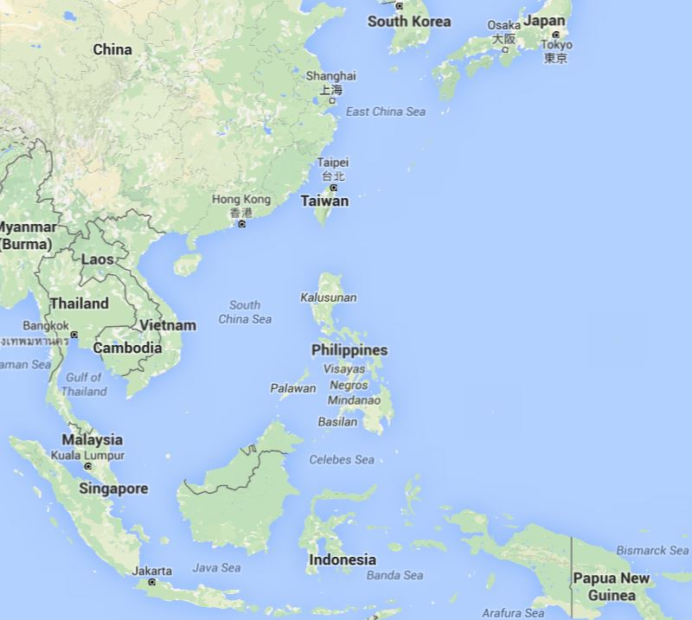
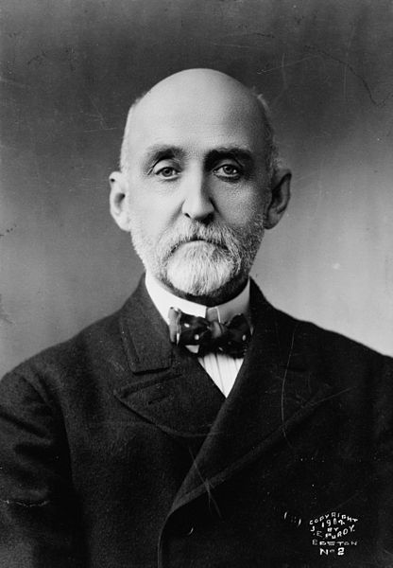
The Spanish-American and Philippine-American Wars 1899-1902
Questions for consideration:
Why did the United States conquer the Philippines between 1898 and 1902?
Why did Filipinos help the United States conquer and then defend the Philippines?
Map: Since 1898 the control and access to the South China Sea was and still is a critical element to U.S., Chinese and Japanese foreign policy. Even today who ever controls the South China Sea controls trade in western Asia and Pacific. For this reason in the United States Navy developed plans to seize control of the Philippine archipelago in the event of war with Spain.
Below Right: Captain Alfred Thayer Mahan (1840-1914), in his book The Influence of Sea Power on History (1890), postulated that a strong navy is required in order to conduct global economic and territorial expansion. The book was and continues to be required reading in the naval academies and ship’s wardrooms of the world’s major naval powers.

Slide 7
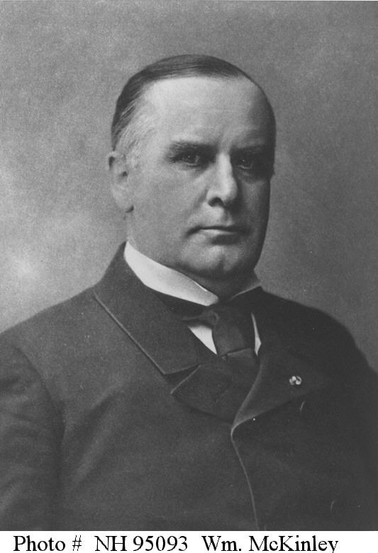
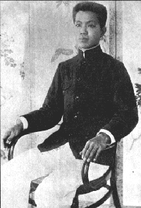
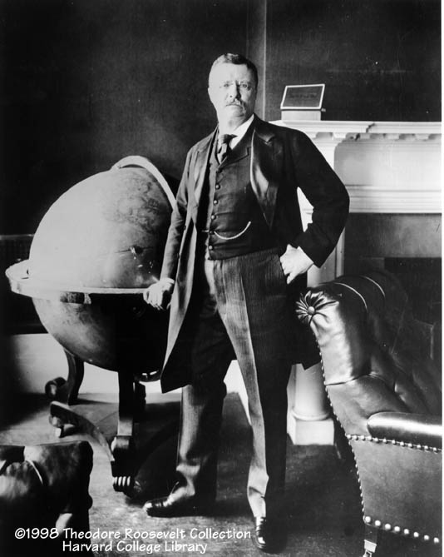
Chronology of the Philippine-American War 1899-1902 The United States and Philippine Leadership
Left to Right: President William McKinley, General and President of the First Philippine Republic. Emilio Aguinaldo, President Theodore Roosevelt

Slide 8
Chronology of the Philippine-American War 1899-1902
Questions for consideration:
How many of you knew the United States fought a war in the Philippines between 1898 and 1902?
Why did the United States colonize the Philippines from 1898 to 1946?
What was the irony of the United States acquiring a colony in the Philippines?
Was President McKinley justified in colonizing the Philippines?
What were the challenges Filipino nationalists led by Emilio Aguinaldo faced in attempting to create the first republic in Asia?
Why did the United States win the Philippine-American War?
What was the cost and responsibilities of the United States in colonizing the Philippines?

Slide 9
Chronology of the Philippine-American War 1899-1902
22-25 April 1898: Emilio Aguinaldo met with U.S. Consuls E. Spencer Pratt and Rounceville Wildman in Singapore. Aguinaldo claimed that the U.S. diplomats promised to support Philippine independence if a Philippine Army helped the United States defeat Spanish forces in the archipelago.
1 May 1898: The Battle of Manila Bay. Problem the Spanish control the land. Rear Admiral George Dewey asked the McKinley Administration to send the U.S. Army forces to occupy the Philippines. Shortly after the battle the McKinley Administration instructs Dewey and Pratt not to make any promises to the Filipino until a policy concerning the future status of the archipelago is determined by the United States.
6-7 May 1898. The Imperial Germany’s Pacific Naval Squadron enters Manila Bay to claim the archipelago for Germany if it is abandoned by the United States. According to Philippine historian Luis H. Francia, France, Great Britain and Japan “showed proprietary and predatory interest” in the Philippines sending their warships to the islands in 1898.
19 May 1898. The McKinley Administration instructed Dewey and Pratt not to make any promises to the Philippines concerning the archipelagos future. With no land forces at his disposal, and before he received instruction from President McKinley’s administration, Rear Admiral Dewey landed Aguinaldo at Cavite. He established a dictatorial government until a constitutional convention could be held. Because he was assisted by Dewey, Aguinaldo assumed the United States recognized a Philippine Republic. The McKinley Administration instruct Dewey and Pratt not to make any promises to the Philippines concerning the archipelagos future.

Slide 10
Chronology of the Philippine-American War 1899-1902
12 June 1898. Aguinaldo proclaims the a Philippine Republic. A Philippine Army quickly laid siege to Manila. 12 June is the Republic of the Philippines national day or the equivalent to the 4th of July in the United States.
Summer 1898: Warships from Great Britain and Japan arrive in the Philippines. The British and Japanese support U.S. sovereignty over the archipelago. Japan and Germany make plans to take over the Philippines in the event the U.S. does not.
3 August 1898: The American Army attacks and captures Manila. An uneasy truce develops between the Americans and Filipinos.
13 August 1898: Spanish forces in the Philippines surrender only to U.S. forces.
10 December 1898. The Treaty of Paris signed ending the Spanish American War. President McKinley decided that the Philippine Islands were not ready for independence because Filipinos were unable to defend their sovereignty. The U.S. purchased the archipelago from Spain for $20 million. The Philippine remained a territory of the United States until 1946.

Slide 11
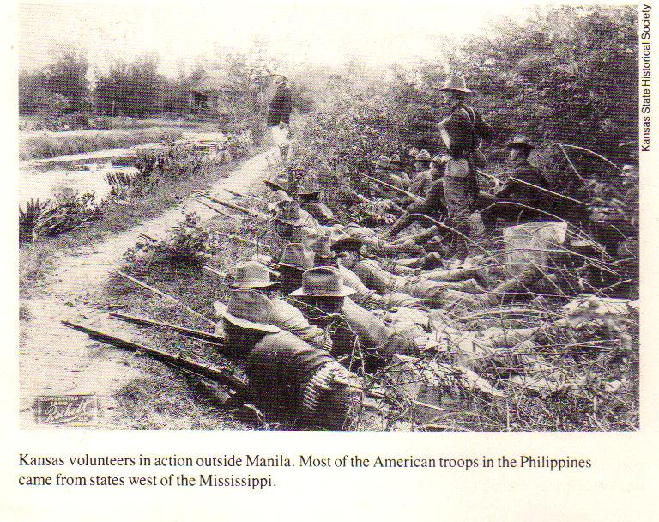
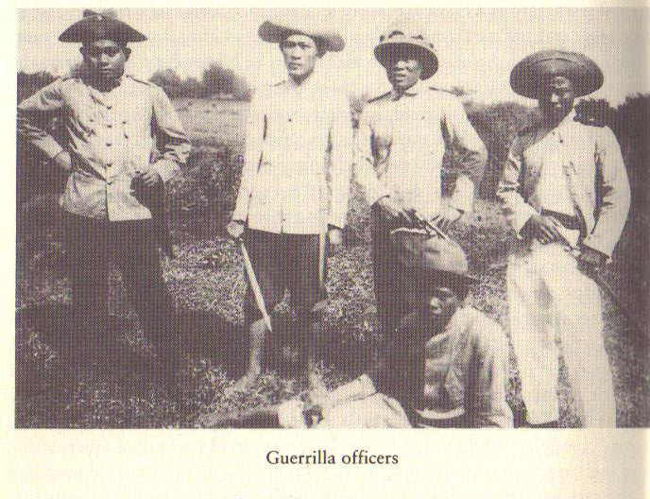
Chronology of the Philippine-American War 1899-1902
21 December 1898: President William McKinley announced the policy of “Benevolent Assimilation” towards the Philippines.
“Finally, it should be the earnest wish and paramount aim of the military administration to win the confidence, respect, and affection of the inhabitants of the Philippines by assuring them in every possible way that the full measure of individual rights and liberties which is the heritage of free-peoples, and by proving to them that the mission of the United States in one of benevolent assimilation substituting the mild sway of justice and right for arbitrary rule.”
Bottom Line: Pres. McKinley’s announcement amounted to a declaration that the Philippines was a territory of the United States. This was accepted by the European powers and Japan who viewed the acquisition of the Philippines by the United States from Spain as nothing more than a transfer of real estate between two sovereign nations since they did not recognize Philippine sovereignty.
4 February 1899: War breaks out between American and Filipino forces.

Slide 12
Chronology of the Philippine-American War 1899-1902
The Treaty of Paris of 1898 that ended the Spanish-American War was controversial in the United States. Two political groups formed. The Americans in opposition of acquiring the Philippines as a U.S. colony were called Anti-Imperialists. Americans in favor of acquiring the Philippines as a U.S. colony were called Imperialists.
Mark Twain, Jane Addams and the African American Press were leading voices in the Anti-Imperialist Movement. The Anti-Imperialists felt the U.S. purchase of the Philippines for $20 million was immoral and against the historical precedent that the United States only took territory that was intended to become part of the United States. They noted that the Philippines like all colonies would be an economic and military burden on the economy and government of the United States. The African American Press accused the McKinley Administration of exporting American racism and segregation to the Philippines. However, the Anti-Imperialist Movement also included white nationalists such as Andrew Carnegie offered to pay the United States government $20 million to let the Philippines go because the United States was land for Europeans (Whites) that already had a large population of “colored” people (Americans of African, Chinese and Japanese ancestry and North American Indians) that the U.S. Government did not take care of, and denied them full civil rights under the U.S. Constitution.

Slide 13
Chronology of the Philippine-American War 1899-1902
The Imperialist led William McKinely based their position on the historical and legal precedent used to recognize the United States in 1783, and the legal precedent used to not recognize the sovereignty of the Confederate States of America during the Civil War in 1861. Basically, the Philippines had no rights as a sovereignty nation since no other nation recognized that sovereignty. In addition, the Filipinos and the First Philippine Republic were unable to defend that sovereignty in 1897 and again in 1899. Their position was that once the American flag flew over the Philippines, the nation would be disgraced if it was hauled down. Finally, others such as President McKinley and future President William H. Taft felt that if the United States did give up sovereignty of the Philippines it would as an independent nation. They felt it was equally wrong to grant the Philippines independence only to have another imperial power colonize the Philippines.
Bottom line: On 6 February 1899, the United States Senate ratified the Treaty of Paris and accepted sovereignty over the Philippines by a vote of 57 to 27. The treaty was ratified by one vote more than the required two-thirds super majority required under the US Constitution. By then the first shots of the Philippine War had been fired. The 1st Philippine Republic and the United States were at war.

Slide 14
Chronology of the Philippine-American War 1899-1902
The Judge was a leading American Anti-Imperialist magazine. The editors of the magazine were highly critical of United States policy in the Philippines during the Philippine- American War. Rudyard Kipling, noted British author, wrote a poem Take Up the White Man’s Burden in which he mocked the United States, a frequent critic of British colonial policy, for hypocrisy in the Philippines.
The cartoon below from The Judge magazine in 1902 accurately reflected the policies implemented by the United States that ended the Philippine-American War. The United States gave Filipinos a choice: continue the war and face devastation, or except American sovereignty over the archipelago and prosper under American tutelage. By 1912, the United States government enacted legislation that began the movement to grant the Philippines sovereignty.

Slide 15
The U.S. Recruits Indigenous Forces during the Philippine American War 1899-1902 the U.S. Armed Forces
The Philippine-American War resulted in a second wave of Filipinos joining the U.S. Armed Forces. In 1899, the U.S. Army forces fighting in the Philippines took advantage of the political and cultural divisions among Filipinos to conquer the archipelago. As they did during the wars against the North American Indians, the U.S. Army recruited Filipinos who had superior knowledge of the terrain, spoke the languages and were hostile the “dictatorial” regime of Emil Aguinaldo. Aguinaldo did not command the loyalty from all Filipinos who from their view point declared himself President of the First Philippine Republic without an election. On 10 September 1899, the Military Governor General of the Philippines, Lieutenant General Elwell S. Otis, authorized the creation of the first native Filipino unit to join the U. S. Army, the Macabebe Scouts.

Slide 16
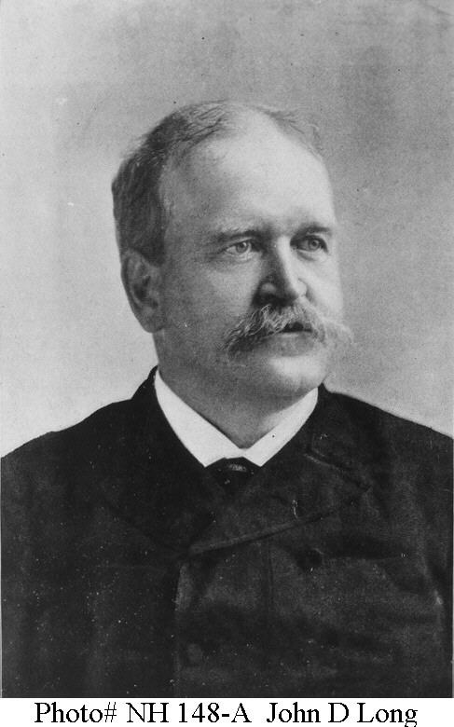
The Insular Force: The Second Wave of Filipino Sailors in the U.S. Navy
The U. S. Navy placed a maritime blockade around the archipelago preventing weapons and supplies from reaching the Filipino forces and preventing the Philippine Republics forces spread out throughout the archipelago from communicating by sea. In addition, naval vessels support the Army’s movement from island-to-island. This required the Navy to raise, repair and commission Spanish warships ships sunk or captured by Dewey. Sailors were needed to man these vessels. Taking a cue from the Army, Secretary of the Navy John D. Long, authorized the enlistment of 500 Filipino sailors to serve with the Insular Force on 8 April 1901.
The Filipino sailors serve aboard former gunboats of the Spanish Navy such as the USS Isla de Luzon pictured to the right.
The Filipino sailors of the Insular Force were assigned all jobs required to run a ship. Like their brothers serving in the United States Army, Filipino sailors were paid less than their American counter parts. For example, a “Native machinist, first class” was paid $28.00 a month. However, this was a substantial salary in the turn of the century Philippines. As a result the Navy was always able to recruit the sailors required to man the insular force.
The ships of the insular Navy allowed the United States to impose an effective maritime blockade around the archipelago by cutting off all of Aguinaldo’s and the Philippine Republic’s sea lines of communication and supply. The Filipino sailors serving with Insular Force contributed to the decision by the US Navy to permit Filipinos to enlist in the Navy after the Philippine-American War ended in 1902.

Slide 17
Frederick Funston and the Macabebe Scouts Capture Emilio Aguinaldo
Above Left: Macabebe Scouts. Above Right: Frederick Funston (left) Emilio Aguinaldo (right) aboard the USS Vicksburg after Aguinaldo’s capture.
At first Emilio Aguinaldo attempted to fight a conventional war against the United States Army and Navy. He was quickly defeated and by the fall of 1899 had converted to fighting a guerrilla war against the United States. The U.S. Army isolated Aguinaldo into the mountains and rainforests of northern Luzon. There he was safe from the U.S. Army, however, he could not communicate with his forces and the rest of the archipelago. In February 1901, US Army intelligence captured a message that revealed Aguinaldo's location. In March 1901, Lieutenant General Arthur McArthur authorized Captain Frederick Funston's plan to capture Aguinaldo. The U.S. Navy landed Funston and a 80 Macabebe Scouts on the coast of North East Luzon. The Macabebe Scouts pretended to be supporters of Aguinaldo bringing him several captured US Army officers. The Macabebe Scouts infiltrated Aguinaldo's headquarters where he was captured and returned to Lieutenant General MacArthur's headquarters. Aguinaldo was treated with respect and on 19 April 1901 he issued a proclamation calling on Philippine Republic soldiers and guerillas to lay down their weapons and accept the authority of the United States government over the Philippines. The majority of Aguinaldo’s supporters laid down the arms as he requested.

Slide 18
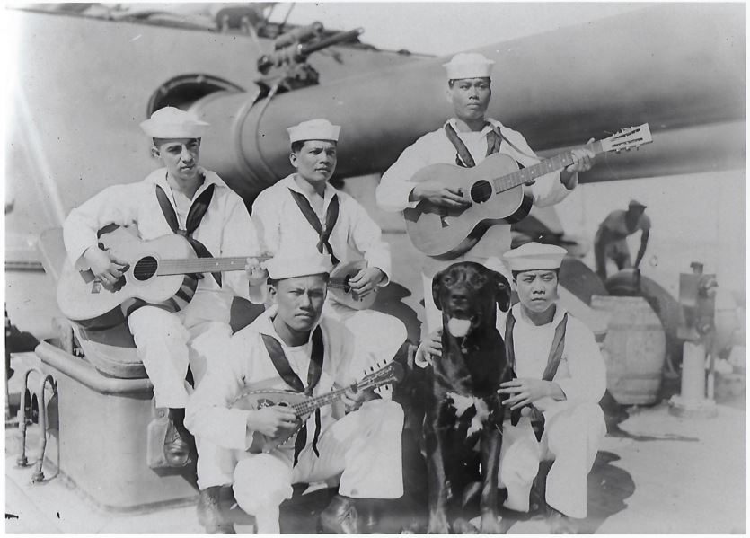
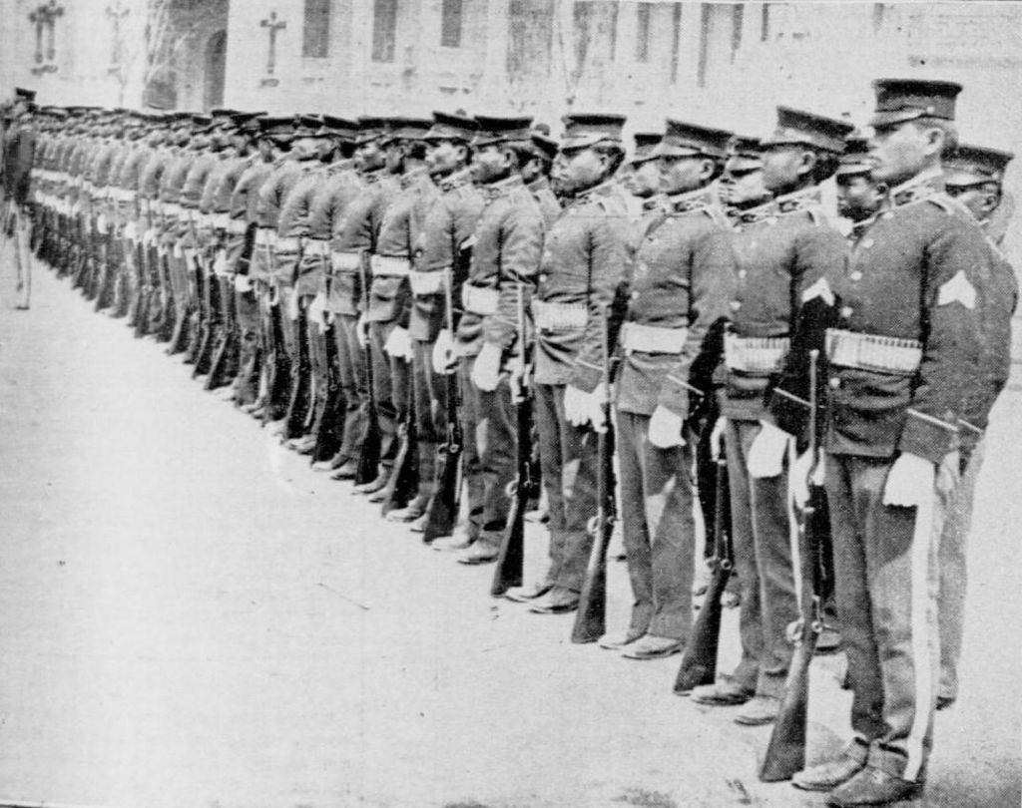
The Philippine Organic Act of July 1902 stipulated that, with the achievement of peace, a legislature would be established composed of a lower house, the Philippine Assembly, which would be popularly elected, and an upper house consisting of the Philippine Commission, which was to be appointed by the president of the United States.
1912: Woodrow Wilson is elected President of the United States. He signed the Jones Act of 1916. The United States government pledged to conduct a referendum on Philippine independence when 60% of adult males could read and write English, or 75% any language. Under Governor Frances B. Harrison, a program of “Filipinization” begins. Filipinos play a larger role in running the colonial government. For example, Filipinos soldiers and sailors are tasked with the responsibility of defending Luzon in the event of invasion.
1916: The U.S. Congress passes Jones Act 1916 eventually guaranteeing the Philippine independence. A part of the “Filipinization” Filipino forces will defend Luzon. The law established a Philippine Senate within the Philippine legislature. President Wilson signs the bill into law.
1917-1918: When the United States enters World War I, Nationalista Party leader Manuel Quezon, urges the Wilson administration to allow Filipinos to serve with the American Expeditionary Forces (AEF) in France. The War Department refuses the offer. However, Filipinos make up the majority of the U. S. Army forces based in the archipelago during the war. However, of 16,137 soldiers defend the Philippines that year, 6738 are Philippine Scouts. The U. S. Navy allows 6,134 Filipinos to serve with the fleet during the Great War. Filipino in the Regular Navy fought German U-boats in the Atlantic
Above: Filipino American mess stewards on the USS Seattle c. 1932. Below: Philippine Scouts on parade in 1905.

Slide 19
The Rizal Experiment: U.S. Warship Manned by Filipinos
27 August 1918. Secretary of the Navy Josepheus Daniels signs the order that the United States destroyer, hull number 174, will be named the USS Rizal. The destroyer is paid for by the Philippine Legislature and people of the Philippines provided the ship is manned by Filipinos and serves with the Asiatic Fleet. On 23 November 1918, the Navy solicits Filipino sailors with the Insular Force and Regular Navy to volunteer for service on the Rizal. They volunteer in over whelming numbers.
21 September 1918. The Rizal is launched at the Union Iron Works, San Francisco, California. The ship’s sponsor is Mrs. Sofia R. de Veyra, the wife of the Philippine liaison to the U. S. Congress. The ship weighs 1284 tons, is 314 feet long, 31 feet wide, with a maximum speed of 33.84 knots. On 28 May 1919, Rizal is commissioned in the United States Navy.
The commissioning crew of the Rizal consisted of 82 Filipino sailors recruited from ships and stations in the United States and the Philippines. 30 American officers and senior Chief and First Class Petty Officers made up the remainder of the crew.

Slide 20
The Rizal Experiment: U.S. Warship Manned by Filipinos
26 May 1919. During pre-commissioning work-ups, Rizal collided with the brigantine Hesperian in San Francisco Bay.
25 June 1919. Four weeks after the Rizal is commissioned, the commanding officer of the ship, Lt. E. S. Root files a report critical of the Filipino crew. Lt. Root reported that a Filipino crew will not be able to sail the vessel safely “unless their training extends over a considerable period under the leadership of Americans in responsible ratings…That the Americans should consider themselves in their positions as instructors and that they should be patient and painstaking in their dealings with the Filipinos, understanding many mistakes would be made due to lack of comprehension of the English language. They should express themselves in simplest terms; that they should not loose their temper, but repeatedly explain and endeavor to make themselves clear as to why certain things were or were not done; that they should in no way refer to difference in color or race.” Lt. Root requests the number of Filipino crewmen be reduced so 49 Americans can be added to the crew of 112.

Slide 21
The Rizal Experiment: U.S. Warship Manned by Filipinos
6 September 1919. The Department of the Navy responds to Lt. Roots report. His request is denied as the Navy demobilizes after World War I. Training of the Rizal crew continued.
2 May 1920. USS Rizal arrived in Manila and joined the U. S. Asiatic Fleet. Until the ship returned to the United States in 1931, she spent the summers training in China and the winter training in the Philippines. The ship was re-designated as a Destroyer Minelayer.
14 January 1922. The Department of Navy ordered that Filipinos serving in the Navy be paid the same as American sailors, “they should be made to be capable of performing the same duties as a regular or similar rating or should be disrated or discharged.”
24 April 1922. The ship’s commanding officer, Lt. D. M. Wood reported that many Filipinos assigned to the ships gun crews are “gun shy.” However, he also reported that the gun crews improved “100%” over the previous year. As training continues the Filipino gun crews gained confidence and were “improving, and if the same men continue they will overcome this trouble in time.”
25 September 1922. The Navy Department holds Lt. Eberhart responsible for the collision with the Hesperian.

Slide 22
The Rizal Experiment: U.S. Warship Manned by Filipinos
Between 1920 and 1931 the enlisted crew of the Rizal averages 110 (80 Filipinos and 30 Americans). The officers continue to be Americans and senior enlisted Chief Petty Officer billets are held by Americans.
11 December 1930. Rizal departs for the United States for decommissioning and scrapping. The ship is a victim of the provisions of the London Treaty for reduction and limitation of naval armament.

Slide 23
Between 1930 and 1932 the U.S. Navy was forced to drastically reduce as a result of the Great Depression. The U.S. Navy stopped recruiting racial minorities. In 1932, the Navy began recruiting racial minorities again. Filipinos were reluctantly excluded from this policy since the Navy Department officials believed the archipelago would soon be granted independence. In addition, the Navy Department was concerned about the legal status of Filipinos if the archipelago was granted independence. The recruiting ban has its worse impact on Filipino Americans in the United States since they too are prohibited from joining the Navy.

Slide 24
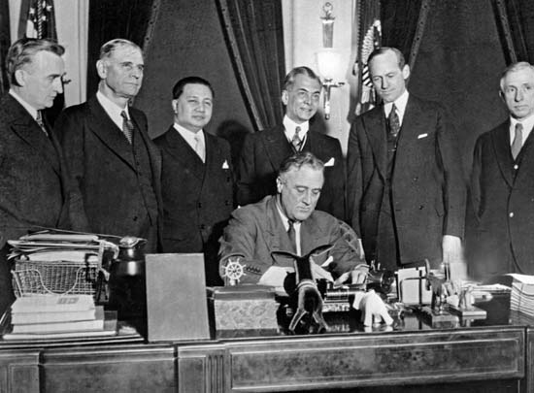
The Philippine Independence Act (Tydings-McDuffie Act) of 1934
The act was a great victory for Filipino nationalists such as Manuel Quezon standing center directly behind President Franklin D. Roosevelt in the photograph as he signed the act into law. However, the act was written in terms favorable to the United States and a disaster to Filipino Americans. In 1936, the United States approved the terms for sovereignty and the structure of the future Republic of the Philippines government that would go into effect in 1946. However, prior 1946 the United States and Philippine Commonwealth governments had to prepare how to defend the sovereignty of the future republic from Imperial Japan.
Under the provisions of the act, the United States the Philippines was a territory of the United States. The United States reserved the right supervise the foreign affairs of the Philippines and “at the earliest practical date, to enter into negotiations with foreign powers with the view of to the conclusion of a treaty for the perpetual neutralization of the Philippine Islands.”

Slide 25
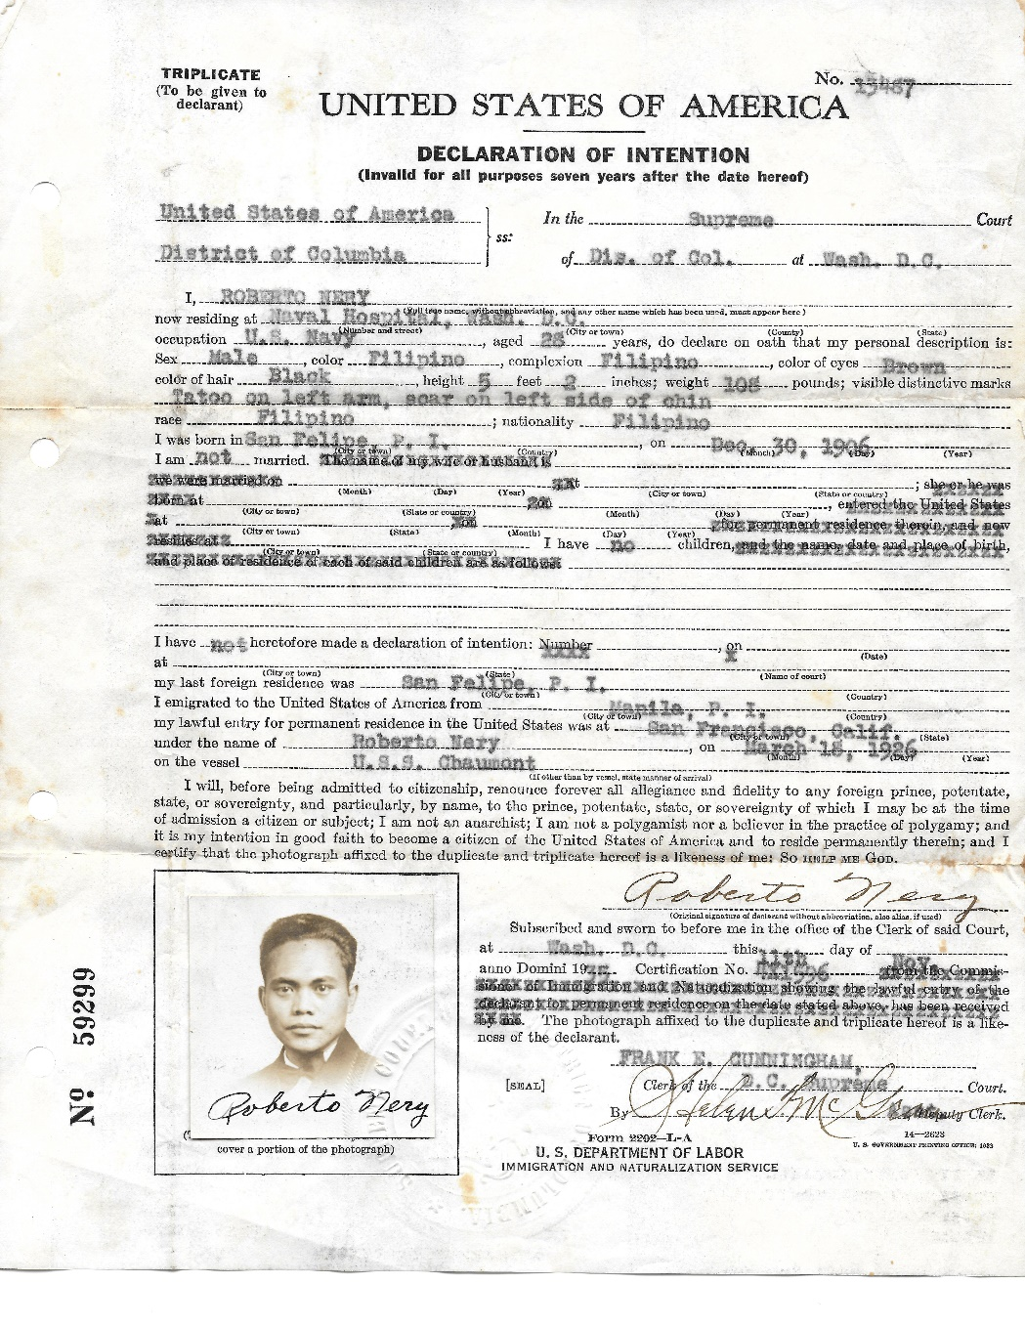
The Philippine Independence Act (Tydings-McDuffie Act) of 1934
For Filipino Americans the Philippine Independence Act was a disaster. Under Section 8 of the act “citizens of the Philippines who are not citizens of the United States shall be considered as if they were aliens. For such purposes the Philippine Islands shall be considered as a separate country and shall have for each fiscal year a quota” of 50 immigrants a year permitted into the United States.
Filipinos sailors in the U.S. Navy such as
Roberto Nery had to sign “Declaration of Intention” documents in order to stay in the Navy.
Between 1931 and 1939 the U.S. Navy does not enlist Filipinos in the U.S. Navy.

Slide 26
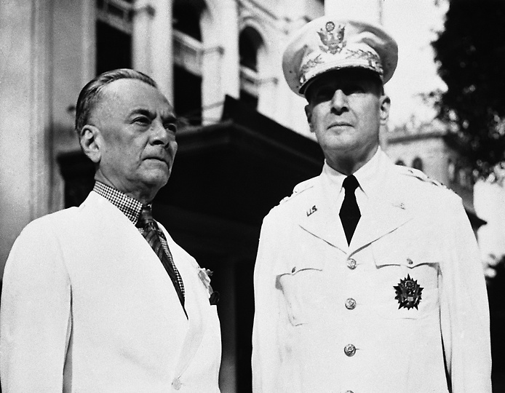
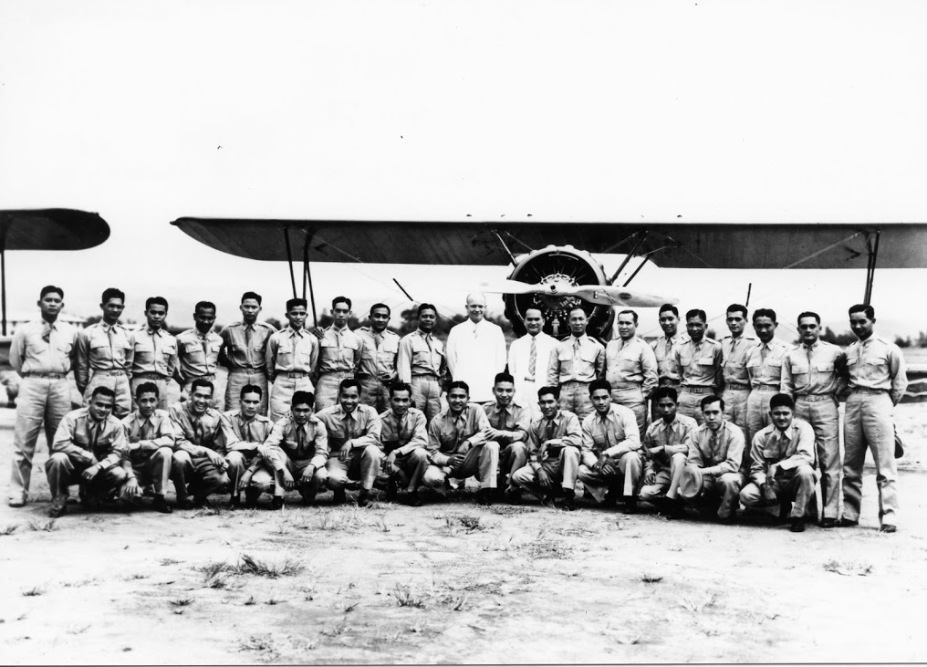
Filipinos in the U.S. Army during the Commonwealth Period, 1934-1941
1920: The National Defense Act of 1920 incorporated the Philippine Scouts in the U. S. Army.
7 July 1924: 380 Philippine Scouts conduct a peaceful mutiny for equal pay with their American counterparts.
1931-1937: World War II begins in Asia when Imperial Japan invaded China.
March 24, 1934: The Tydings-McDuffie Act (officially the Philippine Independence Act; Public Law 73-127) provided for self-government of the Philippines and for Filipino independence (from the United States). Under Sectuon 2 the United States preserved the right to, “maintain military and other reservations and armed forces in the Philippines, and, upon order of the President, to call into service of such armed forces all military forces organized by the Philippine Government.”
September 18, 1935: President Franklin D. Roosevelt approved orders assigning General Douglas MacArthur to be an advisor to the Philippine Commonwealth in military and naval affairs at the request of Philippine Commonwealth President Manuel Quezon.
Douglas MacArthur’s task is difficult. Defense budgets for the United States and Philippine Commonwealth are constrained due the on going Great Depression. Building a Philippine Air Force is difficult and slow since the United States can only provide out date aircraft for Filipino pilots to fly.
Notes:
Filipinos in the U. S. Army
When the Philippine War begins, American officers begin to recruit Filipino ethnic groups who were hostile to the Tagalogs who controlled the Philippine government and forces led by Emilio Aguinaldo. The first native scout units recruited were called the Macabebee Scouts and played a key role in Aguinaldo’s capture by Brig. Gen. Frederick Funston in 1901. On 4 July 1902, the Philippine War is declared over. However, other groups of Filipinos in the archipelago rebel against U. S. rule. Between 1903 and 1915, Philippine Scouts play the major role in the pacification program.

Slide 27
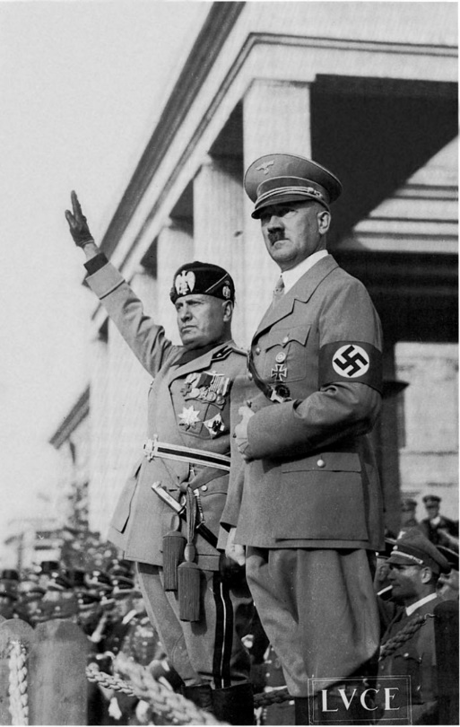
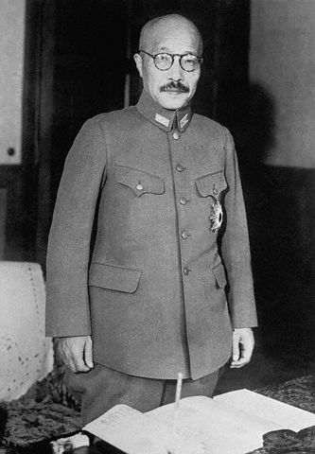
Filipinos in the U.S. Army during the Commonwealth Period, 1934-1941
July 1939: In an effort to curb Japanese aggression in China, Pres. Franklin D. Roosevelt terminated the 1911 US Japanese commercial treaty cutting off Japan from vital supplies needed to conduct military operations oin China made in the United States. At that time Japan got 66% of its oil, virtually all of its aviation fuel, 90% of its metal scrap, and 91% of its copper from the United States. The Japanese government considers this a hostile act and immediately begins to make plans to obtain these resources from other countries and British, French, Dutch and American colonies and territories in Asia.
September 1940 - July 1941: World War II began in Europe. By July 1940 Nazi Germany has occupied the continent of Europe with the exception of Great Britain and the Union of Soviet Socialist Republics (Russia). The Japan government forced France to allow its military forces to occupy its colonies in French Indochina (present day Vietnam, Cambodia, and Laos). This is the first step in Japan's new order policy for Asia called the Greater East Asia Co-prosperity Sphere. The objectives of the policy is to create a self sufficient empire around resource poor Japan that included a perimeter ensure access to the raw materials such as iron ore, oil, tin, rubber, and coal required by Japan to be a global power. In order complete the empire Japan needed to neutralize American military bases in the Philippines.
Benitio Mussolini (1883-1945) dictator of Italy and Adolf Hitler (1889-1945), the dictator of Nazi Germany.
Prime Minister of Japan Hideki Tojo (1884-1948).

Slide 28
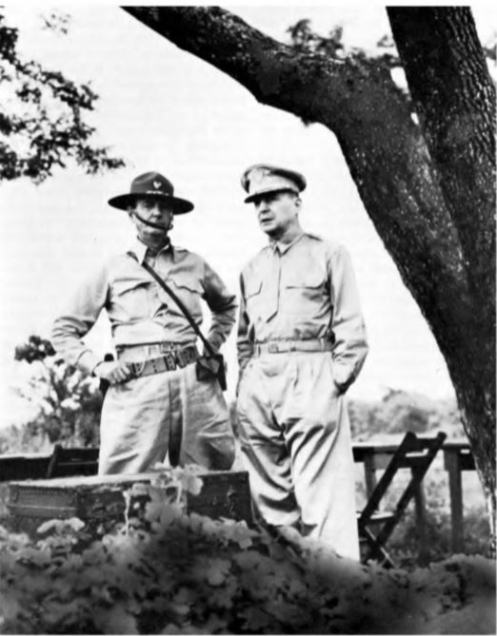
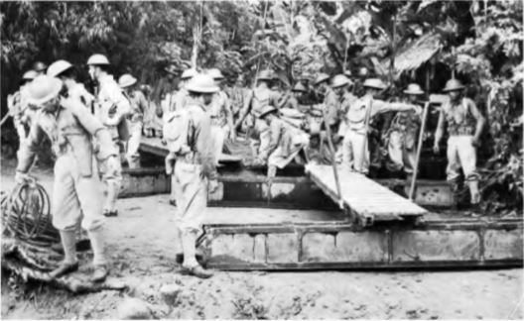
Mobilization: July to December 1941
Left photograph: Major General Jonathan Wainwright and Lieutenant General Douglas MacArthur observed training exercises for USAFFE forces in October 1941. Above photograph: Philippine Scouts conduct bridging exercises in the days before World War II.
In July 1941 President Franklin D Roosevelt initiated a series of actions in response to Japanese forces taking control of all of French Indochina. One of the first actions was to recall Douglas MacArthur to active duty with the rank of Lieutenant General and place them in command of the United States Army Forces Far East (USAFFE). In addition, in accordance with the tidings McDuffie act the President mobilized the Philippine Commonwealth Army within the service of the Armed Forces of the United States. Preparing and training the regular U.S. Army forces in the Philippines, the majority of which were Philippine Scouts would pose no problems for General MacArthur. The challenge was to increase the Philippine Commonwealth Army from one active duty division of 7,500 soldiers to 10 divisions of approximately 120,000 soldiers before war broke out. Gen. MacArthur developed and initiated plans to have the Philippine Army fully mobilized and ready for combat by the spring of 1942. As Filipino troops reported for active duty there was a shortage of training facilities, officers, noncommissioned officers, uniforms, weapons and equipment. As a result, training for the new Philippine Army did not begin until late August 1941.

Slide 29
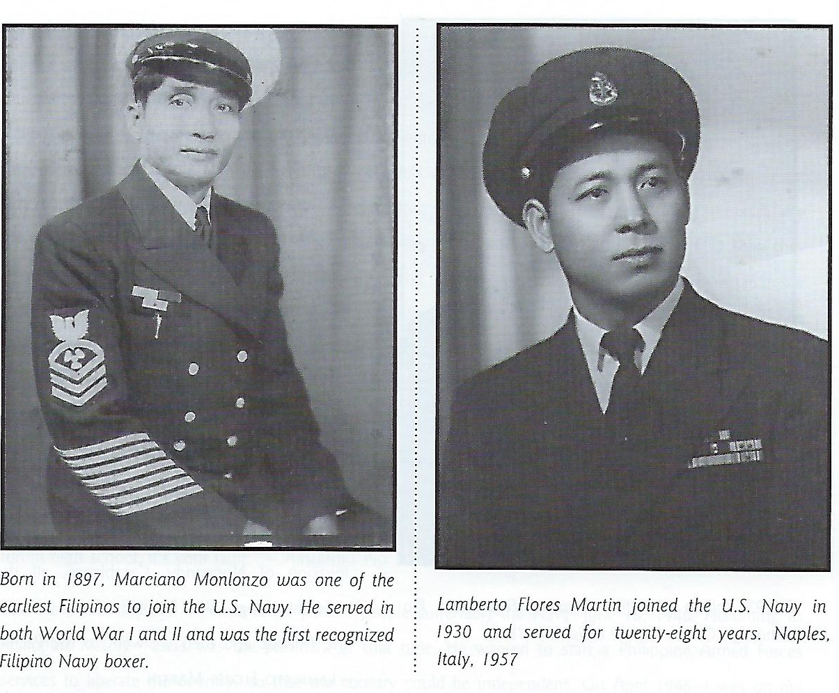
Filipino Americans in the U.S. Navy during World War II
In 1939 the U.S. Navy ended it’s suspension of enlisting Filipinos living the Philippines. On 3 January 1942, the U.S. Congress revised Nationality Act of 1940 allowing Filipino residents of the Philippine Commonwealth and the United States to be classified in the same manner as citizens of the United States for military service. Filipinos could join the Armed Forces without restrictions. However, Filipinos in the Navy were restricted to serving in the Steward and Mess Management branches of the Navy. Before 7 December 1941, 1,713 Filipino sailors were serving in the Navy. After the United States declared war against Japan the U.S. Coast Guard became part of the Department of the Navy. By the time World War II ended the Department of the Navy listed 5,511 Filipinos on active duty. By November 1944, 917 were listed as casualties; as casualty rate of 16.6%.

Slide 30
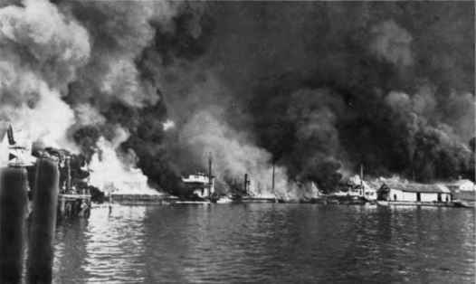
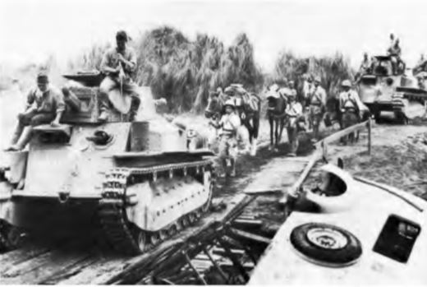
The First Philippine Campaign, December 1941 to May 1942
Japanese air forces attacked USAFFE and naval bases on 8 December 1941 within hours of the attack on Pearl Harbor. At that time General MacArthur had 31,095 American Army troops under his command of which 11,957 were Philippine Scouts. The Philippine Army forces under his command included 110,000 soldiers. The Japanese quickly neutralized or destroyed most of the USAFFE air forces obtaining air superiority over the Philippines. The Japanese 14th Army under the command of Lieutenant General Masaharu Homma was tasked with conquering the Philippines within 50 days. The Japanese forces landed on the island of Luzon on 10 and 12 December 1941. In the first three weeks the Japanese quickly defeated most of the poorly trained Philippine Army and U.S. Army units. General MacArthur quickly realized that if he continued to try to fight the Japanese in the open terrain of Luzon his forces would be defeated. As a result, he ordered USAAFE forces in Luzon to retreat into the Bataan peninsula and the island forts of Manila Bay. In order to prevent unnecessary casualties to Filipino civilians he notified the Japanese that Manila was an “open city” and would not be contested saving the lives of thousands of Filipino civilians.
Above: The Cavite Navy Yard burning after a Japanese air raid, 8 December 1941. Japanese units move on Manila December 1941,

Slide 31
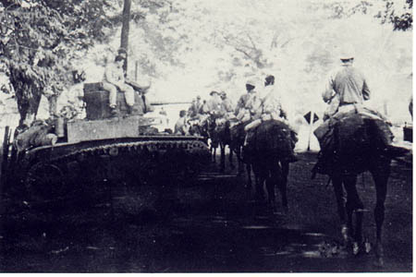
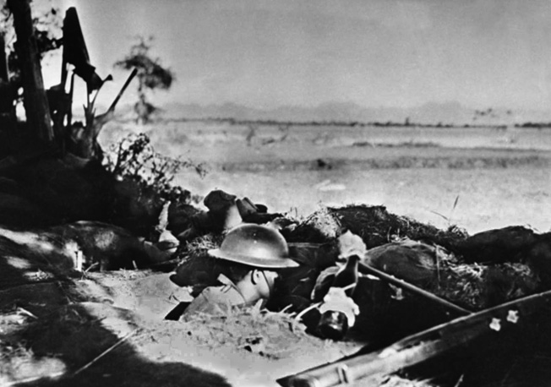
The First Philippine Campaign, December 1941 to May 1942
The Filipino and American forces successively withdrew into the Bataan peninsula by 7 January 1942. General MacArthur’s headquarters was located on the island of Corregidor. With him was president Manuel Quezon of the Philippine Commonwealth. General MacArthur had to immediately begin rationing food and medicine because of the large number of military and Filipino civilians on Bataan. The situation was exacerbated by March 1942 as Japan completed its conquest of all territories surrounding the Philippines in the Western Pacific. The United States and its allies militarily could not relieve the Filipino and American forces fighting in the Philippines. In essence the Filipino and American forces in the Philippines were doomed. President Roosevelt urged them to fight as long a possible. The President Roosevelt in a message to Manuel Quezon promised, “so long as the flag of the United States flies on Filipino soil as a pledge to our duty to your people it will be defended by our own men to the death.”
Upper right: Units of the 26th Cavalry (PS) pass American tanks. The 26th Cavalry (PS) conducted the last horse cavalry in the history of the U.S. Army on 16 January 1942.
Below left: Philippine Scouts in defensive positions on Bataan

Slide 32
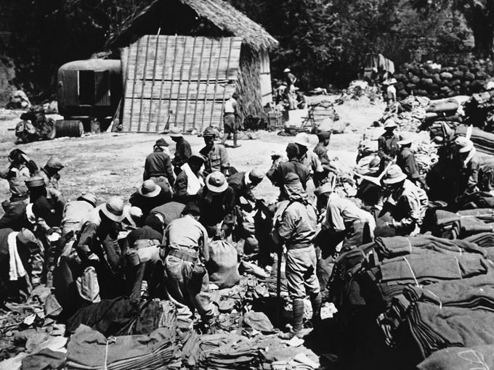
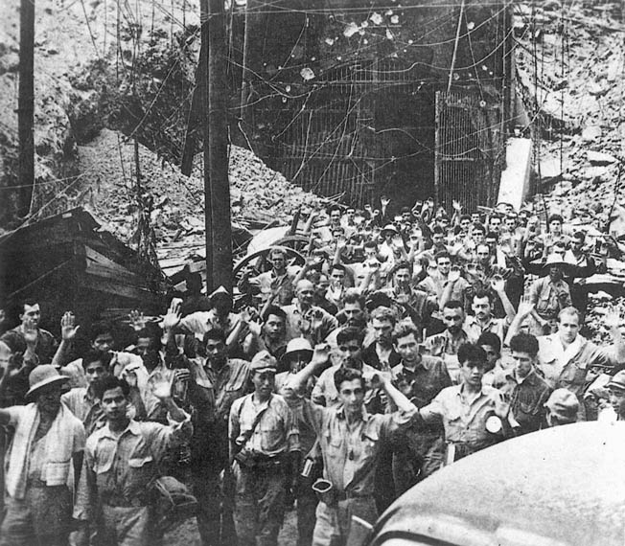
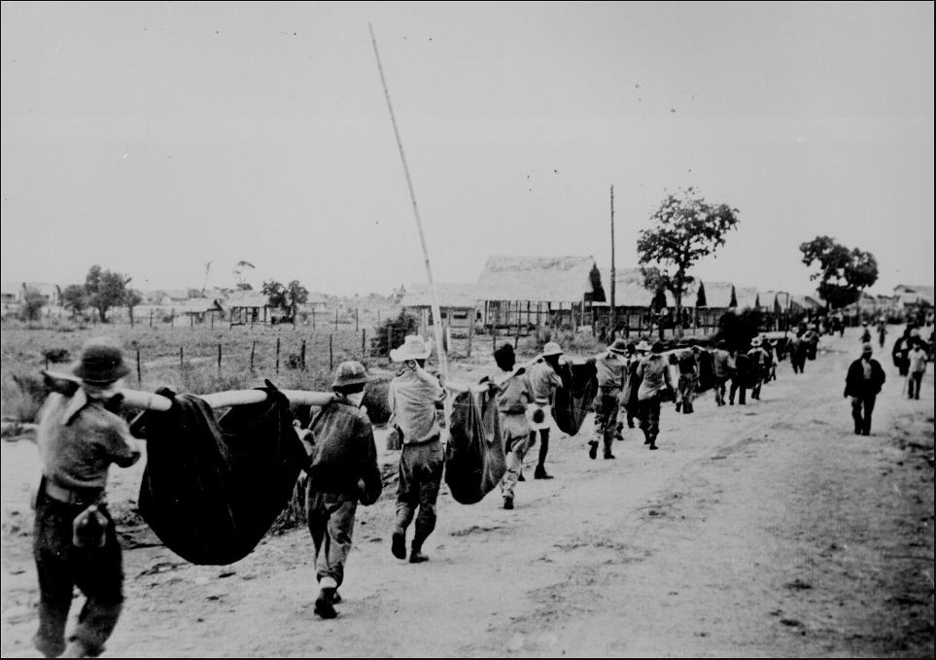
The Fall of the Philippines
General Homma was supposed to conquer the Philippines in 50 days. Instead it took him twice as long preventing Japan from sending forces tied down in The Philippines to other theaters to conquer new territory. By March 1942, President Quezon and General MacArthur by order of President Roosevelt were evacuated to the United States and Australia respectively. Upon arrival in Australia, General MacArthur vowed to liberate the Philippines. On 8 April 1942 on Bataan surrendered followed by Corregidor on 6 May 1942. The Japanese did not treat the prisoners in accordance with the Geneva Convention. An estimated 10,000 Filipinos and 600 Americans died of Japanese cruelty and indifference during the Bataan Death in March 1942. An estimated 5,000 Americans captured during the First Philippine Campaign died in captivity. It is estimated that 45,000 Filipinos died as prisoners of war to the Japanese.

Slide 33
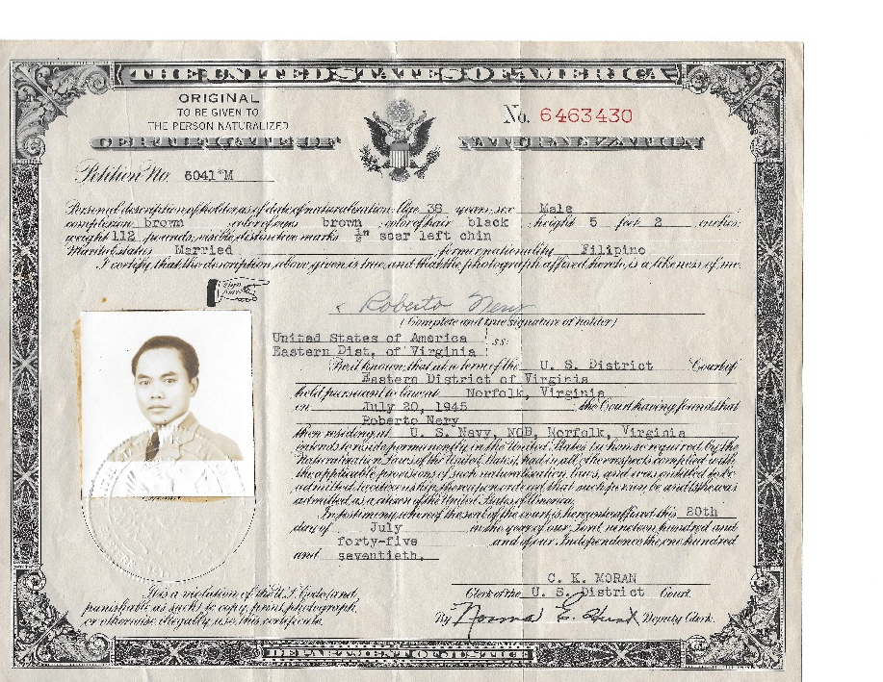
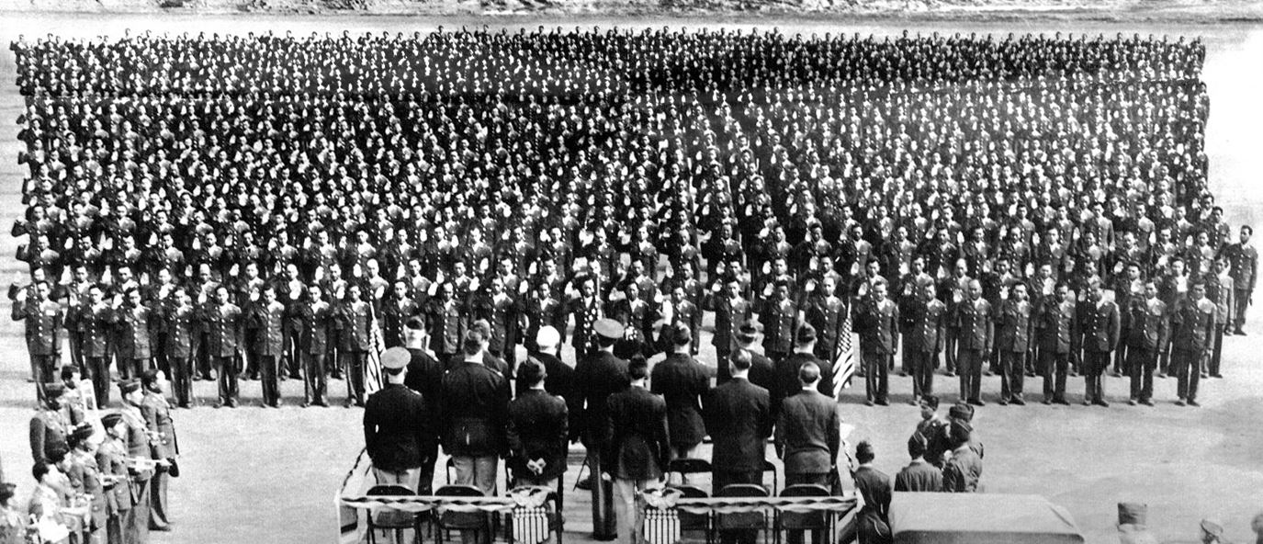
Taking advantage of revisions to US citizenship laws
The U.S. Congress revised Nationality Act of 1940 allowing any resident alien living in the United States including native-born Filipinos who served honorably in the U.S. Armed Forces for a 3-year period and if separated from the service under honorable conditions could be eligible to apply for naturalization.
Filipino sailors serving in the U.S. Navy such as Roberto Nery (left) took advantage of the new legislation to become U.S. citizens. Hundreds of Filipino American soldiers of the 1st Filipino infantry Regiment take the oath of allegiance to the United States in a naturalization ceremony at Camp Beale, California in 1942.

Slide 34
In 1943, President Roosevelt stated, “On December 28, 1941, three weeks after the armies of the Japanese launched their attack on Philippine soil, I sent a proclamation to you, the gallant people of the Philippines. I said then: "I give to the people of the Philippines my solemn pledge that their freedom will be redeemed and their independence established and protected. The entire resources, in men and in material, of the United States stand behind that pledge." We shall keep this promise, just as we have kept every promise which America has made to the Filipino people.
On 20 March 1942, Gen. MacArthur reiterated President Roosevelt’s commitment to the Philippines. He told reporters Adelaide, Australia, “The president of the United States ordered me to break through the Japanese lines and pre-proceed from Corregidor to Australia for the purpose, as I understand it, of organizing an American offensive against Japan, the primary purpose of which is the relief of the Philippines. I came through and I shall return.”

Slide 35
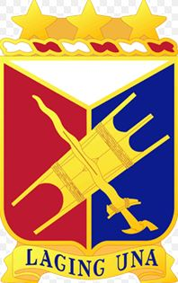
The Japanese Occupation of the Philippines 1942-1945
Filipino Americans did not have to serve in racially segregated units as did African Americans and Japanese Americans. Thousands volunteered for duty with the 1st and 2nd Filipino Infantry Regiments in order to returned to the Philippines and liberate their fellow countrymen and families. General MacArthur’s Allied Intelligence Bureau recruited volunteers from the two regiments who trained to enter the Philippines and train Filipino guerrillas who continue to resist the Japanese occupation of their country. (See photograph below right.) The 1st and 2nd Infantry Regiments participated in the liberation of Philippines in 1945.
Soldiers of the 1st and 2nd Philippine Infantry Regiment had to cope with one of the ugliest vestiges of racial discrimination in the United States: anti-miscegenation laws. Many of the Filipino soldiers in fell in love with white women. In order to marry the Filipino soldiers and their white fiancés traveled to New Mexico which did not have anti-miscegenation laws. However, California legal authorities threatened to arrest Filipino soldiers and their brides who returned to California. The commanding officer of the 1st Filipino infantry Regiment, Colonel Robert Offley informed California law authorities that if they tried to arrest the Filipino soldiers or their brides they themselves would be arrested for violating federal laws in that they interfered with American soldiers carrying out their duties in a time of war. California officials backed down.
After the war American veterans of all ethnicities returned to the United States with 16,000 Filipina war brides under the War Brides Act of 1945. However, white American servicemen and their Filipina brides could not live in states with anti-miscegenation laws such as Virginia until 1967.

Slide 36
The Japanese Occupation of the Philippines 1942-1945
As soon as he arrived in Australia, Gen. MacArthur initiated an insurgency within the Philippines against the Japanese occupation. “I Shall Return“ became the rally cry of Filipino and American guerillas. Directed by the Allied intelligence Bureau of the Southwest Pacific area command, Filipino guerilla units were established throughout the archipelago. Their primary mission was to gather intelligence on Japanese forces on the islands in preparation for the eventual liberation of their nation. When Allied forces landed in Leyte in October 1944, Philippine guerrilla units attacked Japanese forces from behind and once their areas were liberated they were absorbed into the new Philippine Army. They continued to fight Japanese forces in the Philippines until the end and the World War II on 14 August 1945.

Slide 37
A Grave Injustice by the United States
The contribution Filipinos to the Allied victory over the Japanese Empire during World War II was significant. In 1946, the United States Congress enacted the Philippine Rehabilitation Act (PRA) which was signed into law by President Harry S. Truman. The PRA set limits on compensation for Filipino military veterans of World War II. The PRA provided a one-time $200 million benefit for the Philippine Army but with the proviso that benefits for 200,000 Filipinos who had fought with US forces against the Japanese and promised by President Roosevelt in 1941 be withdrawn. That amounted to $1,000 per Filipino veteran.
Filipino American scholar Luis H. Francia described the this injustice best, “The PRA included language that noted that Filipino veterans who had served in the U. S. Military, in their capacity as regulars in the Philippine Commonwealth Army or as guerrillas in units recognized by the U. S. Military, should not be deemed to have been in active military, naval, or air service for purposes of any law of the United States conferring rights, privileges, or benefits upon any person of such service.” The PRA in essence denied veteran’s benefits to Filipino veterans who served in the Commonwealth Army of the Philippines with service from July 26, 1941 through June 30, 1946 while the Commonwealth Army was in the Armed Forces of the United States; Special Philippine Scouts who enlisted between October 6, 1945 and June 30, 1947; and Filipino Guerillas with service prior to July 1, 1946.
It should be noted that Filipinos serving with the Philippine Scouts prior to 1945 and serving in the U.S. Navy during World War II qualified for US veterans benefits.

Slide 38
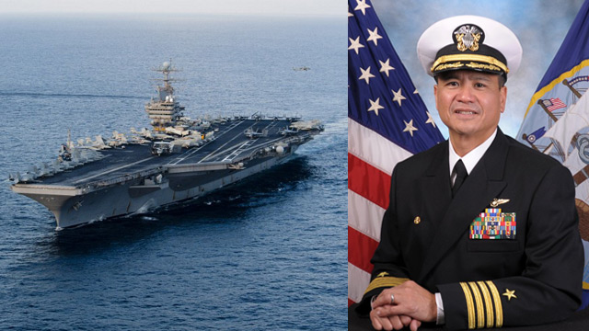
Filipinos in the U. S. Navy, 1940-1991
4 July 1946, the Republic of the Philippines (ROP) becomes an independent nation.
In 1947 the Republic of the Philippines-United States Military Bases Agreement (RP-US-MBA) was enacted by both nations. This status of forces agreement allowed the United State to maintain military based in the Philippines. Article 27 of the SOFA authorized the U.S. Navy to enlist 400 to 2,000 Filipinos in to the Navy. This program became known as the Philippine Enlistment Program (PEP).
In the 21st century the children of Filipino sailors have advanced to the highest ranks of the US Navy. In the photographs above: Captain Ronald Ravelo USN who was at one time the commanding officer of the USS Abraham Lincoln (CV 72)

Slide 39
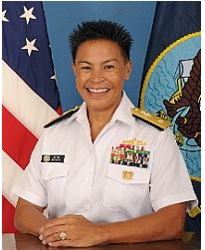
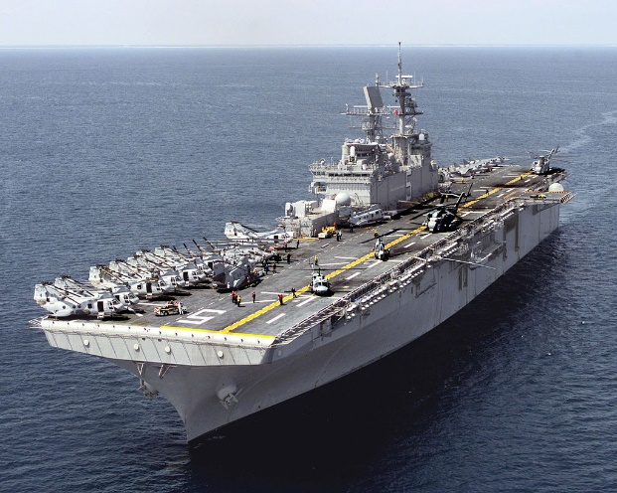
Filipinos in the U. S. Navy, 1940-1991
When the PEP was initiated in 1952, candidates for the PEP had to be 18-26 years old to enlist in the Navy. They must be in excellent health, have a high school diploma, speak English, have letters of recommendation, and be single. Under the Philippine Enlistment Program (PEP) from 1952 and 1991, 35,000 Filipino nationals enlisted in the Navy.
In 1985, Filipino Americans made up the second largest minority group in the Navy. A total of 19,680 male and 405 female Filipino Americans are on active duty in all military occupational specialties (MOSs) of the Navy. In addition, there are 481 Filipino American commissioned officers in the Navy.
The RP-US-MBA was terminated in 1991 by the agreement of both governments with the end of the Cold War and the destruction of Clark Air Force Base and heavy damage the Subic Bay Naval Base due the eruption of the Mt. Pinatubo volcano.
Above right: Rear Admiral Babette “Bette” Bolivar commander of the Joint Region Marianas. In addition, the U.S. Navy commissioned two warships commemorating the Battle of Bataan. Pictured below is the second USS Bataan (LHD-5) which is homeported in Norfolk, Virginia

Slide 40
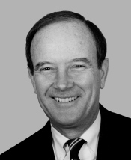
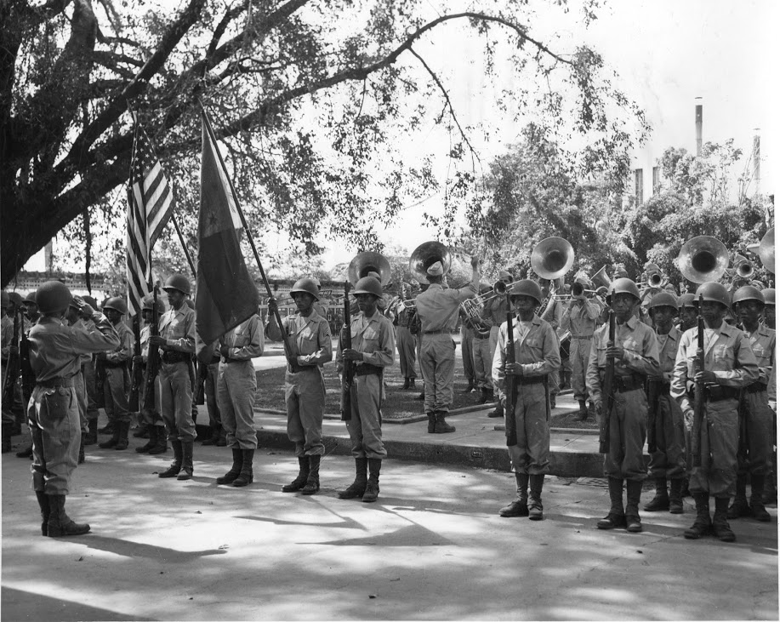
Very Late and Over Due Compensation
On 25 September 1991, Representative Owen Picket (1930-2010)(right), of the 2nd Congressional District of Virginia that included Norfolk and Virginia Beach, wrote legislation that had broad bipartisan support granting special immigrant status to servicemembers who served honorably on active duty for 12 years, or who served honorably for six years and reenlisted for six more. The legislation was signed into law by President George H. W. Bush opened up a path to citizenship for 3,024 Filipinos serving in the U.S. Navy.
Bipartisan Congressional legislation, The Departments of Commerce, Justice, and State, the Judiciary and Related Agencies Appropriation act of 1998 (Public Law 105-119-November 26, 1997), section 112 amended section 405 of the Immigration and Nationality Act of 1980, authorized the United States Embassy in Manila, the Philippines, to administer oaths of allegiance for applications for naturalization by veterans of the Philippine Commonwealth Army, recognized Philippine guerrilla groups and members of the Philippine Scouts who enlisted after 1946. Prior this legislation these elderly veterans had to go to the United States to apply for naturalization prior to passage of this legislation.

Slide 41
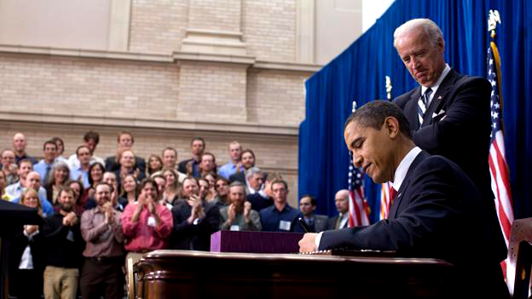
American Recovery and Reinvestment Act of 2009
On 17 February 2009, Pres. Barack Obama signed the American Recovery and Reinvestment Act of 2009 into law. The legislation provided financial compensation to World War II Filipino Commonwealth Army veterans, veterans of recognized Filipino guerrilla groups, and Philippine Scouts who enlisted after 1946. Any of those veterans who were citizens of the United States received a $15,000.00 lump-sum payment for their service. Said veterans still living who were residents in the United States, or citizens of the Republic of this Philippines received a $9000.00 lump-sum payment for their service. As of 1 October 2017, the Department of Veterans Affairs processed 42,755 applications (9310 were approved for $15,000 based veterans, 9670 approved for $9000 based veterans). The department had disapproved 23,775 applications because the applicants did not meet legislative requirements. Total number of approved payments as of 1 October 2017 amounted to $226 million.

Slide 42
The Tradition and Legacy of Service to the United States Continues
Americans of Filipino ancestry continue to serve with distinction in the Armed Forces of the United States
Major General Antonio M. Taguba USA (Ret.) (top right) was the second Filipino-American to reach general officer rank. He was responsible for the Abu Ghraib investigation where he was commended for an honest assessment of the abuse of Iraqi prisoners by undisciplined American soldiers at the prison in 2004. His report was the basis of historical debate concerning the war in Iraq.
Corporal Neil R. Nieto US Marine Corps Reserve (bottom left) served with the 6th Civil Affairs Group May 2005-May 2006. On 16 December 2005 he was awarded the Navy Achievement Medal with a “V” device for valor. Cpl. Nieto was cited for ‘assisting a wounded Marine” under fire. He was credited with “Saving the Marines limbs and potentially his life.”

Slide 43
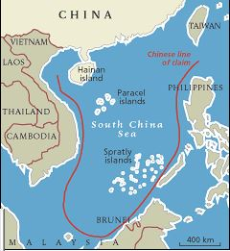
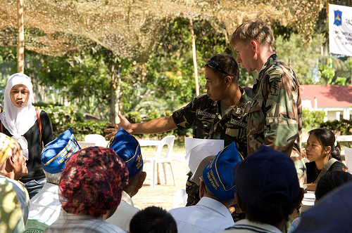
The shared history of the United States and the Republic of the Philippines continues.
Map below left depicts China’s “9-Dash Line.” Since 2001, the Peoples Republic of China (PRC) has made numerous incursions and built illegal bases in the Spratly Islands claimed by the Philippines. International courts and the U.S. do not recognize the PRC’s claim.
Photograph below right: U.S. Armed Force provide counter terrorism training and civil support training to the Philippine Armed Forces in an effort to curb al Qaeda and ISIS support to the Philippine Moslem terrorist groups such Abu Sayaf in Mindanao and Palawan.
The Philippine economy is dependent on $26 billion (9.8% of the Philippine’s GDP) in remittance payments from Filipinos living overseas. The largest portion if these remittance payments come from the United States.
.
Over 3.4 million Americans can claim Filipino ancestry in the United States. This is the largest population of Filipinos outside the Philippines.

Slide 44
Appendix A: Filipino American Medal of Honor Recipients

Slide 45
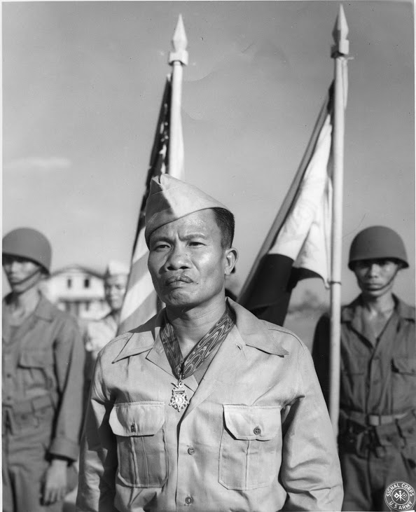
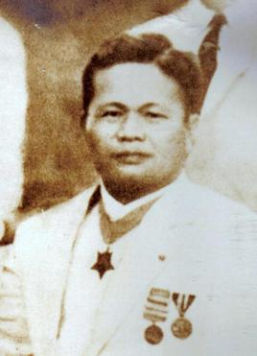
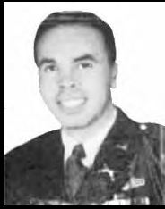
Filipino American Medal of Honor Recipients
Private Jose B. Nisperos US Army, 34th Company, Philippine Scouts, at Lapurap, Basilan, Philippine Islands, 14 September 1911.
Fireman 2nd Class Trinidad Telesforo US Navy, USS San Diego, 21 January 1915. (Below center)
Sergeant Jose Calugas, US Army, Battery B, 88th Field Artillery, Philippine Scouts, at Culis, Bataan, Philippine Islands, 16 January 1942. (Below left)
Staff Sergeant Rudolph B. Davila US Army, 7th US Infantry, at Artena, Italy, 28 May 1944. (Below right)

Slide 46
Appendix B: The Road to War in Asia and the Pacific 1931-1941

Slide 47
The Road to War
18 September 1931: Japanese troops invade Manchuria in what became known as the “Mukden incident.” Manchuria becomes a protectorate of the Japanese Empire. World War II begins in Asia.
4 March 1933: the United States Armed Forces are ranked 17th in the world. The New York City the police department was larger than the United States Marine Corps.
7 July 1937: Japanese troops invade China. The Japanese government justify the invasion claiming Japanese soldiers were attacked by Chinese troops at the Marco Polo Bridge near Beijing.
November 1937: Japanese troops captured the city of Nanking, China. In what will become known as “The Rate of Nanking,” Japanese soldiers murder 50,000 civilians and rape 20,000 Chinese women.
12 December 1937: Japanese aircraft attacked and sink the USS Panay (PR 5) evacuating US nationals along the Yangtze River. Three American sailors are killed. The United States government protests the incident. In April 1938, the Japanese government paid an indemnity of $2.2 million officially ending the incident.

Slide 48
The Road to War
May-August 1939: Japanese military forces invade Mongolia. In a four-month battle Khalkhin Gol, the Japanese armed forces were defeated by the Armed Forces of the Union of Soviet Socialist Republics. The two nations maintain an uneasy truce until 8 August 1945 when the Soviet Union declared war on Japan five days before the end of World War II.
1 December 1939: World War II begins in Europe when Nazi Germany invades Poland.
June 1940: France is defeated and occupied by Nazi Germany.
20-26 September 1940: Vichy France submitted to Japan’s demand allowing that nation to occupy northern French Indochina, present-day Vietnam, Cambodia and Laos. This is the first step in Japan's new order policy for Asia called the Greater East Asia Co-prosperity Sphere. The objectives of the policy was to create a self-sufficient empire around resource poor Japan that included a perimeter ensure access to the raw materials such as iron ore, oil, tin, rubber, and coal required by Japan to be a global power.
August 1940 - July 1941: The Battle of Britain is fought in the skies over Great Britain.
27 September 1940: Nazi Germany, Fascist Italy and Imperial Japan signed the Tripartite Pact a military alliance that called for each nation to provide military assistance in the case of an attack by any nation not yet in World War II. The pact was targeted against the United States and the Soviet Union the two largest nations not yet in World War II.

Slide 49
The Road to War
22 June 1941: Nazi Germany invades the Soviet Union. Italy declares war on the Soviet Union in accordance with the Tripartite Pact. However, Imperial Japan does not declare war on the Soviet Union.
26 July 1941: Imperial Japan seizes control of southern Indochina. In response Pres. Franklin D Roosevelt freezes all Japanese and Chinese assets in the United States. The United States government convinces the government of Great Britain and the Netherlands to freeze all exports of petroleum to Japan. The Japanese government immediately begins planning to go to war with the United States and its allies before the lack of petroleum results in their Armed Forces being further crippled. The target for the Japanese are the Dutch colonies in present-day Indonesia which contain oilfields that could supply all of Japan’s petroleum needs. The problem is all shipping lanes between Indonesia and Japan must pass the Philippines and were vulnerable to air and sea attacks by the United States from its Philippine Commonwealth bases. As a result, Japanese war plans not only must take into consideration neutralizing or destroying the US Pacific Fleet at Pearl Harbor, Hawaii but also a military occupation of the Philippine archipelago.

Slide 50
The Road to War
9-12 August 1941: Prime Minister Winston Churchill and President Franklin D. Roosevelt hold their first wartime meeting in Placentia Bay, Canada. They decide that when the United States enters World War II Nazi Germany will be defeated first followed by Imperial Japan. Both men agree that if possible war between their nations and the Japanese Empire should be delayed as long as possible until Nazi Germany is defeated.
26 November 1941: Japanese naval task forces are located by United States and British reconnaissance units in the South China Sea. However, a powerful task force of six aircraft carriers departs northern Japan undetected sailing towards Hawaii.
6 December 1941: President Franklin D. Roosevelt requests Japan remove military forces from French Indochina as a basis for peace negotiations.
7 December 1941: Japanese naval air forces attack US naval forces at Pearl Harbor, Hawaii, sinking seven of eight battleships and killing over 2000 Americans. That same day, which was 8 December 1941, because of its location across the international date line, Japanese air forces attack American bases on the island of Luzon, Philippines destroying most of the American and Filipino aircraft defending the archipelago.
8 December 1941: the United States declares war on Japan.

Slide 51
Appendix C: Filipinos in the U.S. Army 1902-1940

Slide 52
Filipinos in the U. S. Army 1902-1940
Year | Total in US Army | Total US Soldiers in PI | Total American Soldiers in PI | Total Philippine Scouts
1902 | 75,028 | 21,217 | 16,346 | 4,871
1905 | 66,956 | 18,375 | 13,194 | 5,181
1910 | 80,678 | 17,834 | 12,282 | 5,552
1915 | 105,993 | 18,521 | 12,909 | 5,612
1918 | 2,379,579 | 16,137 | 9,399 | 6,738
1920 | 201,918 | 20,282 | 13,173 | 7,109
1925 | 135,254 | 11,285 | 4,601 | 6.684
1930 | 137,645 | 11,232 | 4,690 | 6,542
1935 | 137,966 | 11,615 | 5,187 | 6,428
1941 | 1,461,000 | 22,532 | 10,569 | 11,963

Slide 53
Appendix D
Filipinos in the U.S. Navy 1902-1984
Filipino Americans in the U.S. Armed Force 2000

Slide 54
Filipinos in the U. S. Navy, 1902-1940
Year | Total Strength U. S Navy | European Ancestry | African Ancestry | Filipino Ancestry
1903 | 27,245 | Not Available | Not Available | 9
1906 | 32,165 | 28,511 | 1,456 | 285
1910 | 45,075 | 41,765 | 1,535 | 969
1915 | 52,561 | 48,908 | 1,265 | 1,726
1918 | 435,398 | 425,323 | 5,328 | 3,724
1920 | 99,212 | 99,212 | 3,037 | 5,742
1925 | 84,289 | 77,524 | 935 | 4193
1930 | 84,938 | 79,570 | 462 | 4,375
1935 | 82,839 | 78,009 | 1,152 | 3,246
1940 | 139,554 | 132,889 | 4,007 | 1,833

Slide 55
Filipinos in the U. S. Navy 1952-1984 as a result of the Philippine Enlistment Act
Year | Number | Gender | Grade
1952 | 1,000 | Male | E-1
1955 | 1,509 | Male | E-1
1957 | 536 | Male | E-1
1960 | 1,094 | Male | E-1
1963 | 590 | Male | E-1
1968 | 2,146 | Male | E-1
1971 | 420 | Male | E-1
1975 | 1,862 | Male | E-1
1984 | 433 | Male | E-1

Slide 56
Ethnic Filipinos Enlisted Personnel in the U.S. Armed Forces as of February 2000
Branch of Service | Total Enlisted | Total Ethnic Filipino Enlisted (Number) | Total Ethnic Filipino Enlisted (Percent)
Army | 394,510 | 3,188 | 0.8
Navy | 310, 415 | 13,845 | 4.5
Marine Corps | 153,241 | 1,116 | 0.7
Air Force | 282,367 | 4,147 | 1.5

Slide 57
Sources
Clay, Steven E. U.S. Army Order of Battle 1919-1941. Fort Leavenworth: US Army Combined Arms Center. https://usacac.army.mil/ (July 8, 2018).
Cordova, Fred. Filipinos: forgotten Asian American, A Pectoral Essay/1763-Circa-1963. Dubuque, Iowa: Kendall/Hunt Publishing Company, 1983.
Fabros, Alex S., ed. In Honor of Our Fathers: The Newspaper Stories of the 1st and 2nd Filipino Infantry Regiments of the US Army in World War II. Fresno, California: The Filipino American Experience Research Project, 1994.
Fabros, Alex S. The Boogie-Woogie Boys: A History of Filipino Americans in World War II. Fresno, California: The Filipino American Experience Research Project, 1994.
Filipino American National Historical Society – Hampton Roads Chapter. In Our Uncles Words: We Fought for Freedom. San Francisico: T’Boli Publishing and Distribution, 2006.
Filipino Executive Council of Greater Philadelphia. The Fighting Filipinos: Poster Story. https://pinoyphilly.com/from-our-editors/the-fighting-filipinos-poster-story/ (July 8, 2018)
Francia, Luis H. A History of the Philippines: From Indios to Filipinos. New York: The Overlook Press, 2014.
Linn, Brian McAllister. The Philippine War 1899-1902. Lawrence: University of Kansas Press, 2000.
Maligat, Luisto G. “Study of the U.S, Navy’s Philippines Enlistment Program, 1981-1991.” Master’s Thesis, Naval Postgraduate School, 2000.

Slide 58
Sources
Mercene, Floro L. Manila Men in the New World: Filipino Migration to Mexico and the Americas from the 16th Century. Quezon City: The University of the Philippine Press, 2007.
Morton, Lewis. United States Army in World War II. The War in the Pacific: The Fall of the Philippines. Washington, DC: US Army Center for military history, 1989.
Morantte, P. C. "Filipinos in the Navy: A Significant Chapter in Naval History Belongs to Our Filipino Shipmates," Our Navy: The Log, vol. XL, no. 6, August 1945.
Nery-Strickland, Sylvia. The Personal Papers and Photographs of the Roberto Nery Family.
National Archives. Records of the Bureau of Naval Personnel. Record Group 24.
National Archives. Office of Naval Records and Library. Record Group 45.
National Archives. Records of the Adjutant General’s Office, 1780’s to 1917. Record Group 94.
National Park Service. Asians and Pacific Islanders and the Civil War, 2015. https://www.nps.gov/civilwar/upload/asias-pac-island-promoflyer-5.pdf (July 7, 2018.)
The Philippine Independence Act (Tydings-McDuffie Act). https://www.lgu.ph/listings/the-Philippine-independence-act-tydings-mcduffie-act/ (July 16, 2018)

Slide 59
Sources
United States Navy. Filipinos in the United States Navy. Naval History and Heritage Command. https://www.history.navy.mil/content/history/nhhc/research/library/online-reading-room/title-list-alphabetically/f/filipinos-in-the-united-states-navy.html (July 29, 2013).
United States Navy. Annual Reports of the Navy Department or the Year 1901. Report of the Secretary of the Navy. Washington, DC: Government printing office, 1901.
United States Navy. Annual Reports of the Navy Department or the Year 1901. Report of the Secretary of the Navy. Washington, DC: Government printing office, 1902.
Photographs of Filipinos sailors in the 1920s. http://pinoykollektor.blogspot.com/2010/09/4-in-navy-postcards.html

